Slide 1
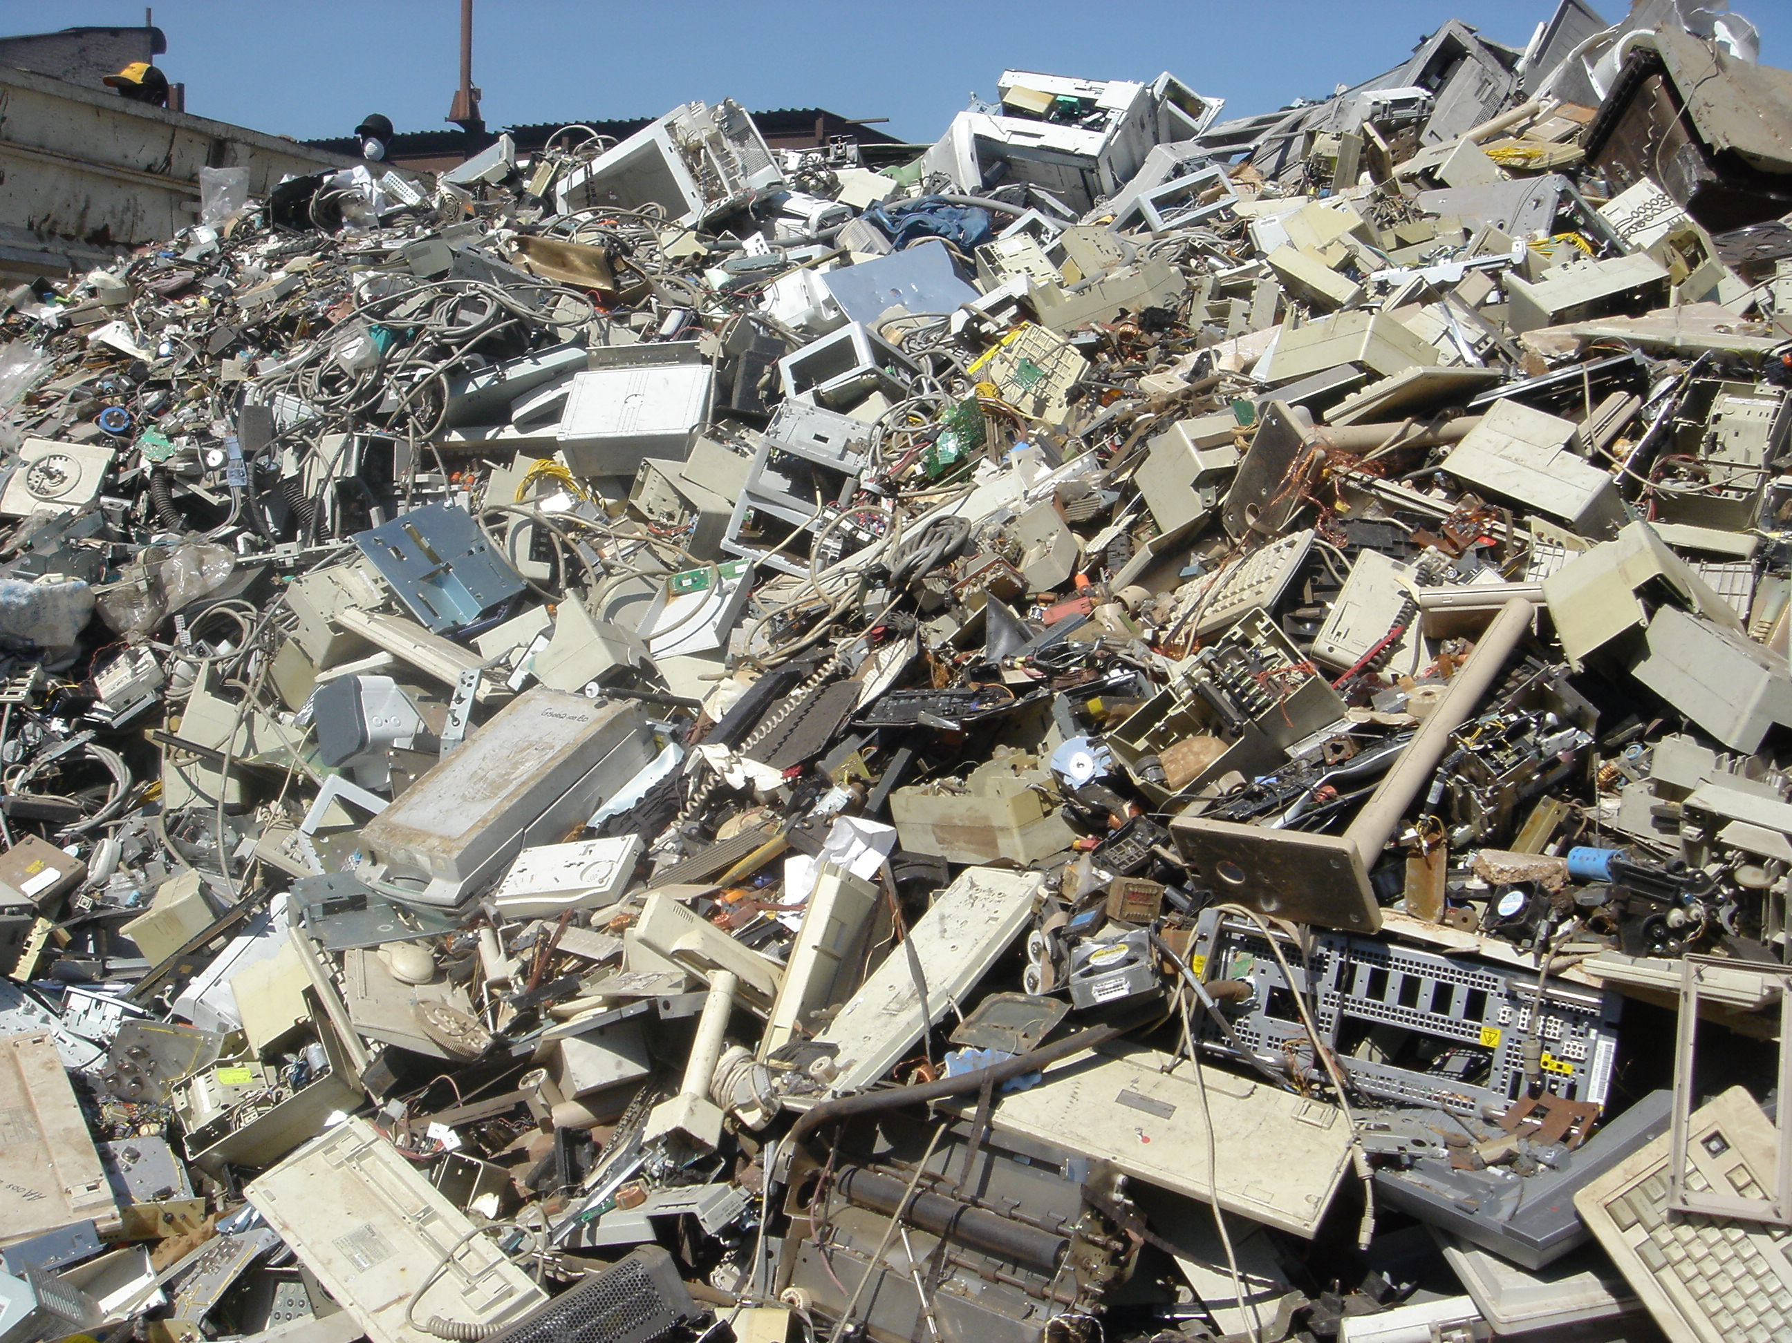
Collaborative Learning Days (November 24, 2014)
Computer Heaven? E-waste Hell?
If you’re alive and you’re living in the U.S., chances are you’ve gone through your fair share of cell phones, laptops, tablets and various other techno-gizmos. I’m sure you’ve also noticed that every time you think you’ve emptied your savings and maxed your credit card on the next most awesome thing you just had to have, a newer even better edition comes out in a month. We’re programmed to update, upgrade, trade-in all for the sake of keeping up with the proverbial Jones’. But what our electronic consumerism doesn’t address is what to do with all that now obsolete technology….
[An] unfortunate amount find their way into dumpsters or recycling bins. Now, recycling bins may not seem so bad…if they’re being collected by the right people…
Imagine mountains of box TV’s and flip phones leaching their mercury and lead into local water supplies, children climbing around busted monitor screens or refrigerator insulation used as kindling for fires. I’m sure the image I’m painting sounds like some kind of future, dystopian sci-fi hell, but for the people of Accra, Ghana it’s very real. [Source]

Slide 2
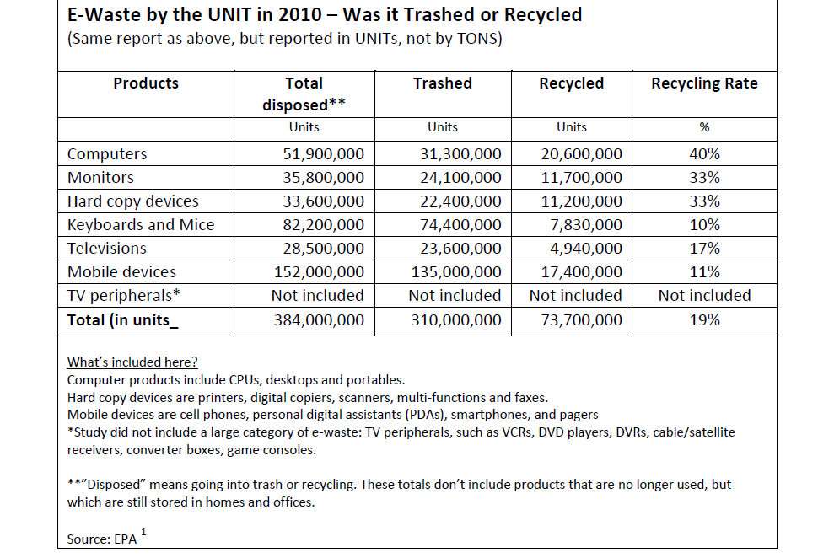
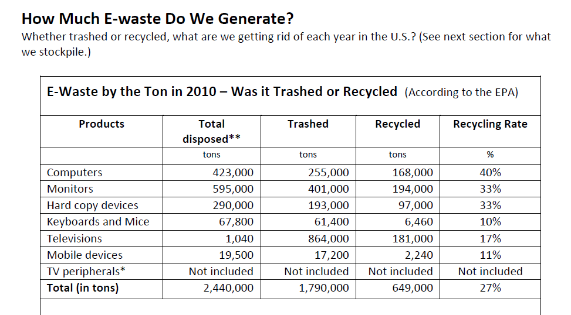

Slide 3
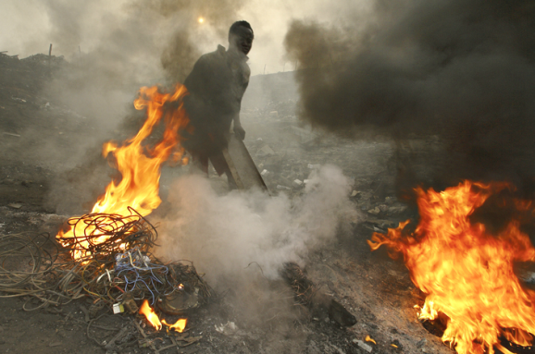
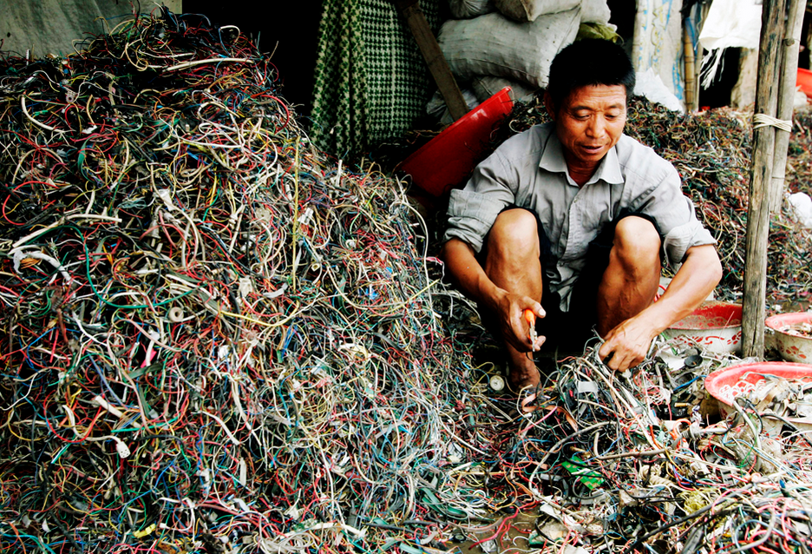
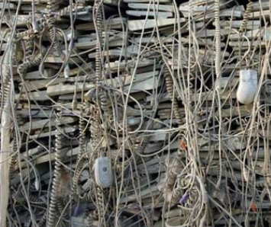
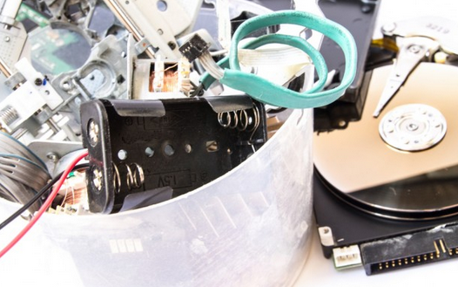
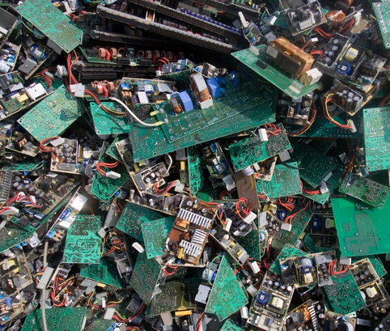
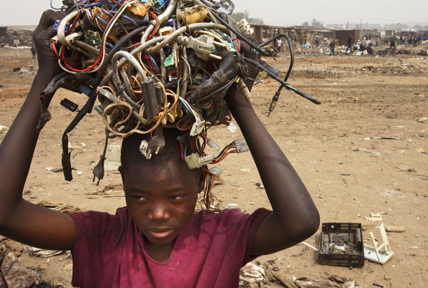
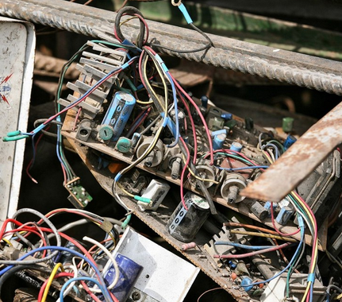
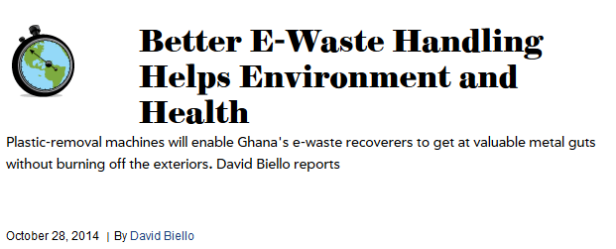

Slide 4
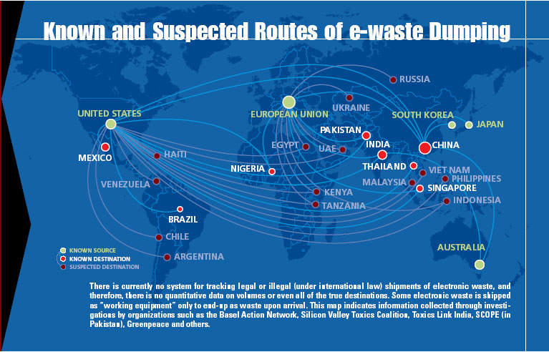

Slide 5
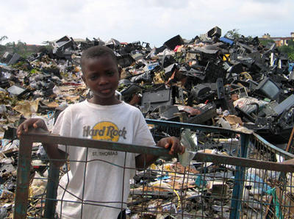
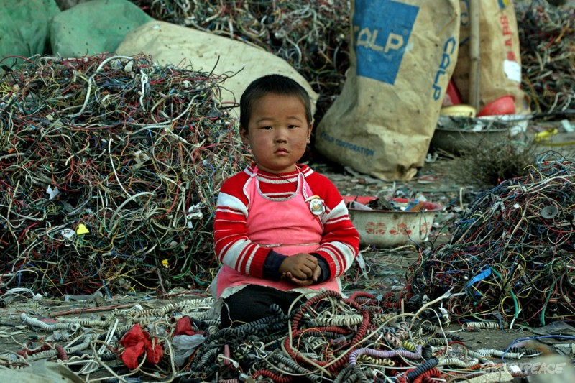
What happens to our electronic devices when we’re done with them?
Why should we care? [CBS, 2013]
What can be done? [Mike Biddle, PBS Newshour]
Every year, hundreds of thousands of old computers and mobile phones are dumped in landfills or burned in smelters. Thousands more are exported, often illegally, from the Europe, US, Japan and other industrialised countries, to Asia. There, workers at scrap yards, some of whom are children, are exposed to a cocktail of toxic chemicals and poisons. [source]

