Slide 1
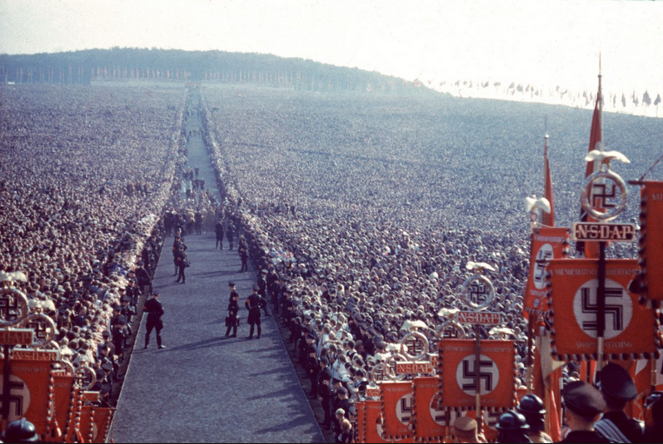
In the Shadow of the Third Reich:
A Walking Tour of Munich, Germany
“Among all German cities, Munich has arguably had the most difficulty during the post-war period in coming to terms with the legacy of the Third Reich.”
Robinson Yost (Social Sciences)
Laura Yost (Distance Learning)

Slide 2
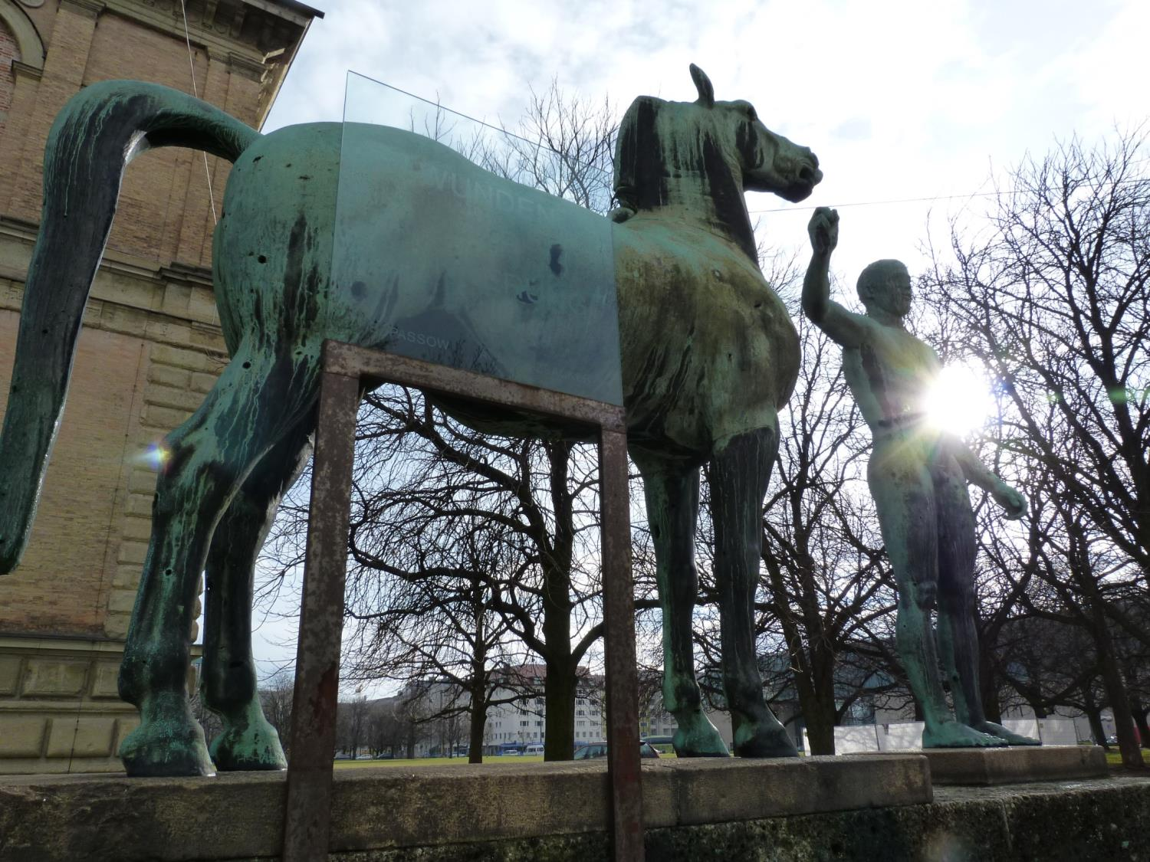
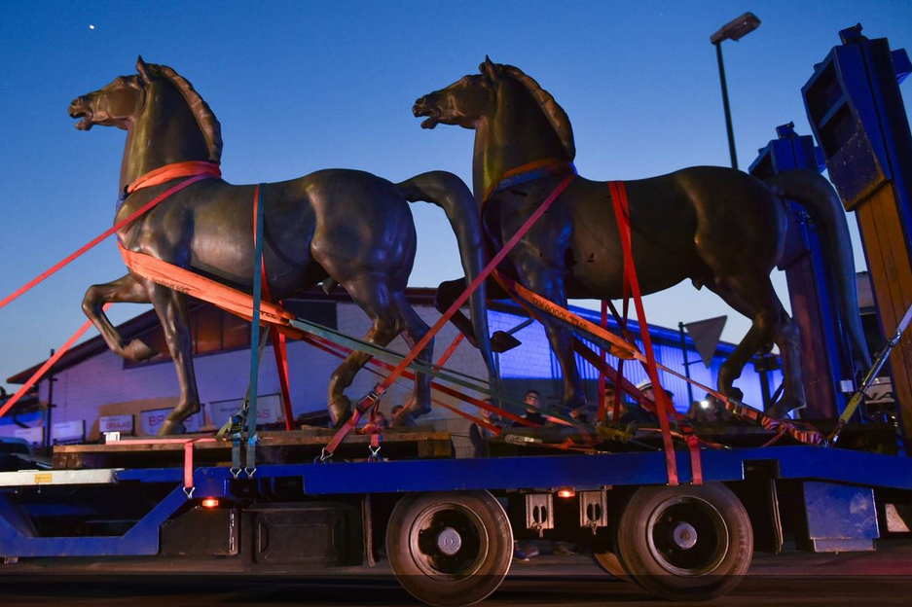
“We need someone to lead us who is used to the sound of a machine gun. Someone who can scare the shit out of people. I don’t need an officer. The common people have lost all respect for them. The best would be a worker who knows how to talk. He doesn’t need to know much. Politics is the stupidest profession on earth,”
Dietrich Eckhart
“That is Hitler-one of the most interesting characters I have met in many months . . . Hitler has the earmarks of a leader. Whether it be merely a band or a great movement, only the future will tell. He believes firmly that his mission is to arouse and save Germany from its internal foes . . .”
Karl Henry von Wiegand (November 1922)

Slide 3
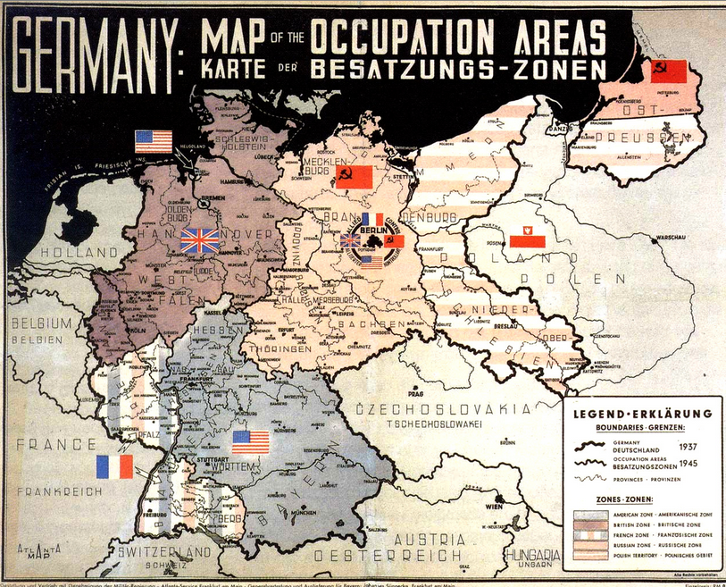
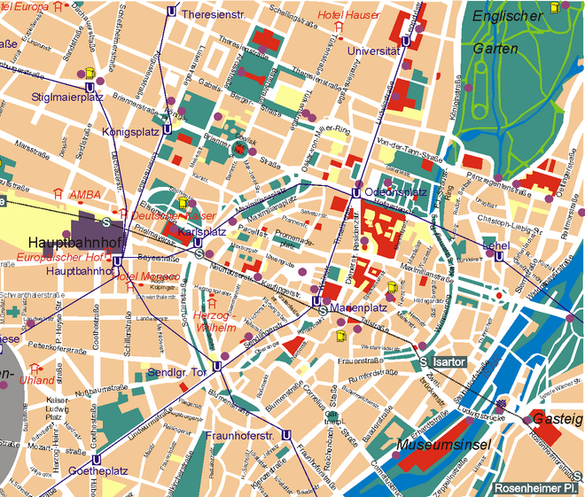

Slide 4
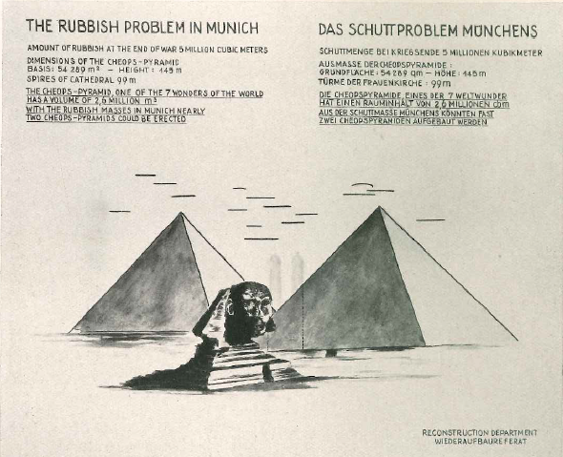
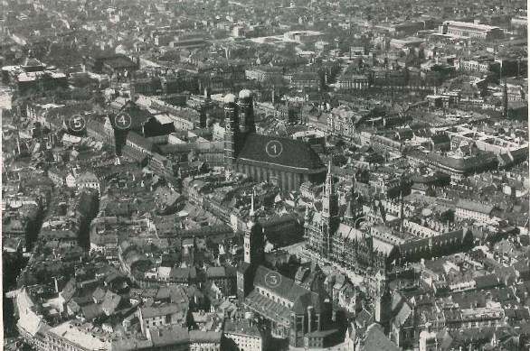
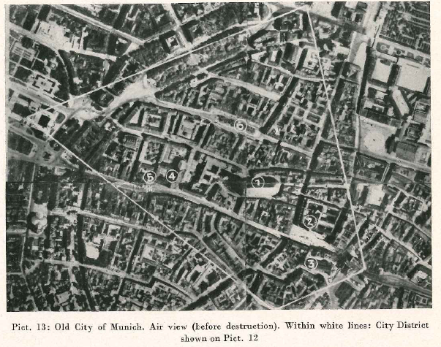
End of WWII Munich:
66 Allied air raids
6,242 dead
10,600 buildings destroyed (17% of city)
1,270 undamaged (2.5% of city)
80,000 dwellings totally destroyed
Bavarian State Library (500,000 volumes lost)
Roman Catholic churches: 96/170 destroyed
2,100/2,800 restaurants gone
45% of buildings beyond repair
“I had imagined it would be terrible, but it was even worse. Munich no longer exists. The entire city center from the main train station to the Odeonsplatz is composed only of ruins,” Klaus Mann (8 May 1945)

Slide 5
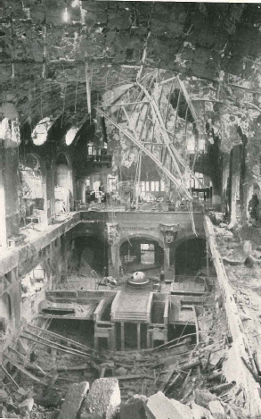
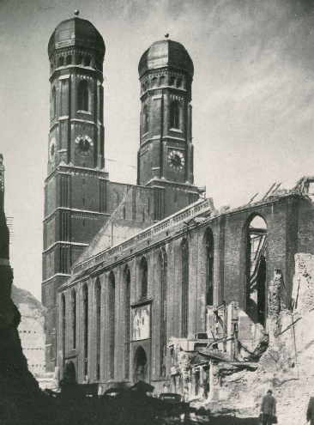
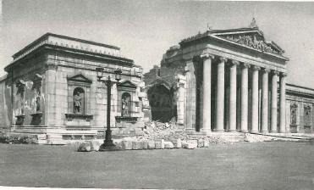
“The danger of a revived mass-radicalization of the possibly unemployed and already homeless should not be underrated. Notwithstanding the Marshall plan, Reconstruction of Germany . . . can only prosper, if the building trade is given an opportunity to maintain its vitality.” (1948)
“[Munich] is largely destroyed… everywhere lies rubble of trash, metal, glass, shattered bricks, burnt rafters; the impression is not simply sad, but also disgusting . . . The fall of the city is . . . so radical that I cannot imagine a revival.” (Summer 1944)

Slide 6
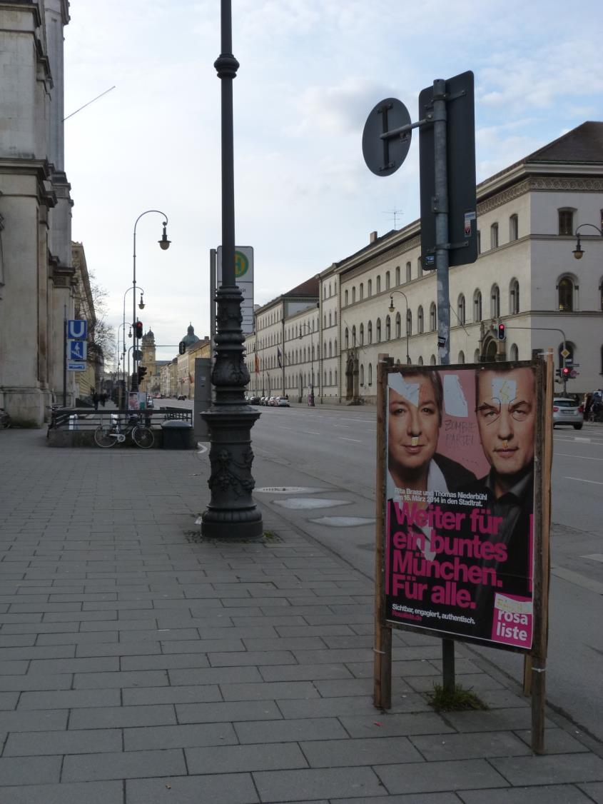
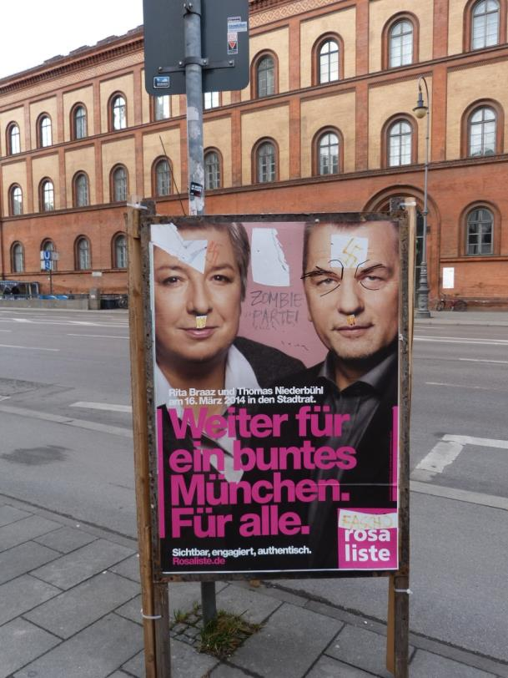
Word of the day:
Vergangenheitsbewältigung
Vergangenheit = the past
bewältigen = to master/struggle
“Munich has distinguished itself in repressing the horrors of Nazism in a near perfect manner . . . Munich has always closed its eyes before the memory of the terror that emanated from the powerful figures in these buildings.” (1988)

Slide 7
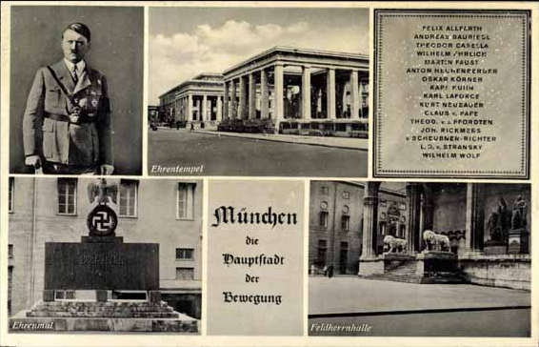
“AND THE RIGHT HAS FURTHER COMPLETELY FORGOTTEN THAT DEMOCRACY IS FUNDAMENTALLY NOT GERMAN: IT IS JEWISH. It has completely forgotten that this Jewish democracy with its majority decisions has always been without exception only a means towards the destruction of any existing Aryan leadership. The Right does not understand that directly every small question of profit or loss is regularly put before so-called 'public opinion,' he who knows how most skillfully to make this 'public opinion' serve his own interests becomes forthwith master in the State. And that can be achieved by the man who can lie most artfully, most infamously; and in the last resort he is not the German, he is, in Schopenhauer's words, 'the great master in the art of lying' - the Jew. ”
Adolf Hitler, speech in Munich (April 12, 1922)
Munich: Hauptstadt der Bewegung
“Capital of the Movement"
(May 1913) Hitler comes from Austria
(August 1914) Joins Bavarian service (WWI)
(November 1918) Gassed @ Ypres, recovers
(1919) Germany army employs as informant
Hitler infiltrates German Workers’ Party (DAP)
(September) Anton Drexler asks him to join
(1920) NSDAP = “Nazi” party is formed
(1921) Hitler takes over as leader
(1923) Beer Hall Putsch (failure = jail 5 years)

Slide 8
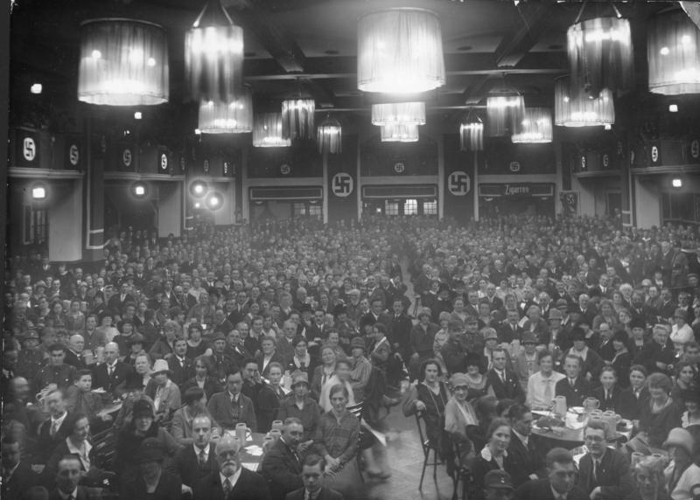
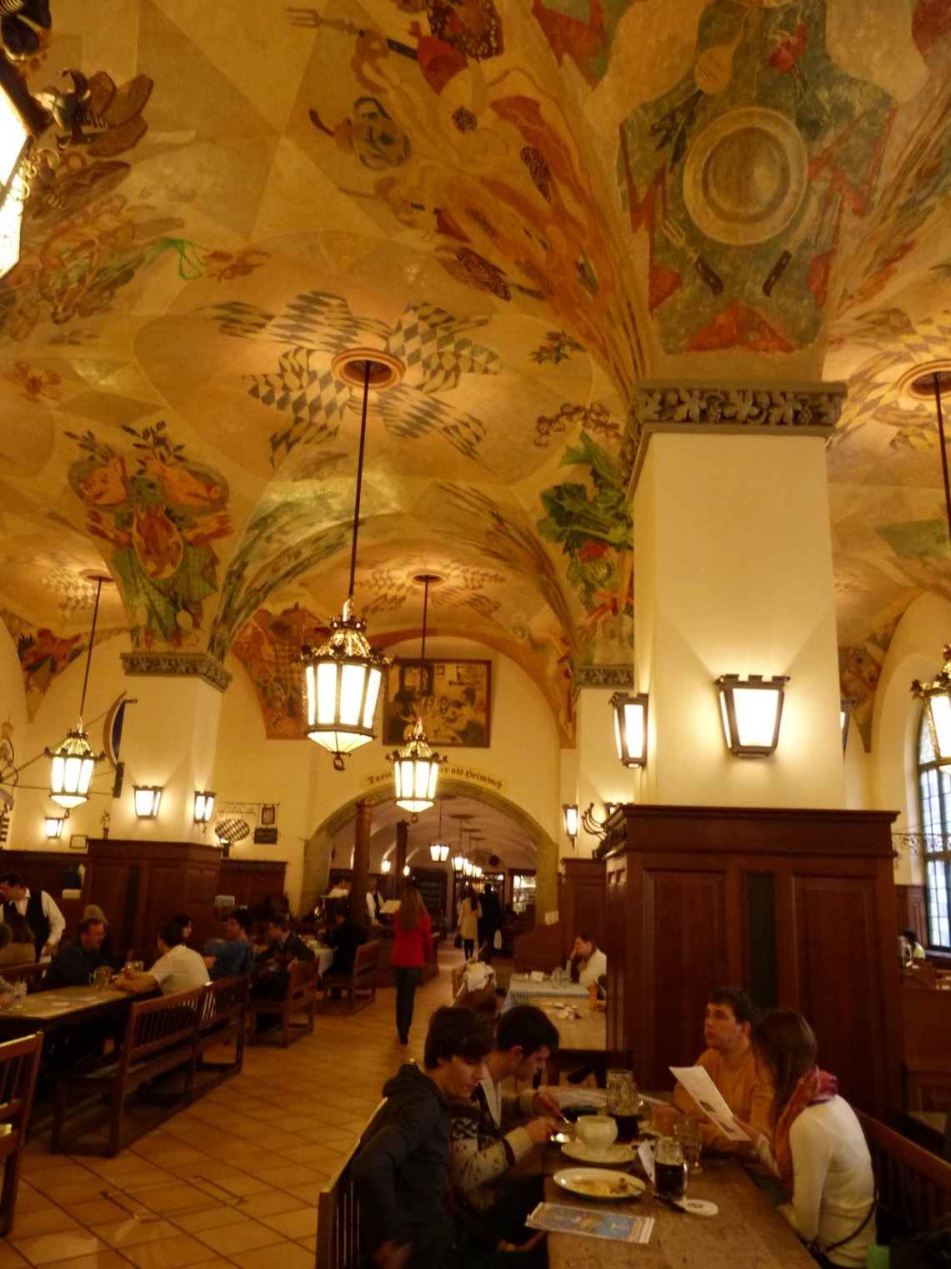
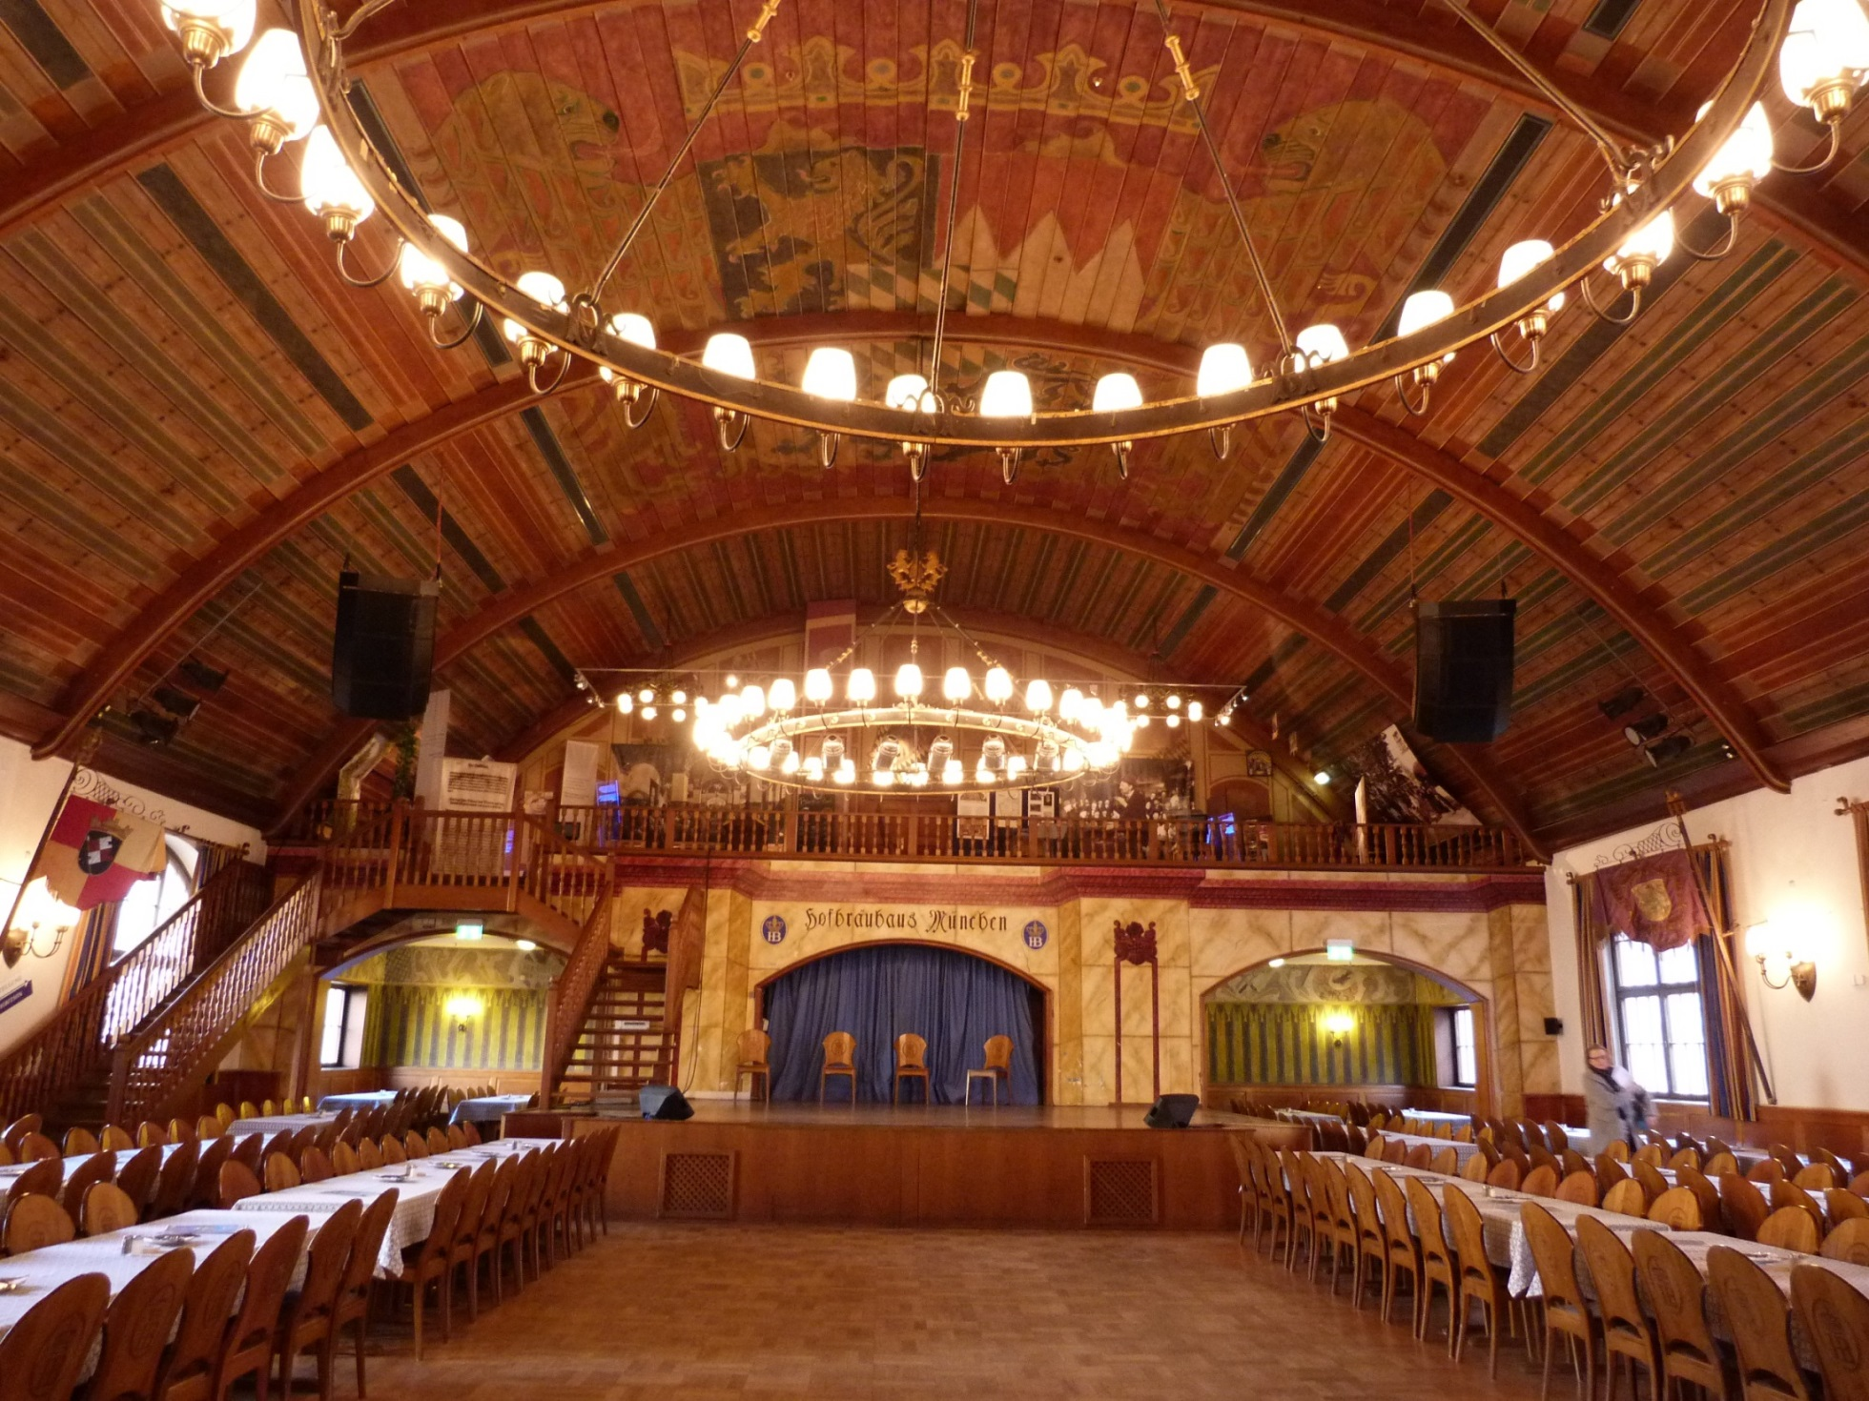
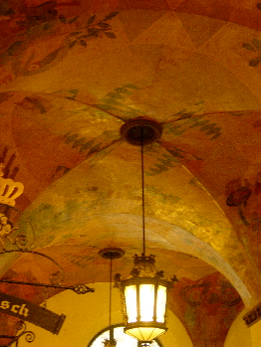
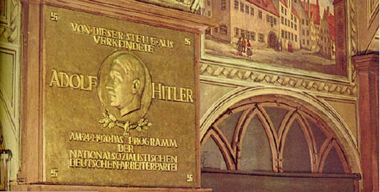
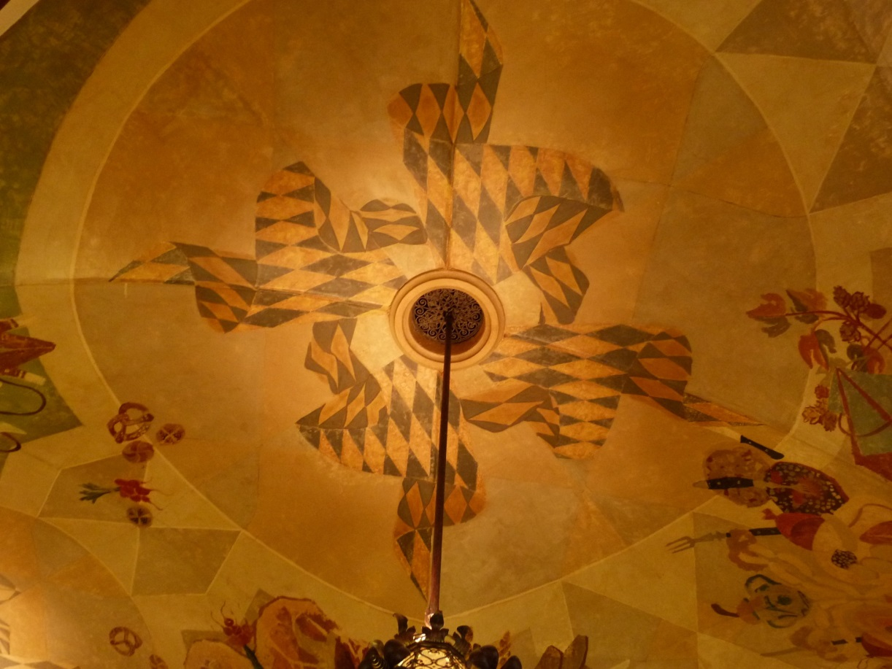
Hofbräuhaus (1897)

Slide 9
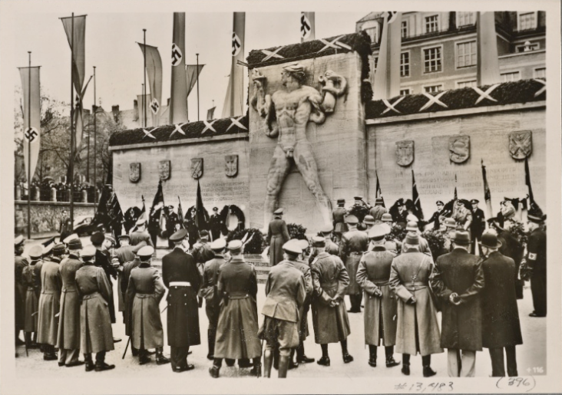
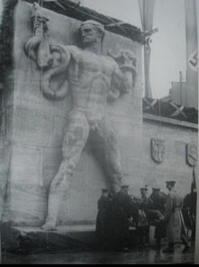
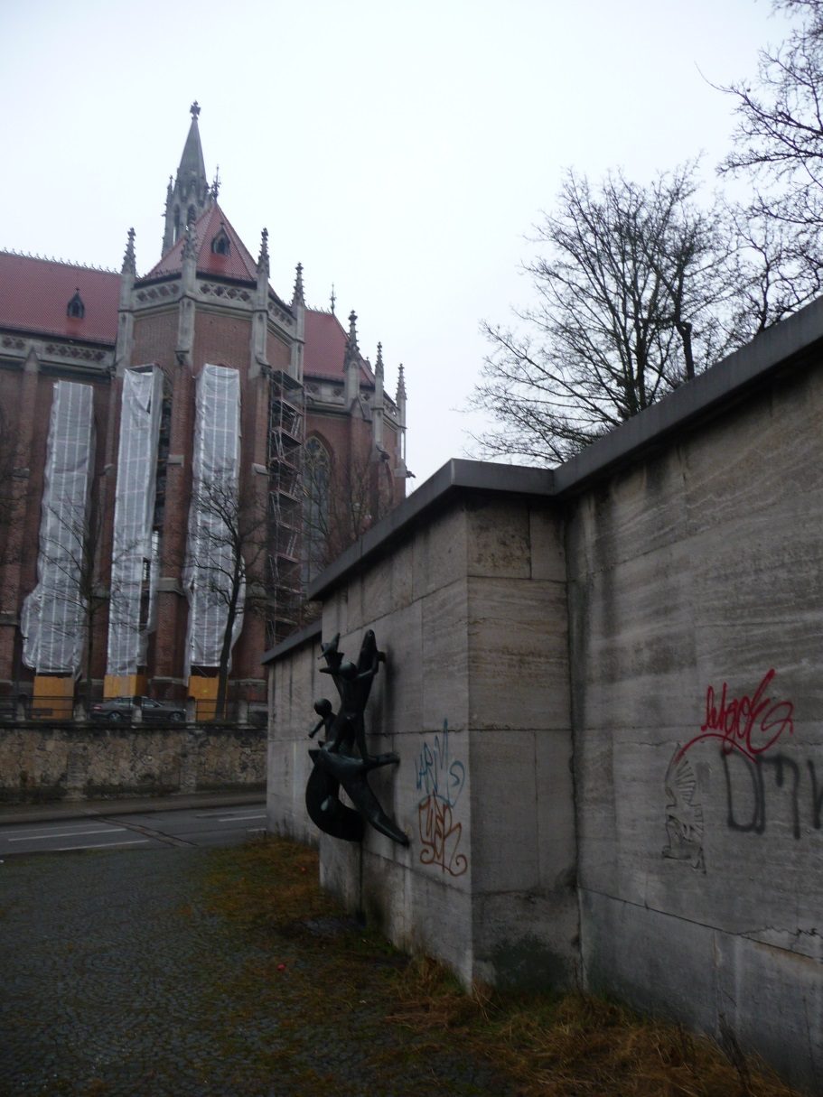
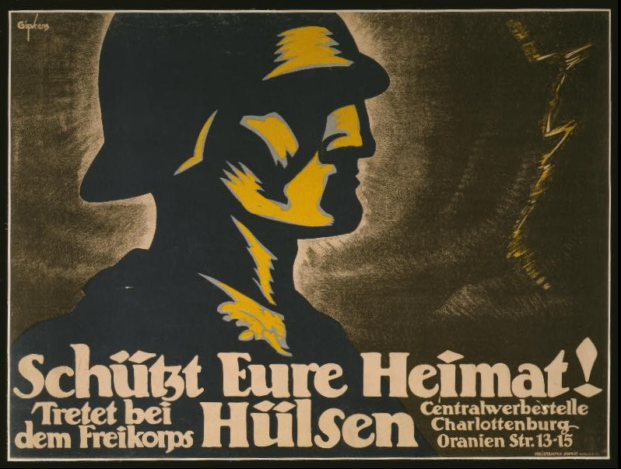
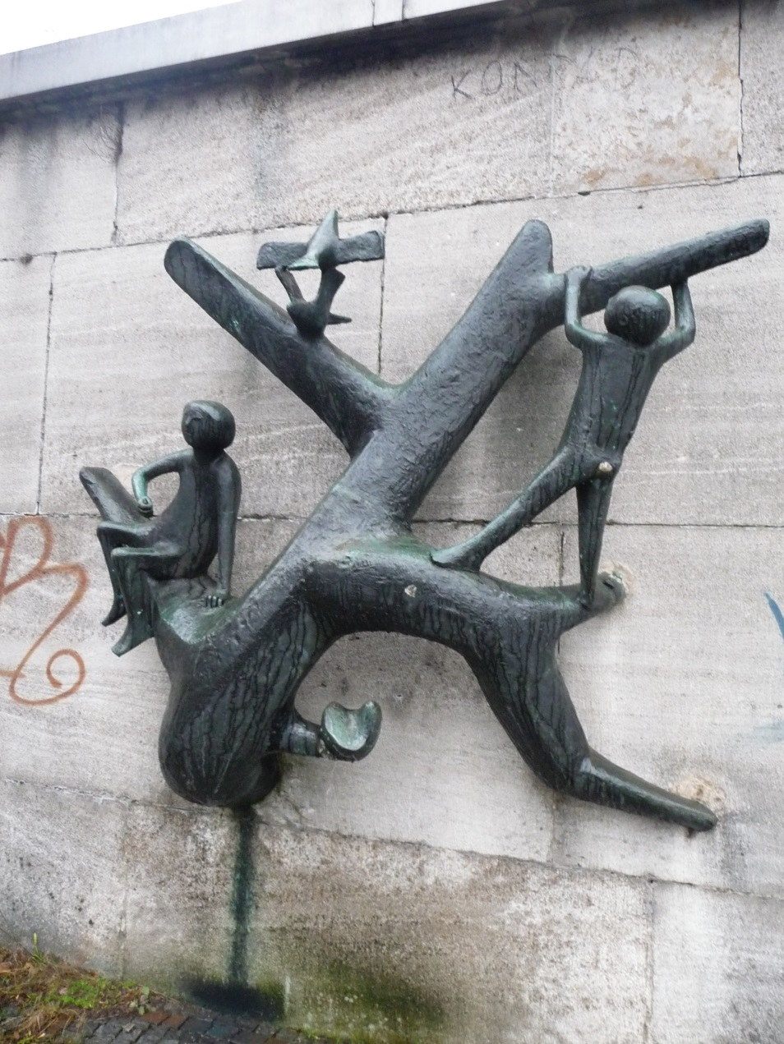
Freikorps Memorial (1924)

Slide 10
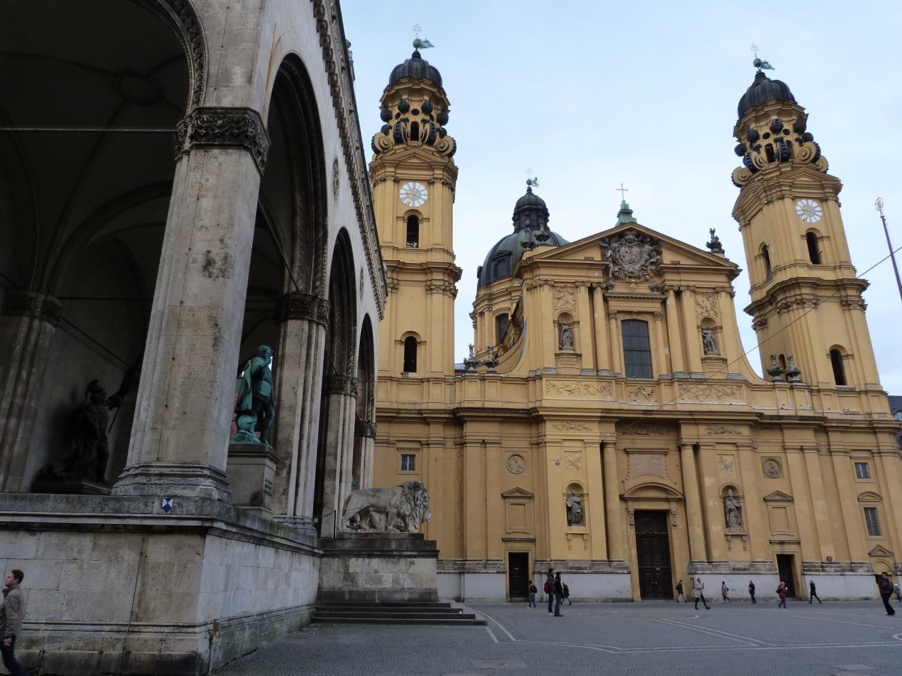
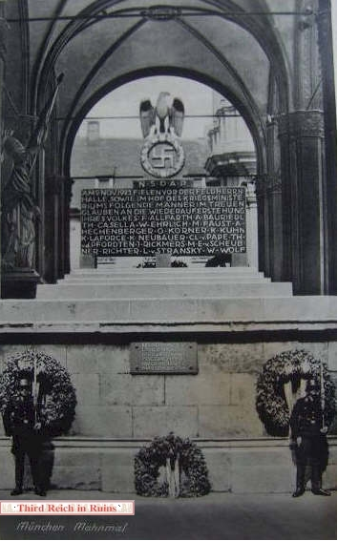
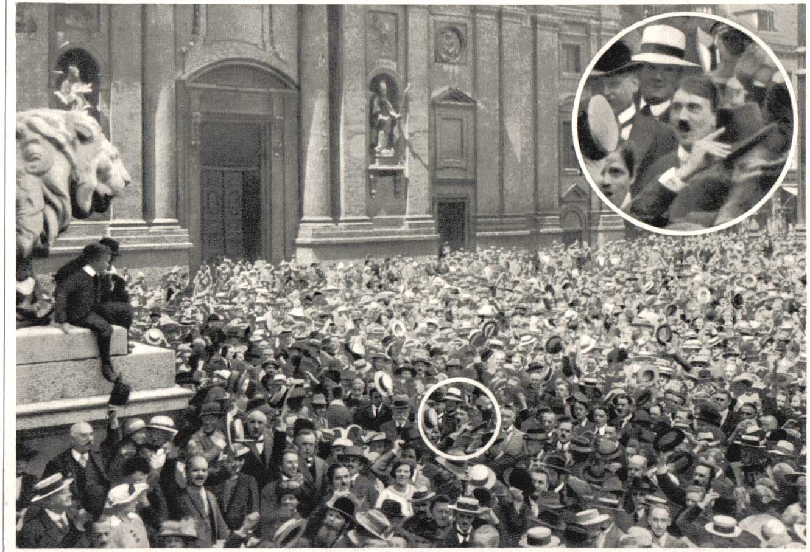
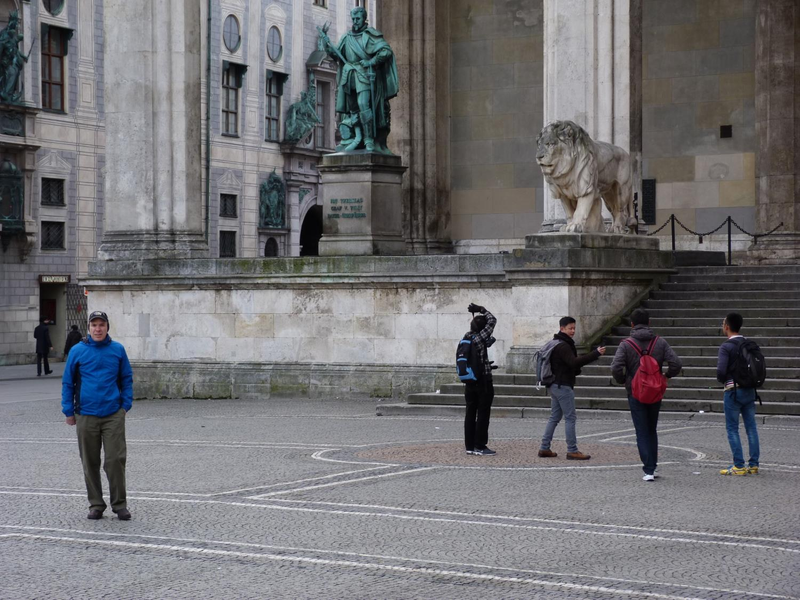
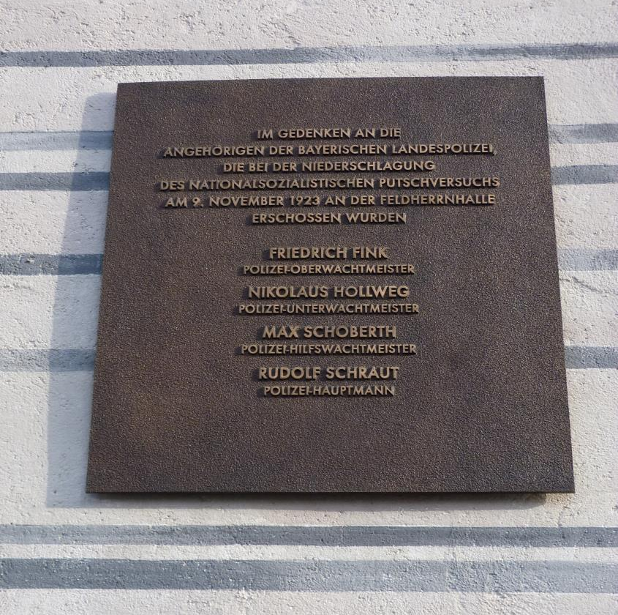
Feldherrnhalle (1844)
“Adolf Hitler, the German patriot in the middle of the crowd stands with blazing eyes,”
The Illustrierte Beobachter (12 March 1932)

Slide 11
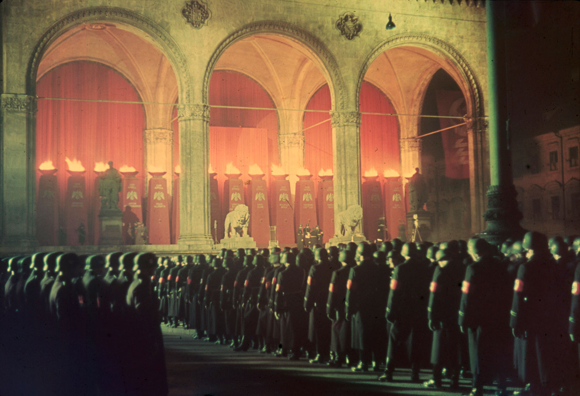
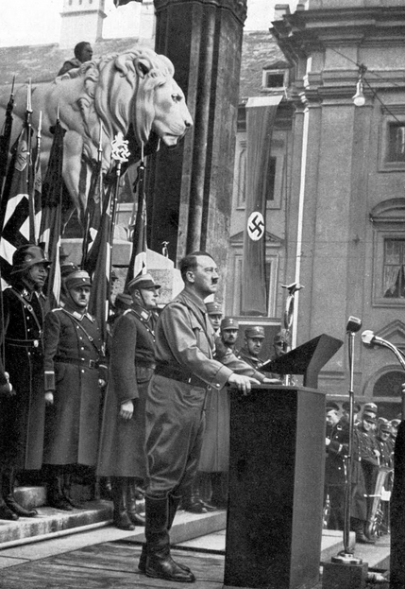
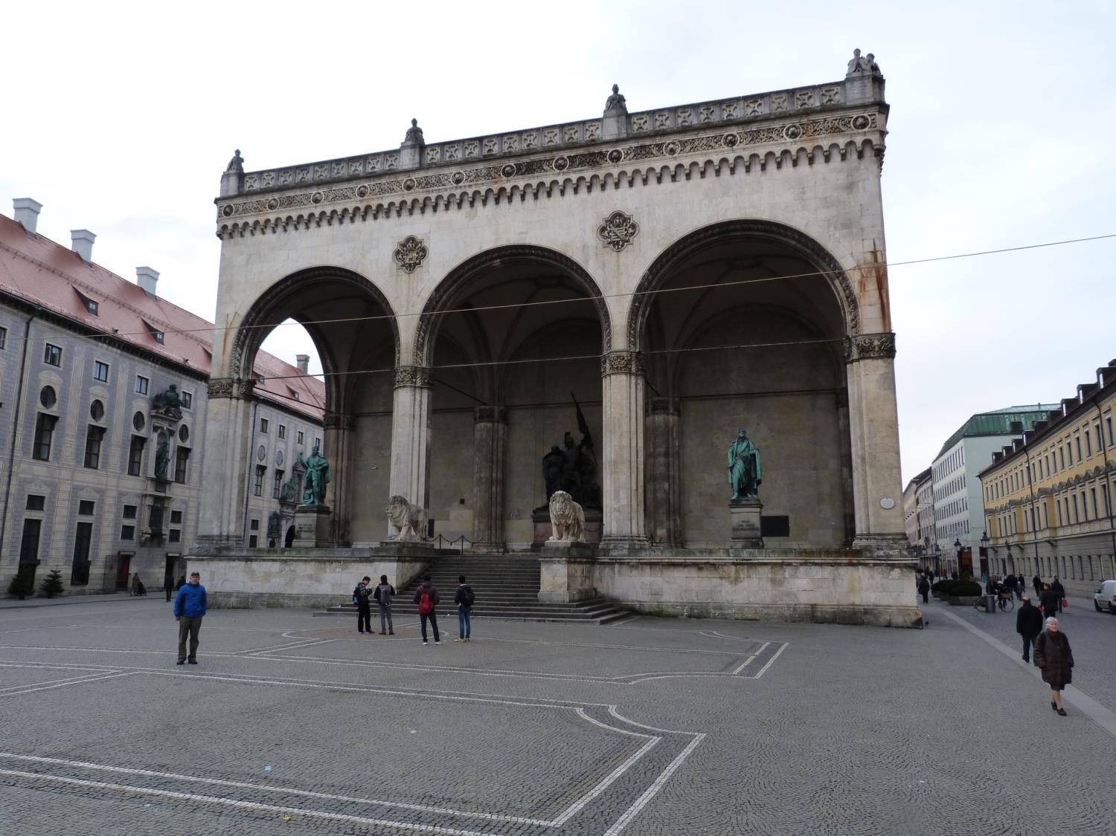
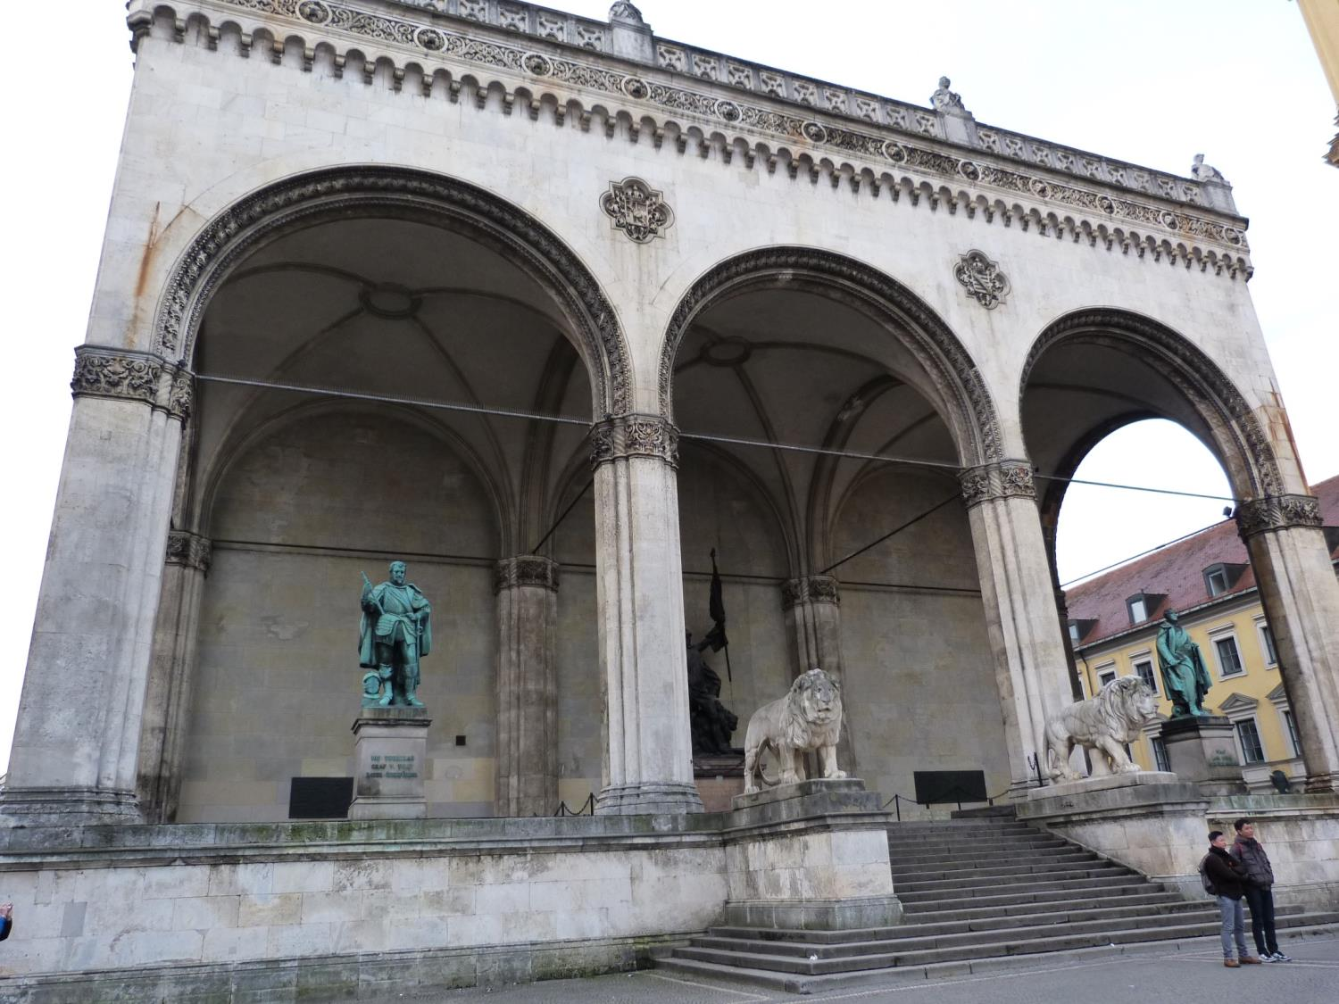
“I vow to you, Adolf Hitler, as Führer and chancellor of the German Reich, loyalty and bravery. I vow to you and to the leaders that you set for me, absolute allegiance until death. So help me God.” Reichswehreid (Oath of Allegiance, 1934-1945)

Slide 12
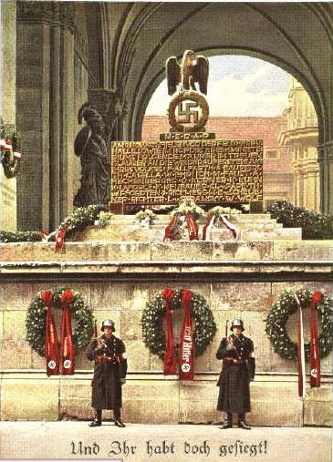
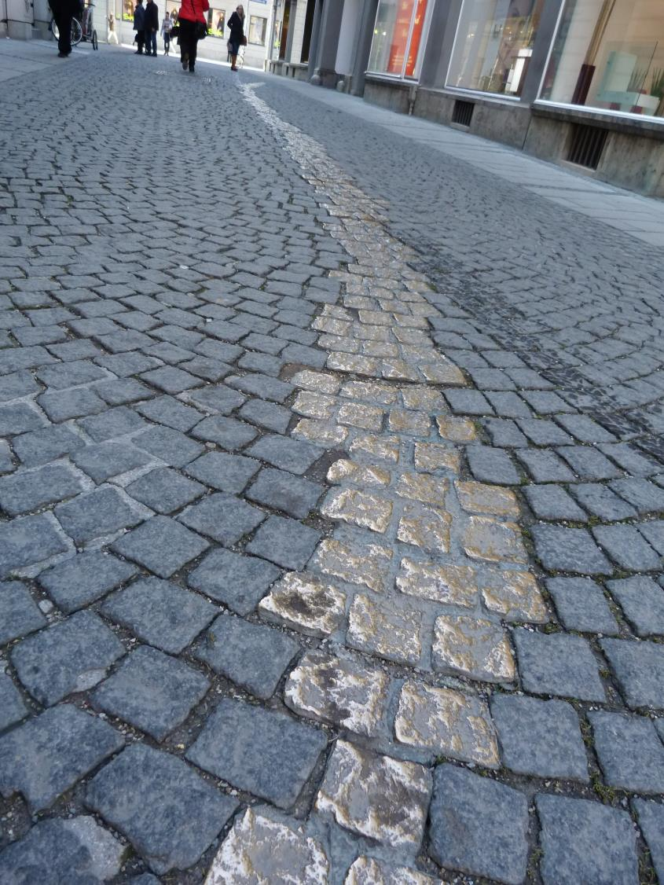
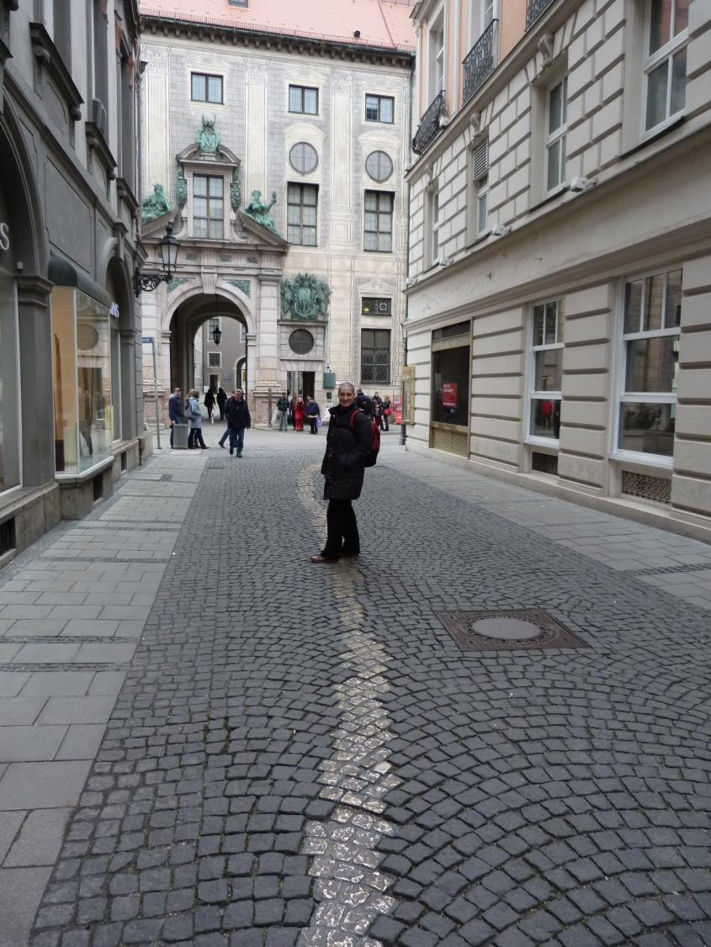
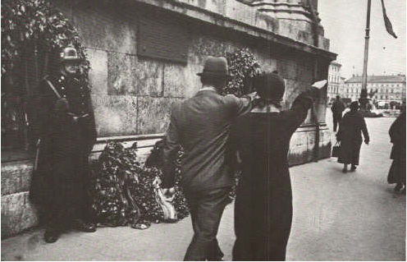
Drueckebergergasse (Shirkers’ Alley)

Slide 13
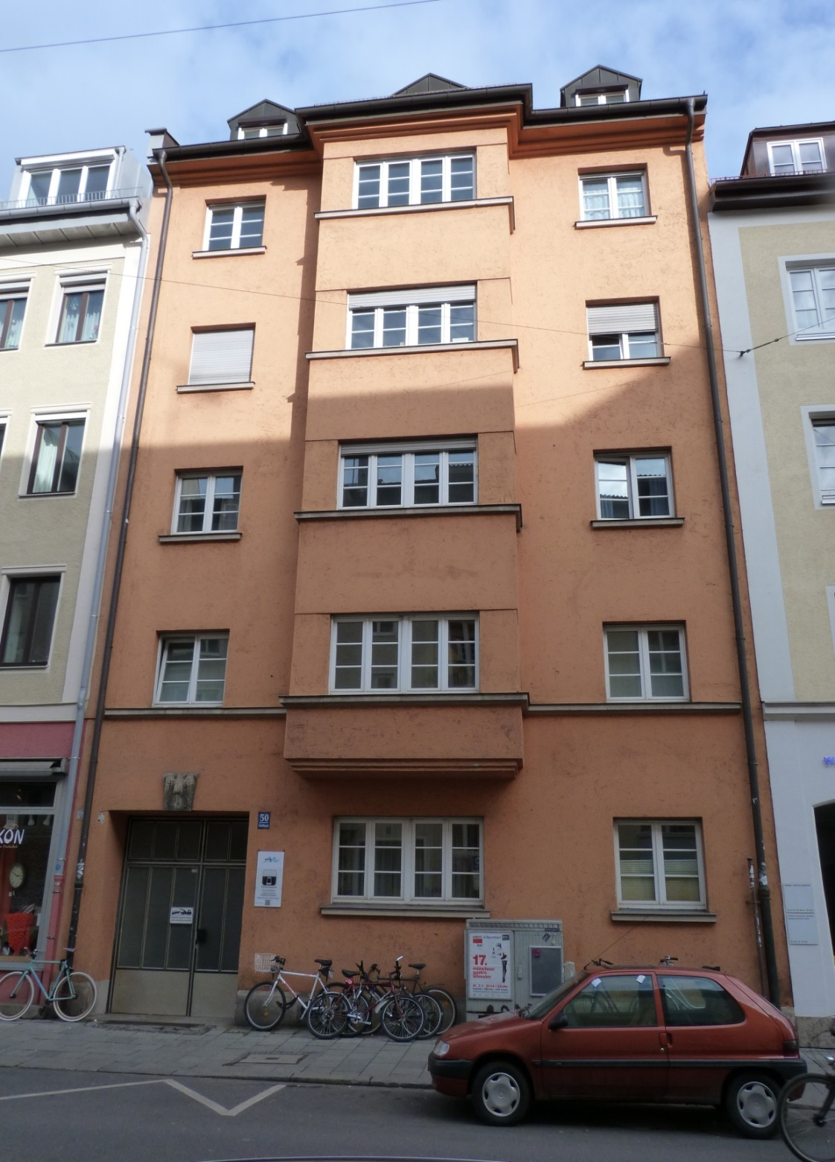
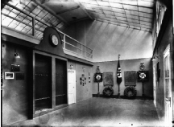
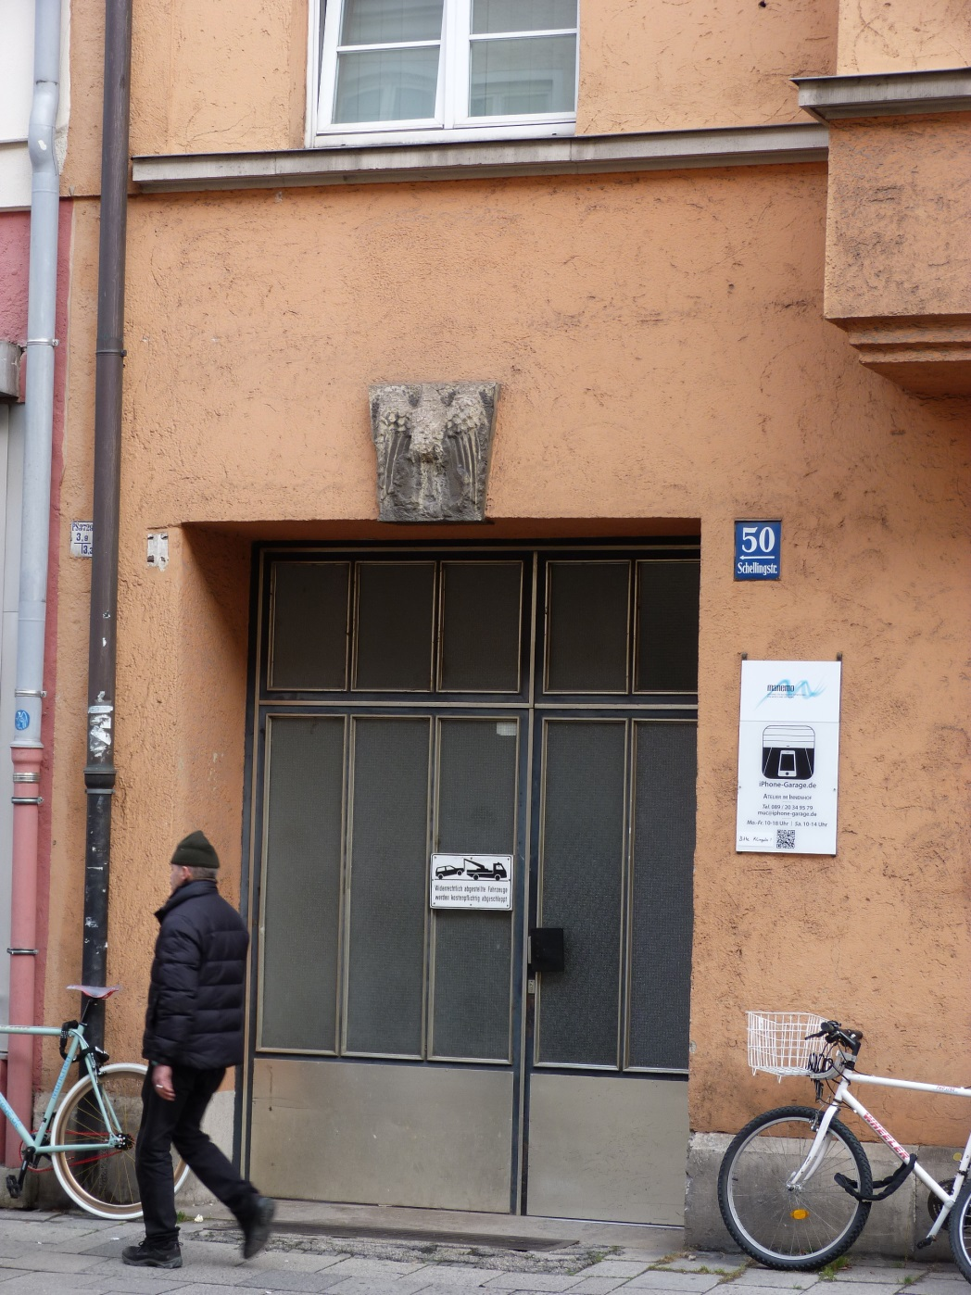
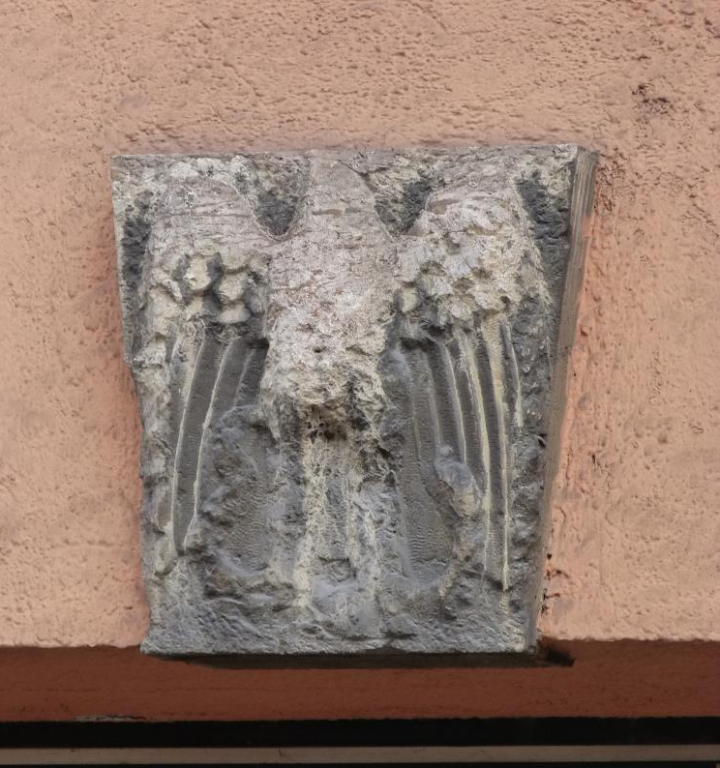
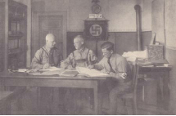
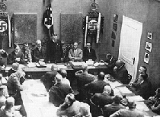
Nazi Party Office (1925-1930) Schellingstraße 50

Slide 14
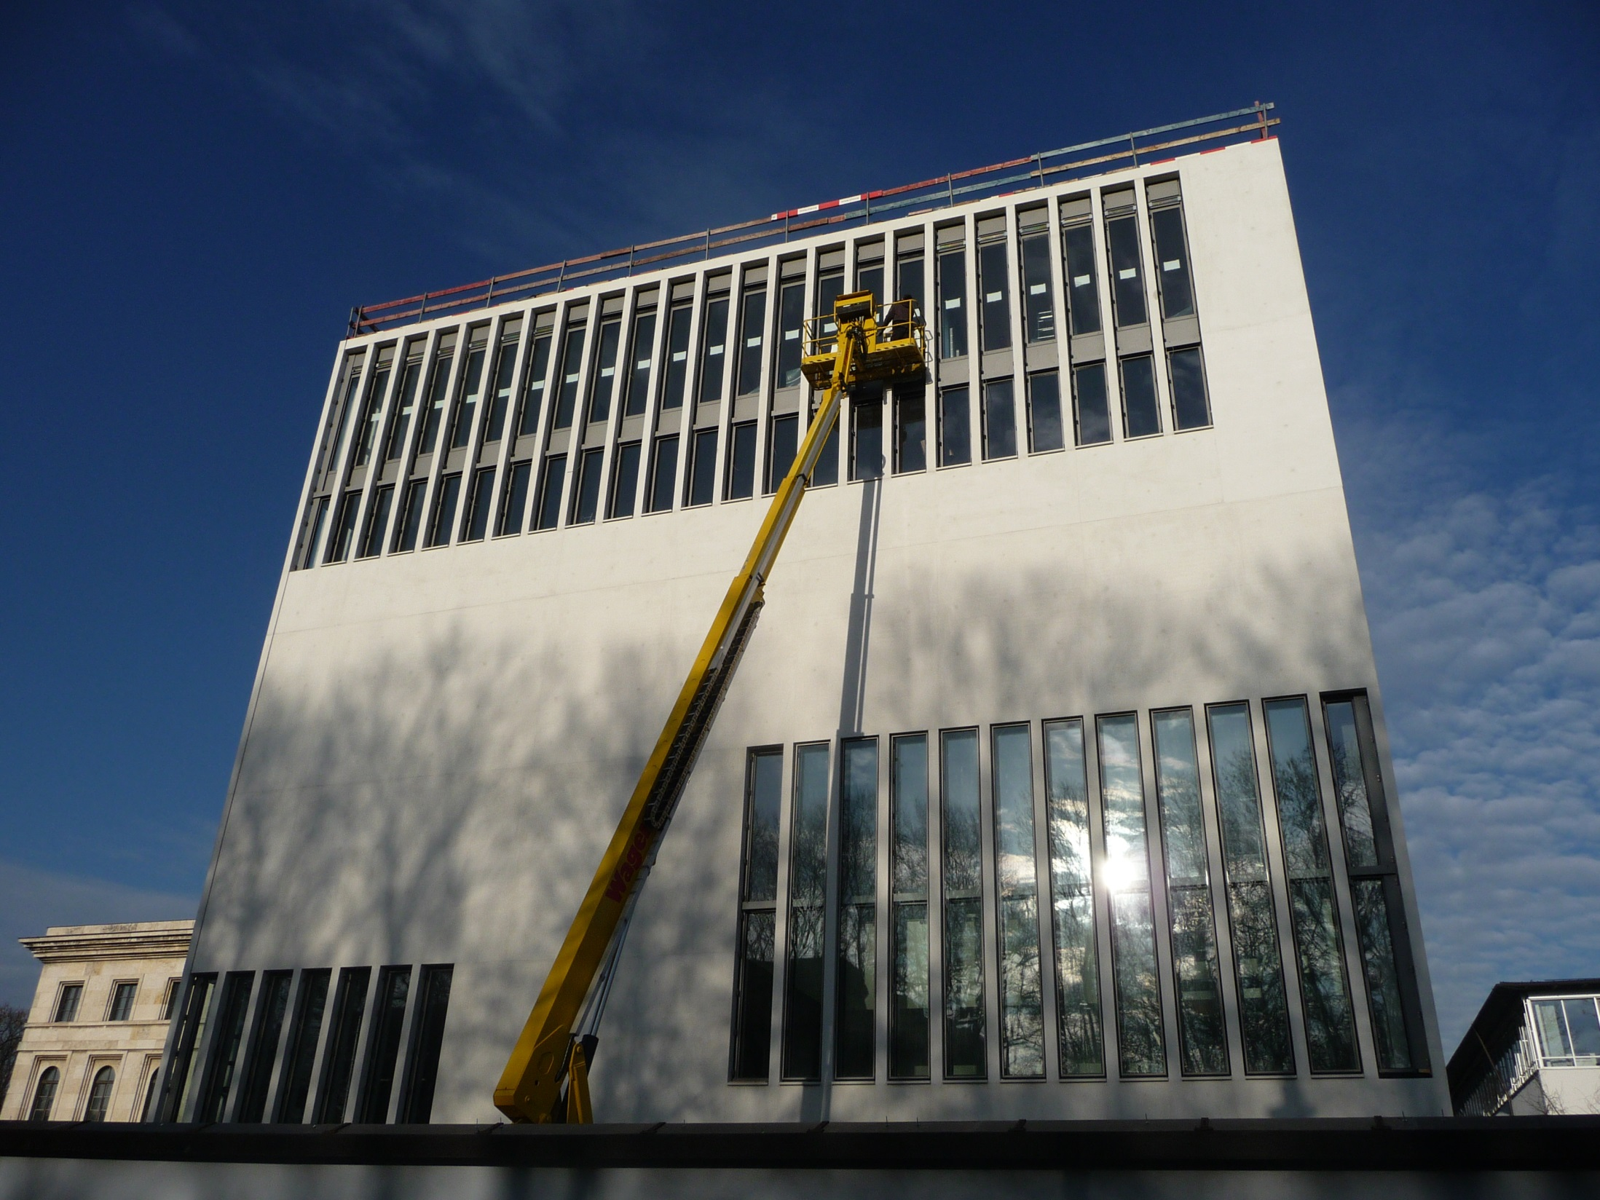
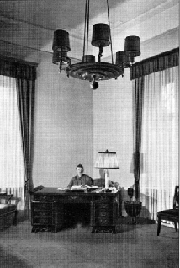
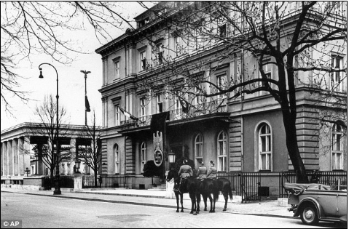
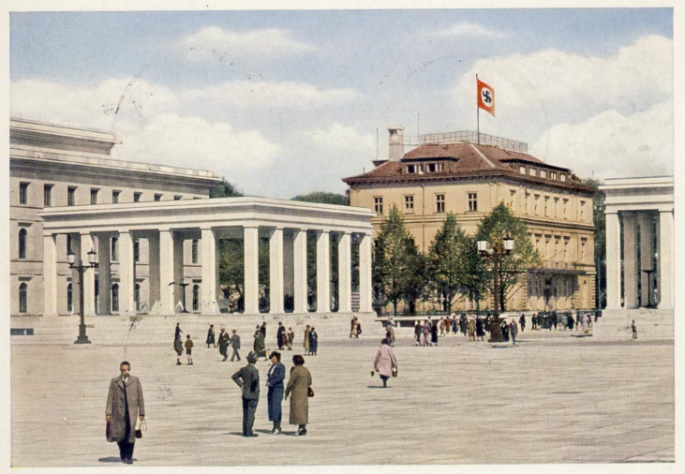
Munich Documentation Centre → Site of Das Braune Haus “Brown House”
(4th Nazi HQ in Munich, 1931-1933)

Slide 15
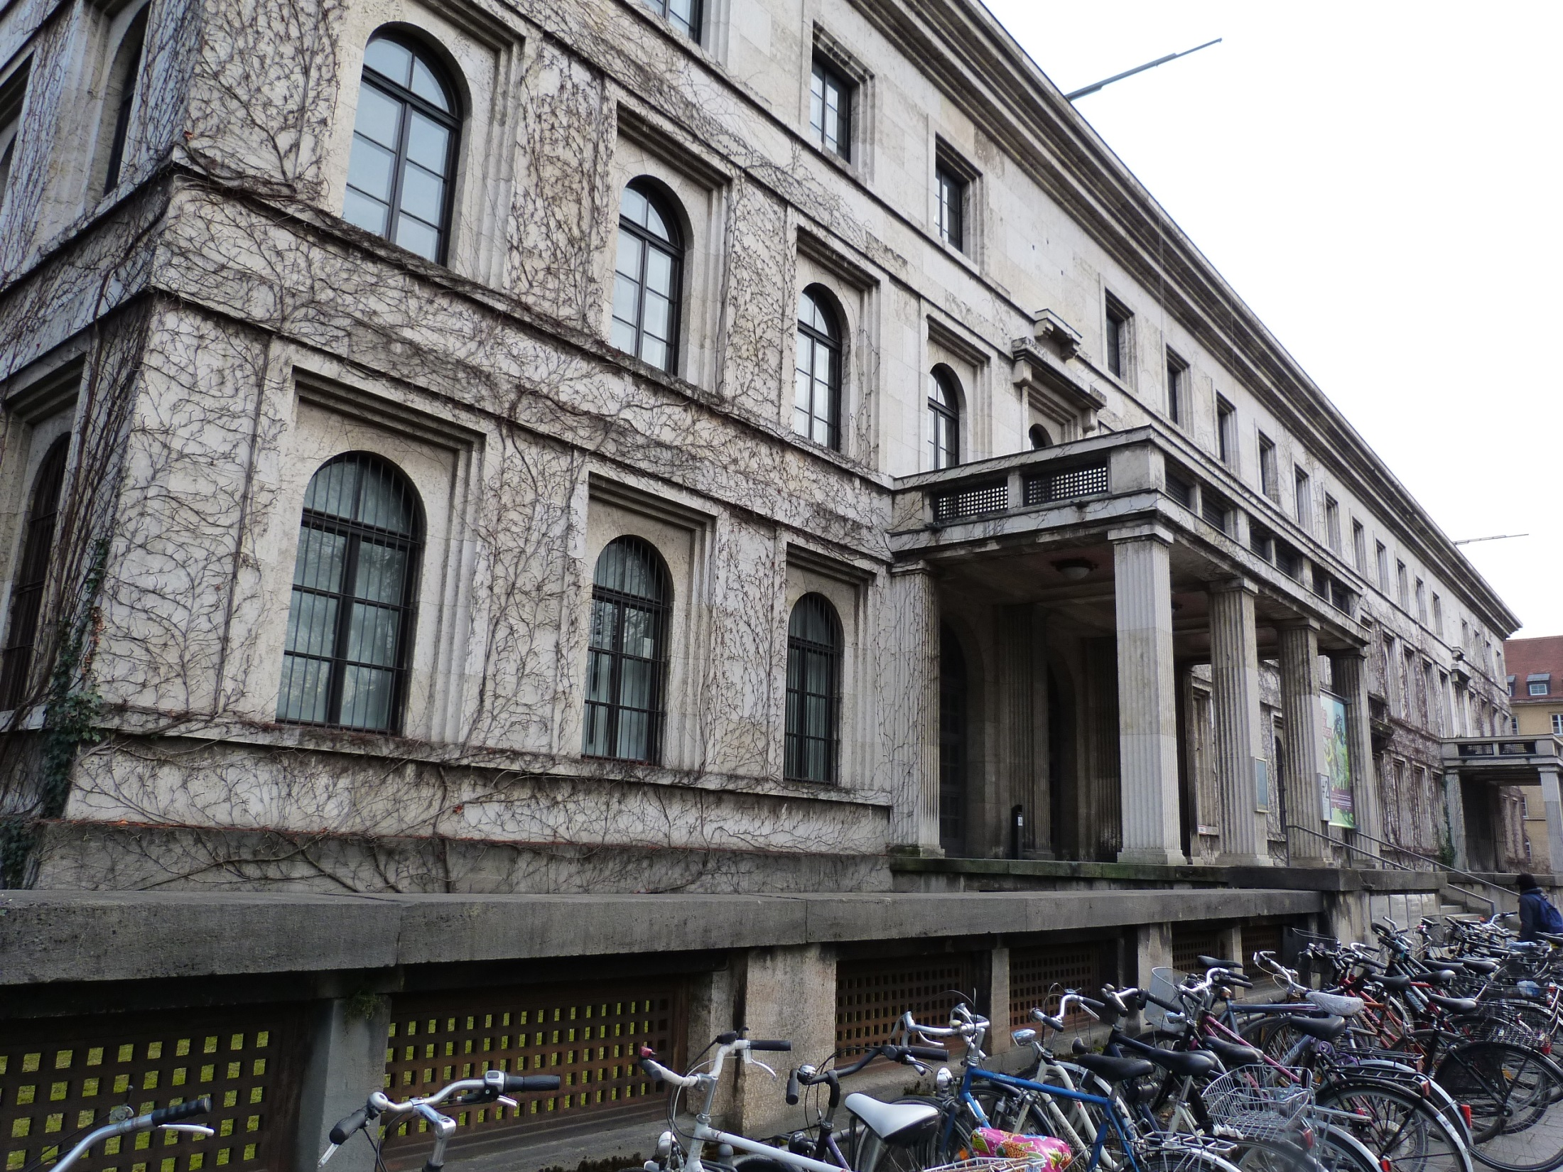
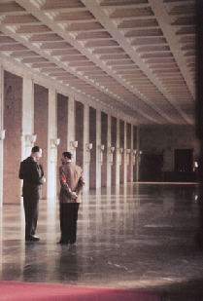
Führerbau, “The Führer’s Building” (Königsplatz) → 5th Nazi HQ
Munich Agreement (1938)

Slide 16
Königsplatz (1816-1862) → National Socialist forum (1935-1945)

Slide 17
Ehrentempel, “Honor Temples” (1935-1947)

Slide 19
Upper Austria House → House of German Doctors (1936)

Slide 20
Regional Finance Office → Bavarian State Tax Office, Sophienstraße 6 (1938-1942)

Slide 21
State Bank of Bavaria → site of Gestapo (Geheime Staatspolizei) HQ, a.k.a. Wittelsbacher Palais

Slide 22
Luftgaukommando (1937) Prinzregentenstraße 24-28

Slide 23
White Rose (Weisserose)

Slide 24
Nothing is so unworthy of a civilized nation as allowing itself to be "governed" without opposition by an irresponsible clique that has yielded to base instinct. It is certain that today every honest German is ashamed of his government.
It is impossible to engage in intellectual discourse with National Socialism because it is not an intellectually defensible program… At its very inception this movement depended on the deception and betrayal of one's fellow man; even at that time it was inwardly corrupt and could support itself only by constant lies.
Every word that comes from Hitler's mouth is a lie. When he says peace, he means war, and when he blasphemously uses the name of the Almighty, he means the power of evil, the fallen angel, Satan. His mouth is the foul-smelling maw of Hell, and his might is at bottom accursed.

Slide 25
Wunden der Erinnerung “Wounds of Memory” (1994-1995)

Slide 26
Plaque Kristallnacht Victims

Slide 27
Square for the Victims of National Socialism (1985)

Slide 28
Memorial to the Resistance to National Socialism (1995)
"My dears! My last letter I write to you. The clemency petition was rejected. I will be executed by three o’clock. So farewell, and in eternity we'll meet again.”
(5 June 1944)

Slide 29
“Munich stands as one of Germany’s most beautiful and architecturally harmonious cities… Yet, another Munich exists behind the city’s better known façade: the Munich of the Third Reich. While Munich glowed in 1900, it burned in 1945…. Comparing Munich to other German cities after 1945 further demonstrates its difficulty in coming to terms with the legacy of the Third Reich.” (Munich & Memory, 2000)

