Slide 1
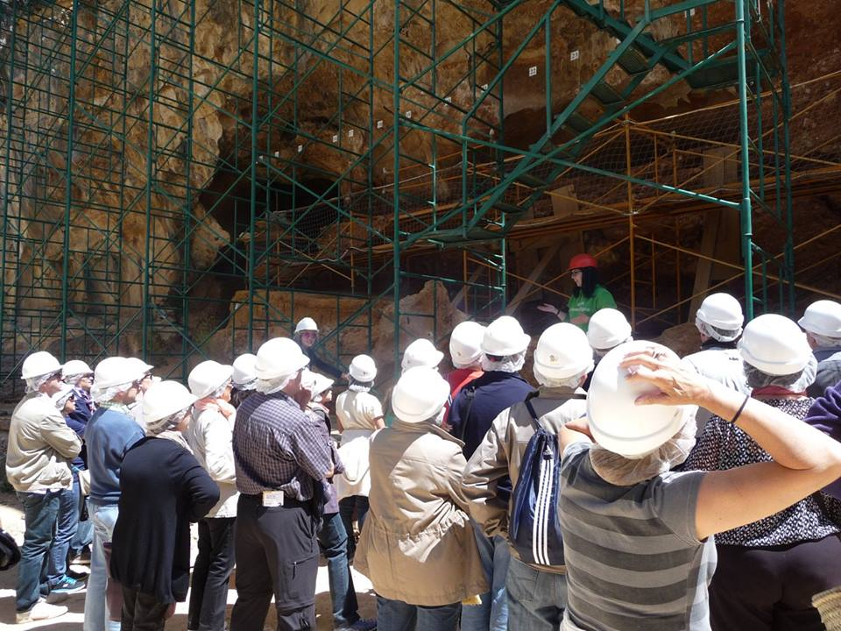
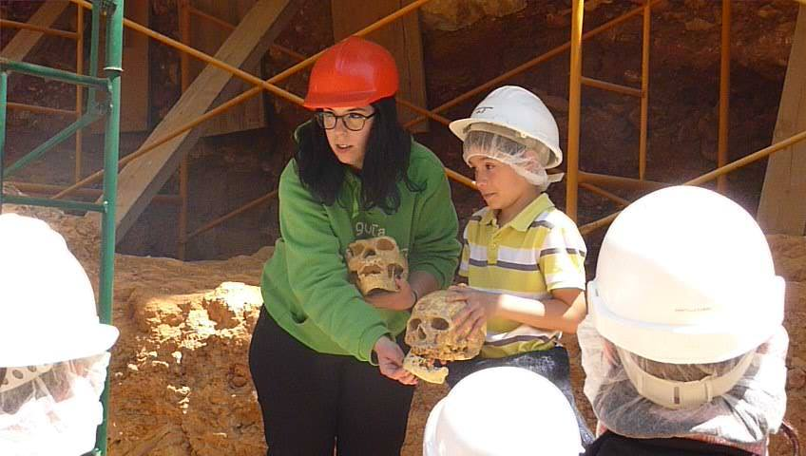

Slide 2
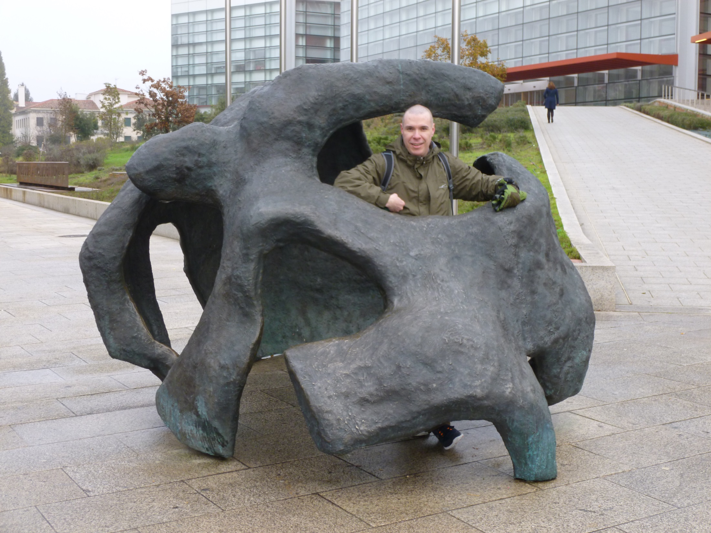
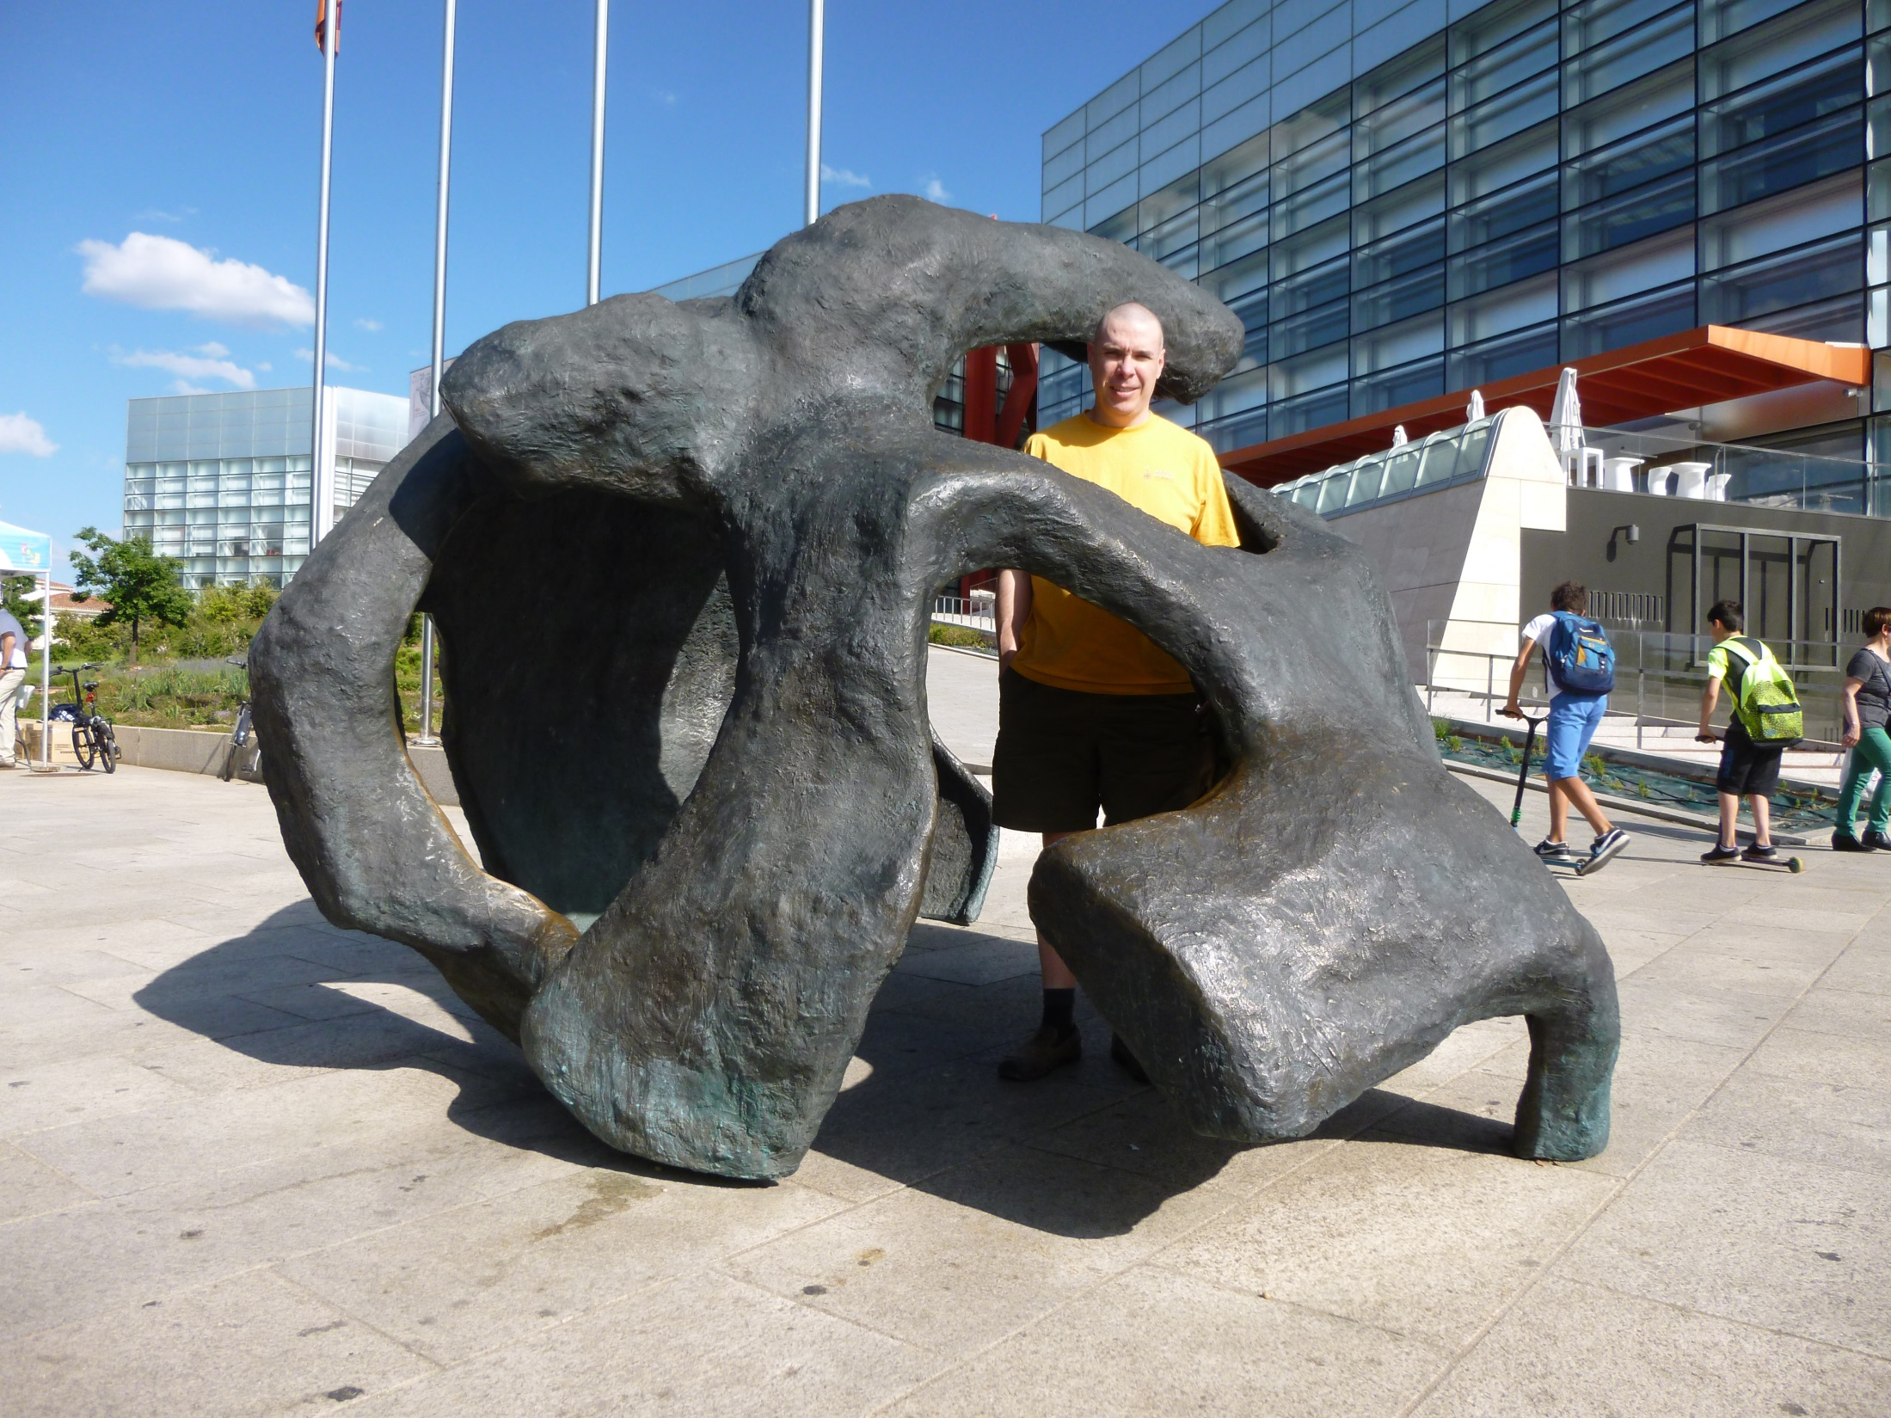
Who are you calling a Neanderthal?
The changing face of Homo sapiens neanderthalensis
Dr. Robinson Yost
October 22, 2015
“Are they human?
Some have portrayed them as respectable citizens,
hardly distinguishable from the chap next to you on the bus or subway.
Others paint them as hairy hunched monsters,
stupid and criminal…
Some have seen them as obvious ancestors,
because they are so similar.
Some have seen them as too different and stupid
to be other than extinct.”

Slide 3
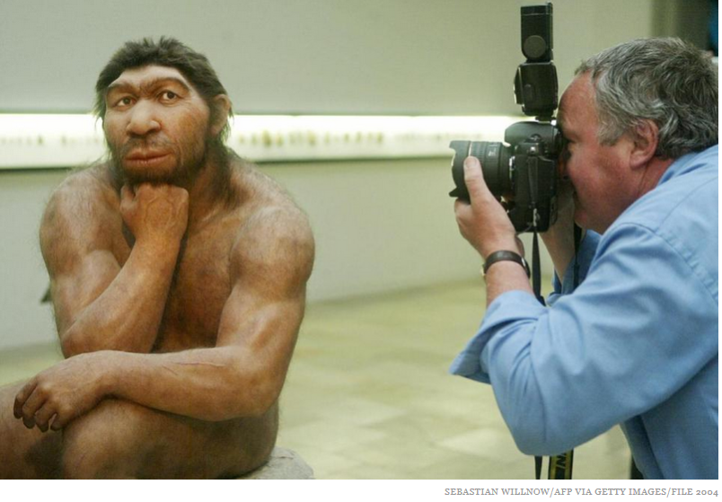
Of all the early hominids, none have been so maligned and misunderstood as the Neanderthals, the cavemen of the cartoonists. Unfairly, the very name Neanderthal has connoted brutish behavior and primitive backwardness….
“The Search for Our Ancestors” (1985)

Slide 4
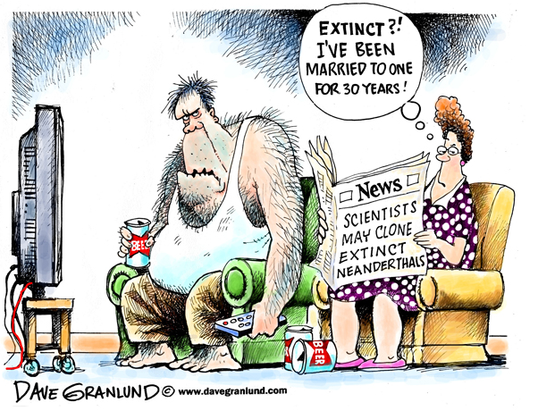
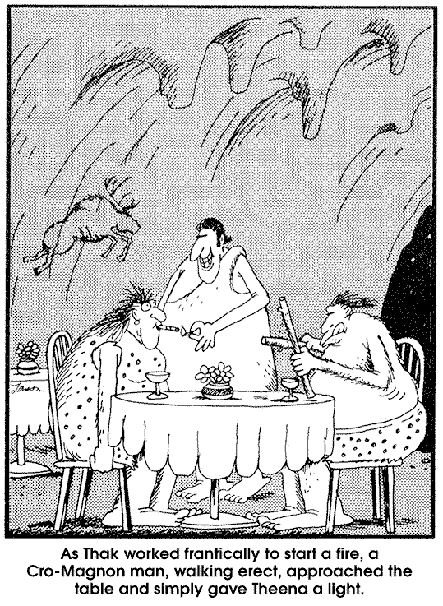
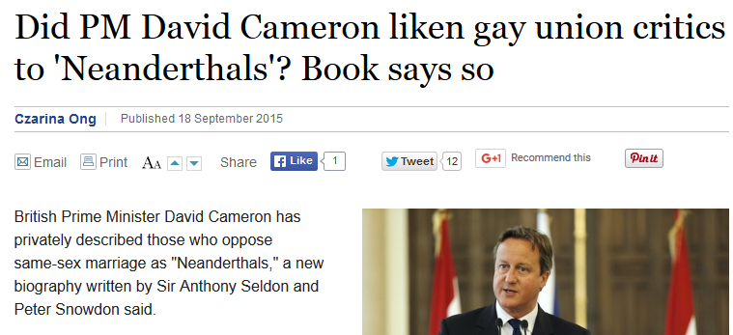

Slide 5
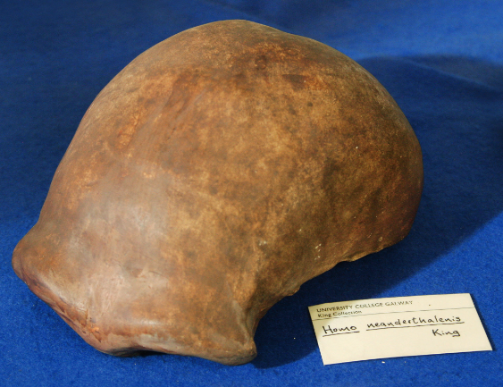
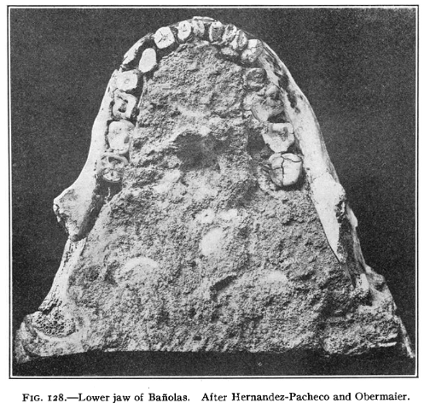
Big Picture:
Who were they?
discovery
initial responses
changing interpretations
Did Neanderthals behave like “Neanderthals”?
How are we related to them?
Why did they go extinct?

Slide 6
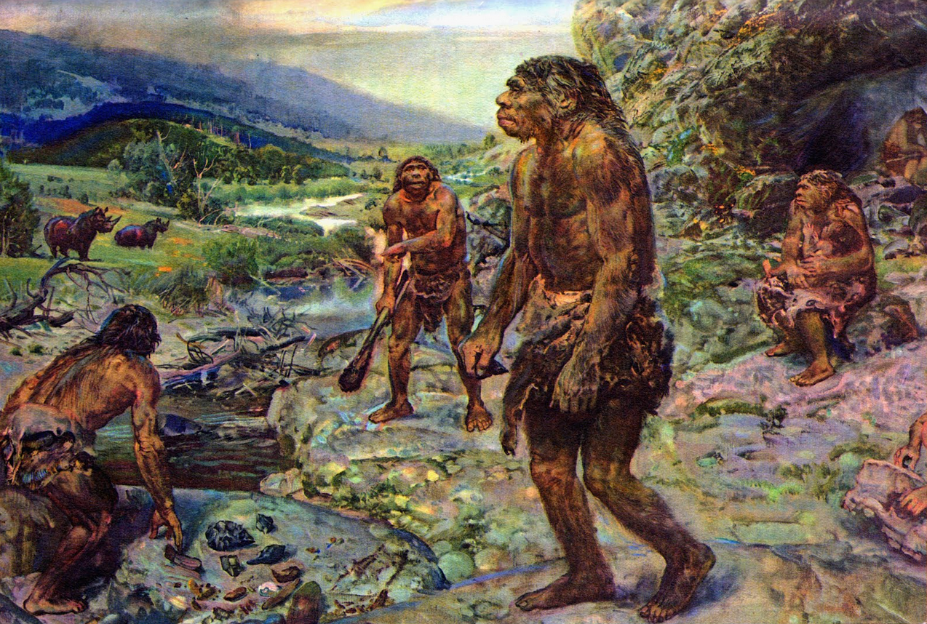
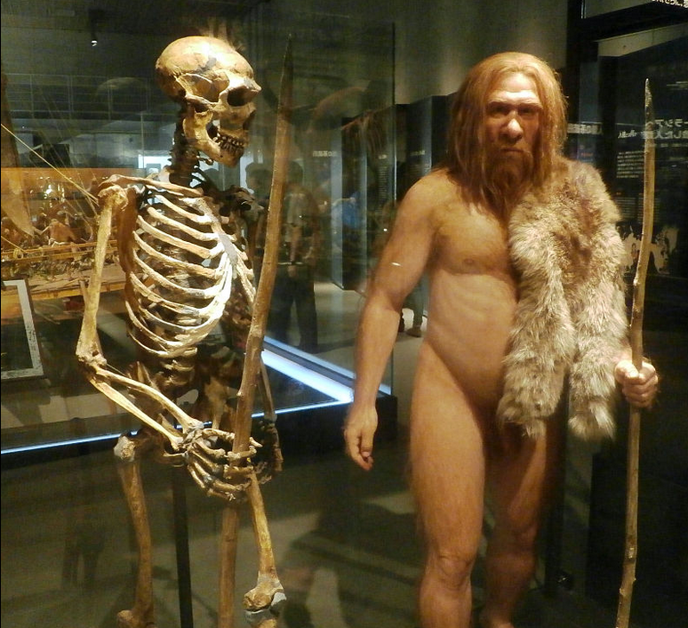

Slide 7
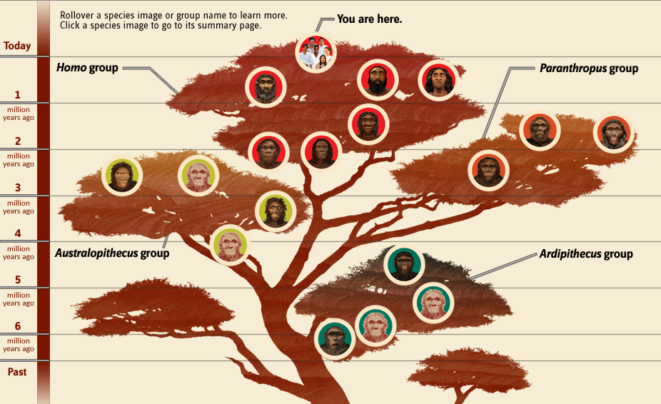
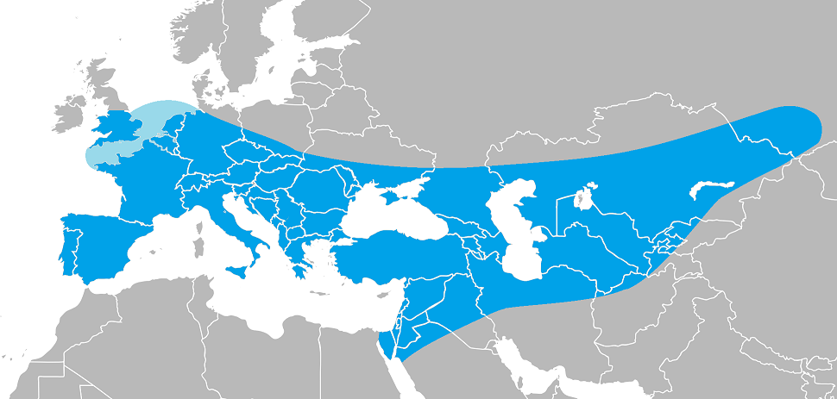

Slide 8
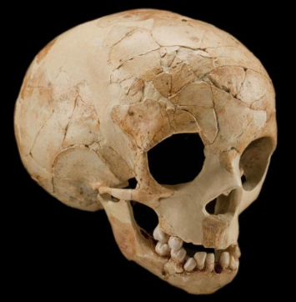
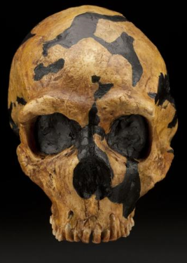
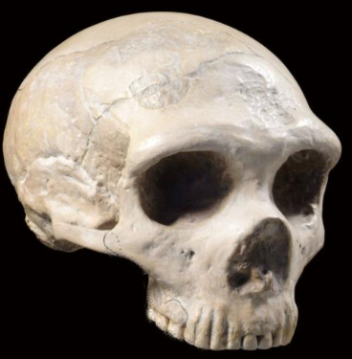
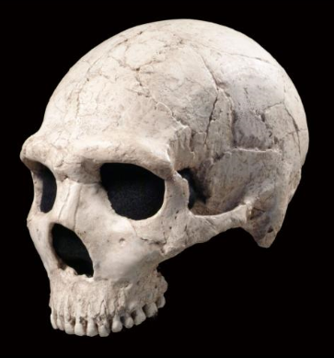
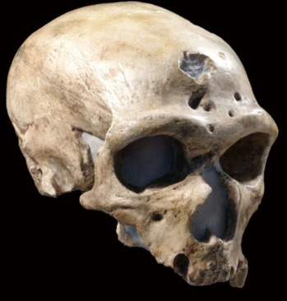
Dederiyeh, Syria (1993)
Forbes’ Quarry, Gibraltar (1848)
Shanidar, Iraq (1960)
La Chapelle, France (1908)
Amud, Israel (1961)

Slide 9
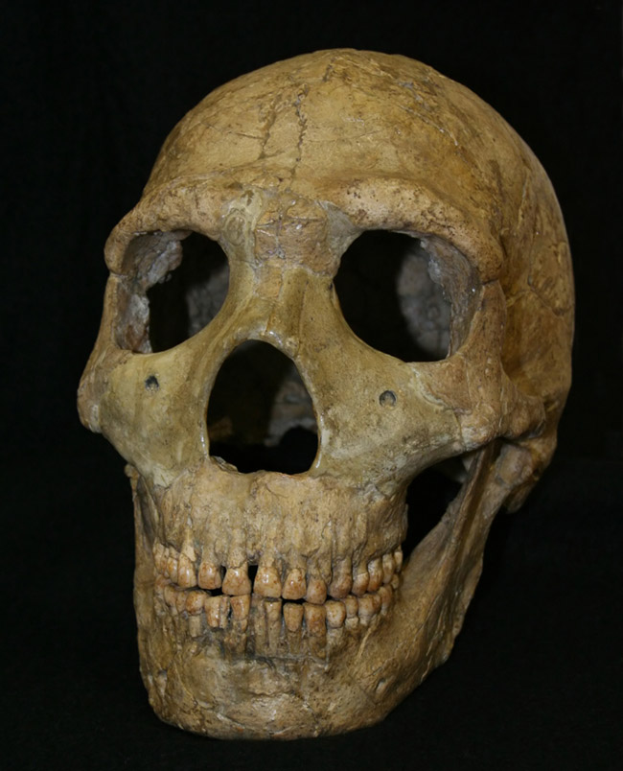
Human Evolution in 24 hours:
Each hour = 100,000 years
Midnight: Homo emerges [2.4 mya]
5-6 am: first leave Africa
Noon: first arrive in Europe
6 pm: Homo heidelbergensis in Europe from Africa
9 pm: Homo neanderthalensis evolve in Europe
10:45 pm: archaic Homo sapiens in Middle East
11:20 pm: Neanderthals dominant in w. Asia, pushing east
11:40 pm: Neanderthals reach Siberia
11:39 pm: Homo sapiens in Europe
11:45 pm: Neanderthals extinct
11:54 pm: Homo sapiens establishing agriculture & permanent settlements
Amud, Israel (1960s)

Slide 10
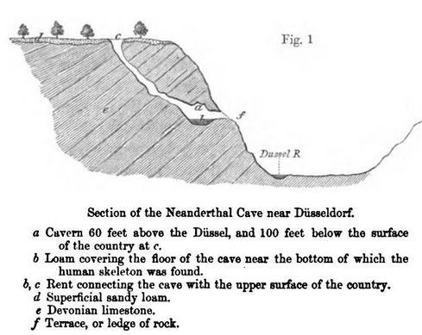
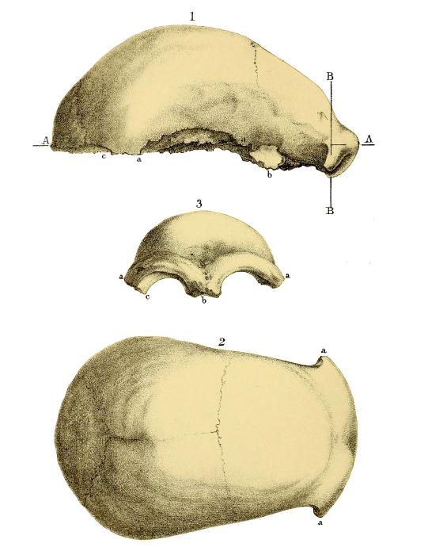
Neanderthal 1 specimen (1856)
Fuhlrott & Schaafhausen (1857-58)
bones: very ancient
natural variation: not observed in modern humans
earliest inhabitants of Europe
Initial Responses:
not ancient: no fossil fauna or artefacts
strange form: disease or mental defect
bad timing: human ancestry very controversial topic
“Light will be thrown on the origin of man and his history.”

Slide 11
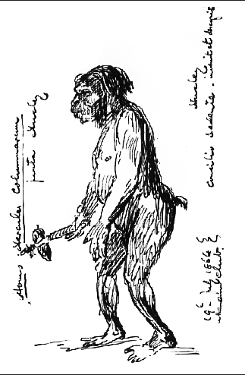
“The apparent ape-like, but really mal-developed idiotic character of its conformation is so hideous, and its alleged proximity to the anthropoid Simiae of such importance, that every effort should be made to determine its probable date in time.” [source]
Three main interpretations (late 19th – early 20th c):
pathologically deformed human
Rudolf Virchow (1821-1902): rickets in childhood and/or arthritis in adulthood
prehistoric variant of Homo sapiens
T. H. Huxley (1825-1895): unusual & extreme version of modern humans (large brain size) → pointed to Australian aborigines for comparison (Man’s Place in Nature, 1863)
new species (or genus) of human
William King (1809-1886): radical proposal, first scientist to name a new & extinct species of fossil human
continued disagreement over Neanderthals’ role in human evolution
“A more ferocious, gorilla-like human being can scarcely be imagined. The savage stands, almost in the attitude of an ape, before his den, where his female companion is seen slumbering, enveloped by shaggy furs. Always ready to attack or defend, he holds in his hand a hatchet of primitive character…” [Harper’s Weekly, 1873]

Slide 12
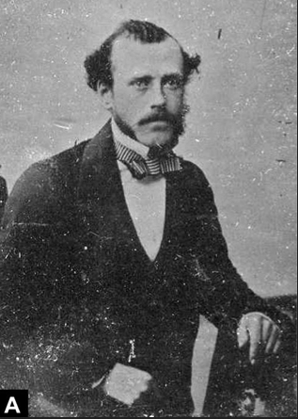
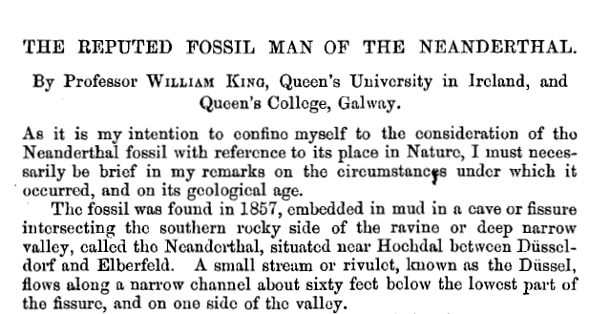
William King (1809-1886)
Professor of Geology & Mineralogy, Queen’s College Galway
BAAS meeting paper (1863)
remains were ancient & sufficiently different → new taxonomic grouping
“Thus the author is led to regard the Neanderthal skull as belonging to a creature cranially and psychically different from man; and he proposes to distinguish the species by the name of Homo neanderthalensis.”
Quarterly Journal of Science paper (1864)

Slide 13
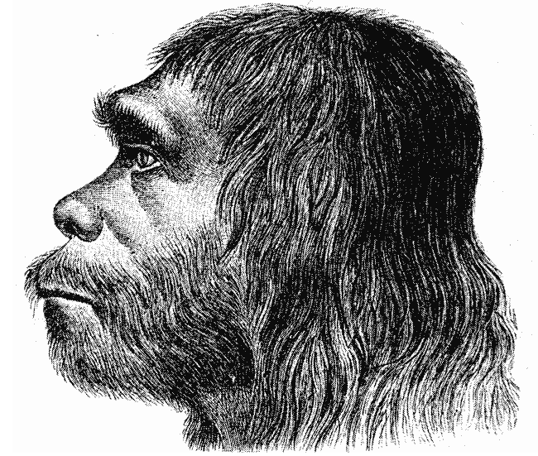
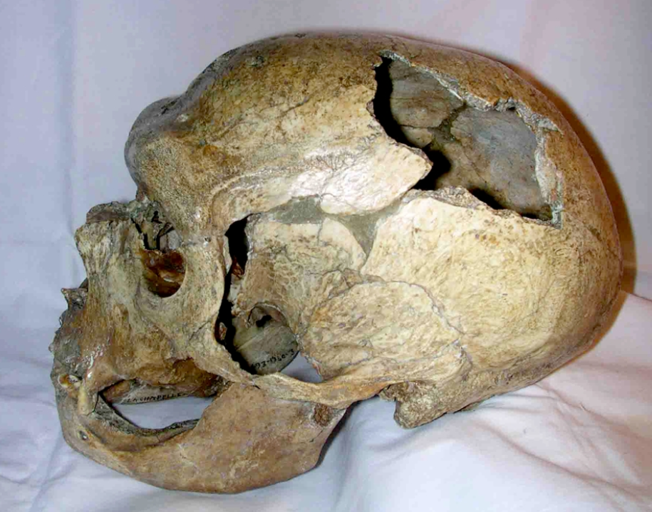
More Discoveries:
(1880) Šipka, Czech Republic
mandible of Neanderthal child
Mousterian tools & traces of hearths
(1886) Spy, Belgium
two nearly complete skeletons
found with Mousterian tools
(1899-1905) Krapina, Croatia
5,000+ items: bones, teeth, artefacts
(1908) La Chapelle-aux-Saints
nearly complete skeleton
Mousterian tools
extinct fauna
(1909) La Ferrassie
largest, most complete skull ever found (“classic” features)
leg & feet bones
(1915) La Quina
child‘s skull (7-8 years old)
(1920s-30s) Mt. Carmel, Israel
Tabun I, Amud, Jamal, & Skhul
first reconstruction of Neanderthal (1888)

Slide 14
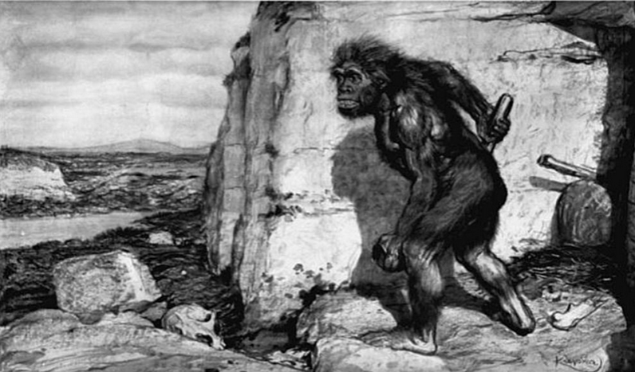
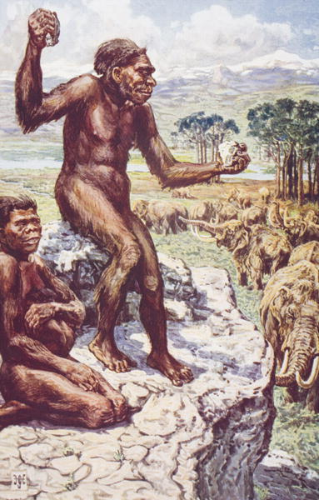
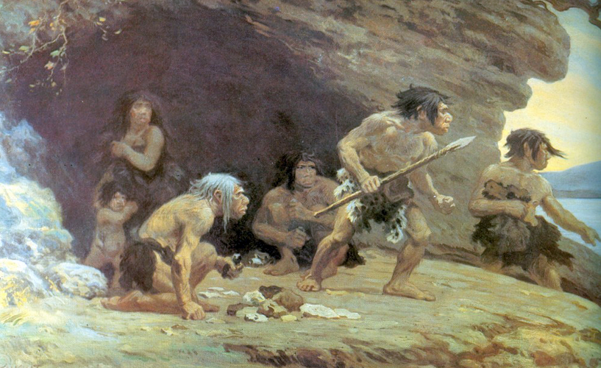
His thick neck sloped forward from the broad shoulders to support the massive flattened head, which protruded forward, so as to form an unbroken curve of neck and back….
The heavy overhanging eyebrow-ridges and retreating forehead, the great coarse face with its large eye sockets, broad nose and retreating chin, combined to complete the picture of unattractiveness…..
Elliot Smith, The Evolution of Man (1924)
Marcellin Boule (1861-1942)
"the old man of La Chapelle"(1908)
primitive, dim-witted brutes
no direct relation to modern humans
“It appears that Boule's own preconceptions about early humans, and his rejection of the hypothesis that Neanderthals were the ancestors of modern humans, led him to reconstruct a stooped, brutish creature, effectively placing Neanderthals on a side branch of the human evolutionary tree.”
The Illustrated London News (1909)
illustration by Frantisek Kupka
These Mousterians are also called Neandertalers. Until quite recently it was supposed that they were true men like ourselves. But now we begin to realise that they were different, so different that it is impossible that they can be very close relations of ours. They walked or shambled along with a peculiar slouch, they could not turn their heads up to the sky… Probably he did not talk at all. He could not hold a pin between his finger and thumb. The more we learn about this beast-man the stranger he becomes to us…
H. G. Wells, The Grisly Folk (1927)
Le Moustier Neanderthals (1920)
illustration by Charles Knight

Slide 15
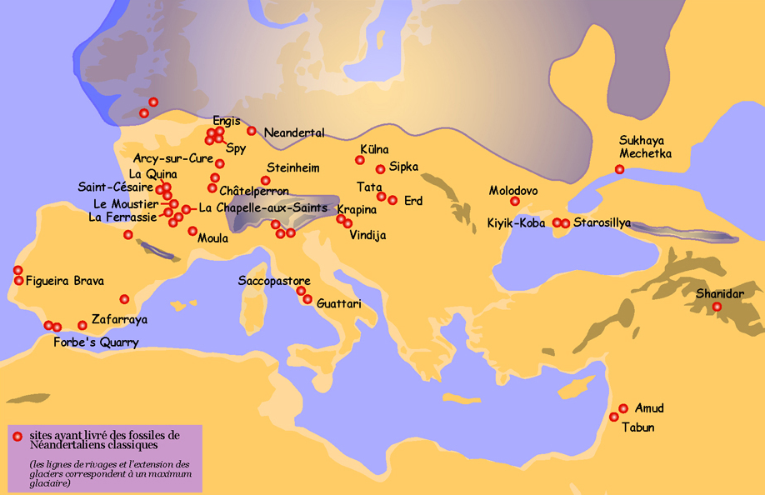
Neanderthal Finds

Slide 16
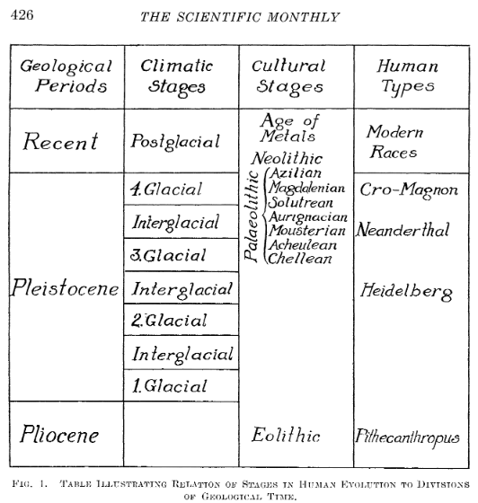
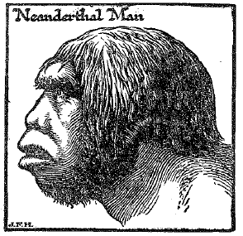
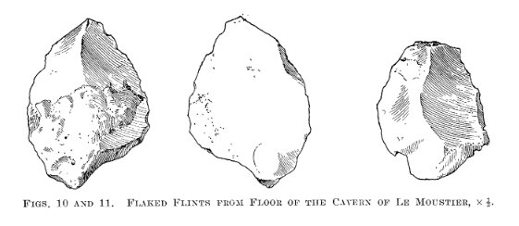
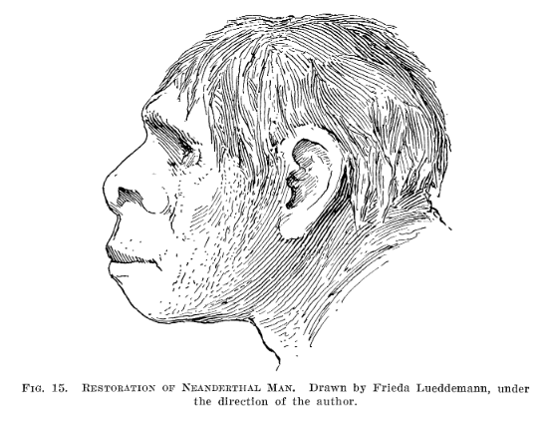
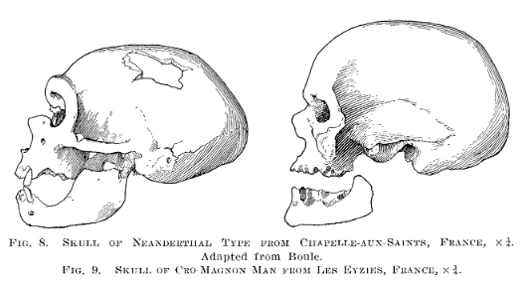
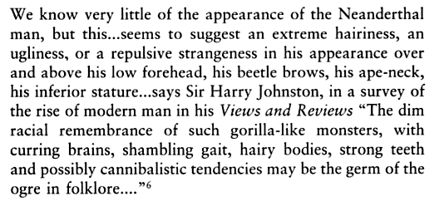
Scientific Monthly (May 1920)

Slide 17
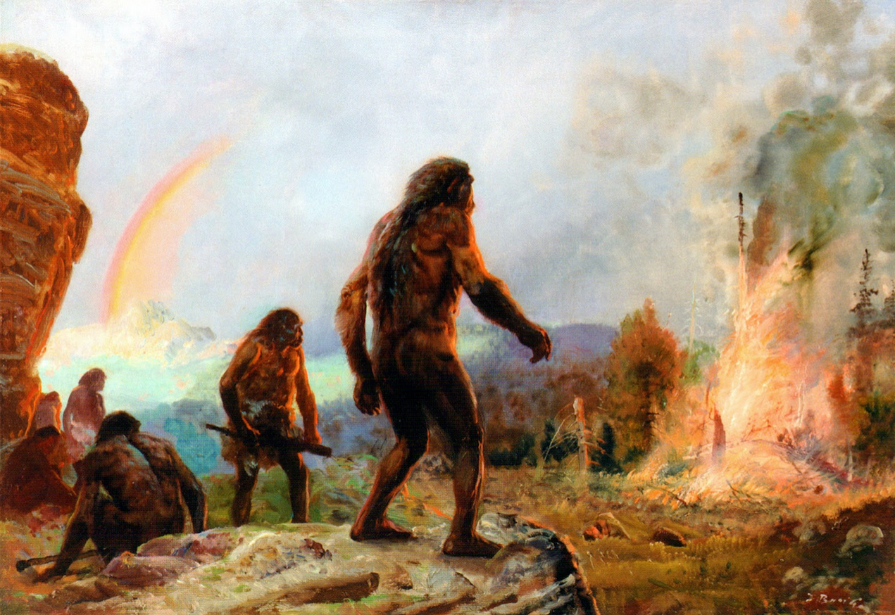
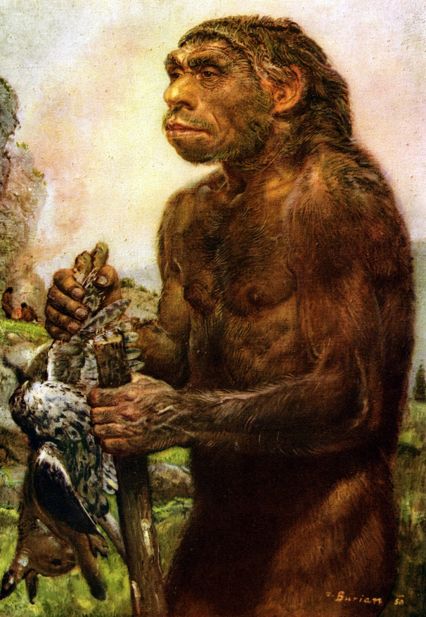
Zdeněk Burian (1905-1981)

Slide 18
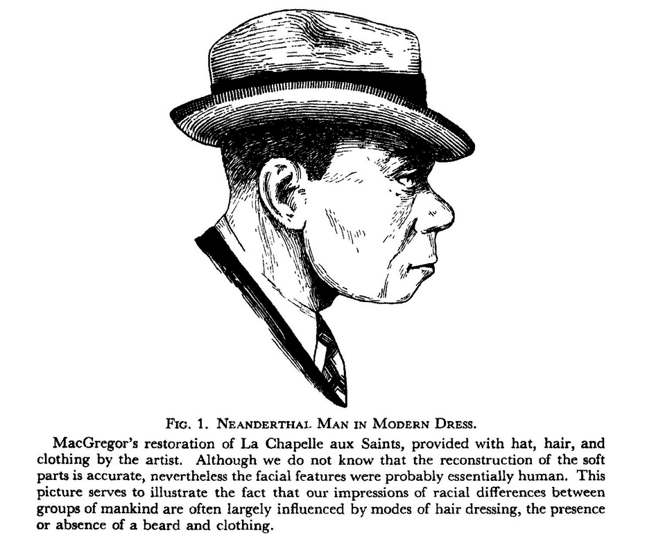
The Races of Europe (1939) by Carleton Coon

Slide 19
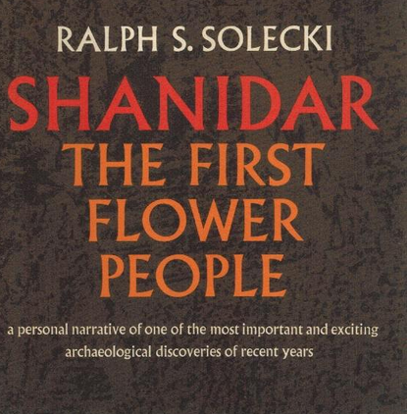
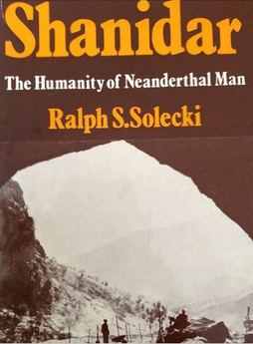
The evidence has undergone a complete change while the argument has remained substantially the same… The aim was to prove that these non-modern hominids could not be the forerunners of truly modern men.
C. Loring Brace (1964)
Emphasis on evidence of Neanderthal culture & behavior
Post WWII:
Neanderthal “renaissance”
Neanderthals as more like us
(1957-1961) Shanidar
ten individuals (“flower burial”)
“there is no valid reason for the assumption that the posture of Neanderthal man…. differed significantly from that of present-day men… provided that he were bathed, shaved, and dressed in modern clothing—it is doubtful whether he would attract any more attention than some of his other denizens.” (Straus & Cave, 1957)
Someone in the last Ice Age must have ranged the mountainside in the mournful task of collecting flowers for the dead… It seems logical to us today that pretty things like flowers should be placed with the cherished dead, but to find flowers in a Neanderthal burial that took place about 60,000 years ago is another matter.
Ralph Solecki (1971)
Neanderthals were just like us

Slide 20
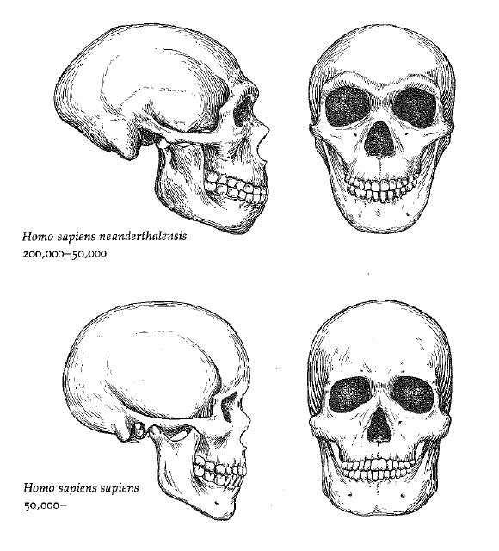
Recent Developments:
technology?
stone tools (Levallois)
glue-pitch (birch bark)
interbreeding? [18 min]
non-African humans (1-4% DNA)
Debates:
Art & Ritual
manganese dioxide crayons? (France)
cut marks on crow & raptor bones? (Gibraltar)
seashells with hematite traces (Spain)
intentional burial with grave goods? (Spain)
Language/Speech
FOXP2 gene
Extinction
main causes? sudden or gradual? [41:30]

Slide 21
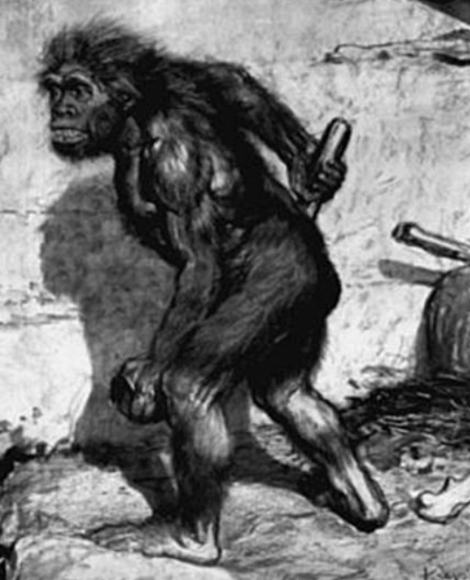
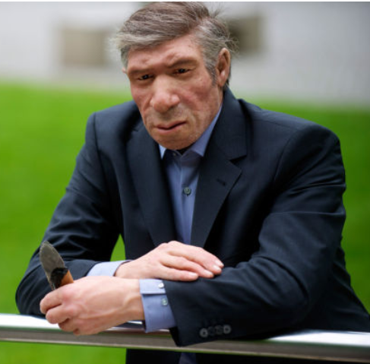

Slide 22
