Slide 1
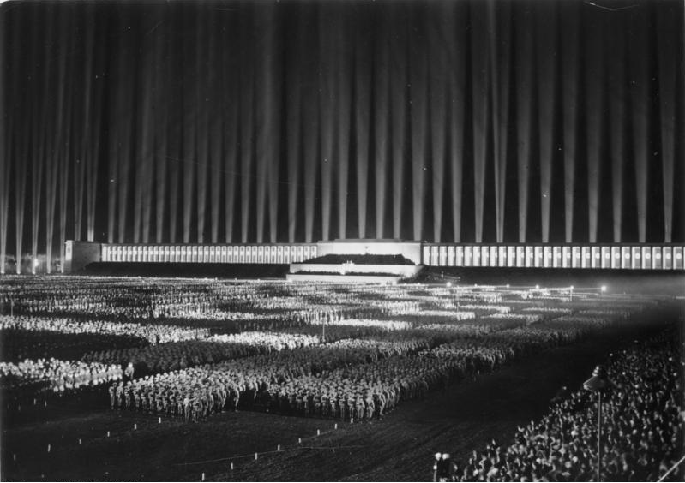
In the Footsteps of Hitler:
A Walking Tour of Nuremberg
April 23, 2015
Robinson Yost (Social Sciences)
Laura Yost (Distance Learning)

Slide 2
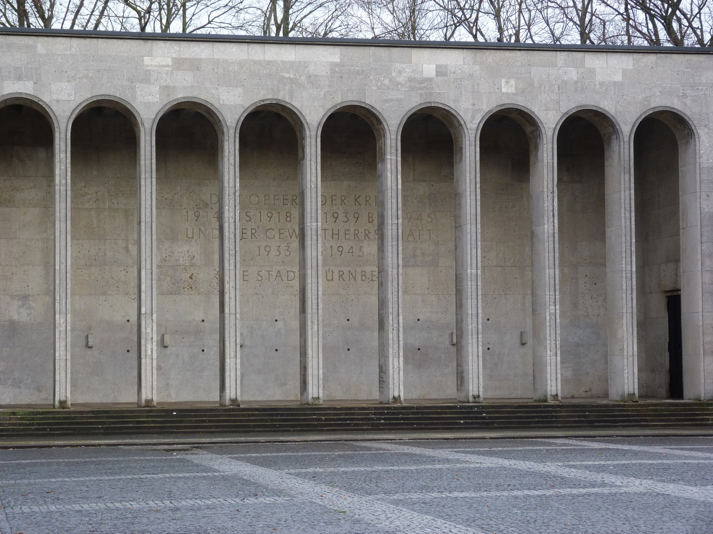
The broad masses of a population are more amenable to the appeal of rhetoric than to any other force.
All propaganda has to be popular and has to accommodate itself to the comprehension of the least intelligent of those whom it seeks to reach.
I use emotion for the many and reserve reason for the few.

Slide 3
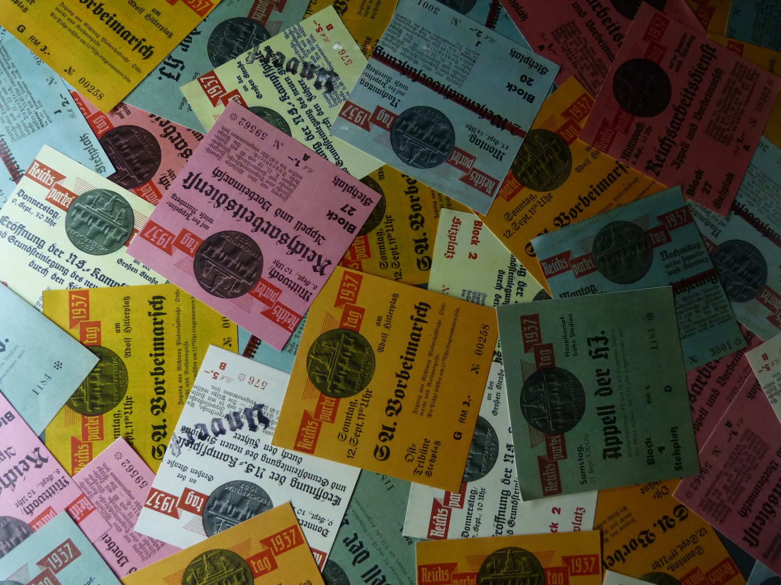
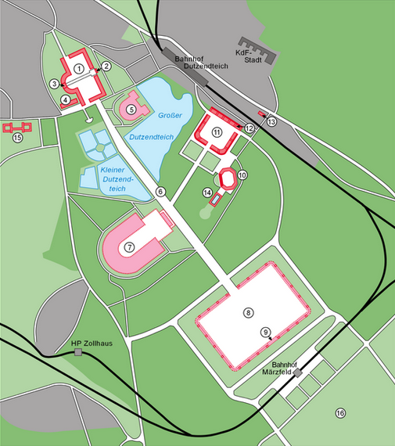
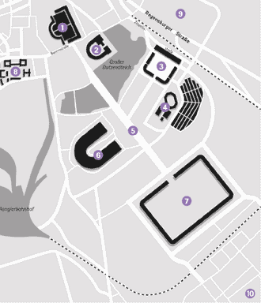
“The City of Nazi Party Rallies.”
Luitpold Arena
Congress Hall
Zeppelin Field
Municipal Stadium
The Great Road
German Stadium
March Field
SS Barracks
KdF-Town
Camp Zone

Slide 4
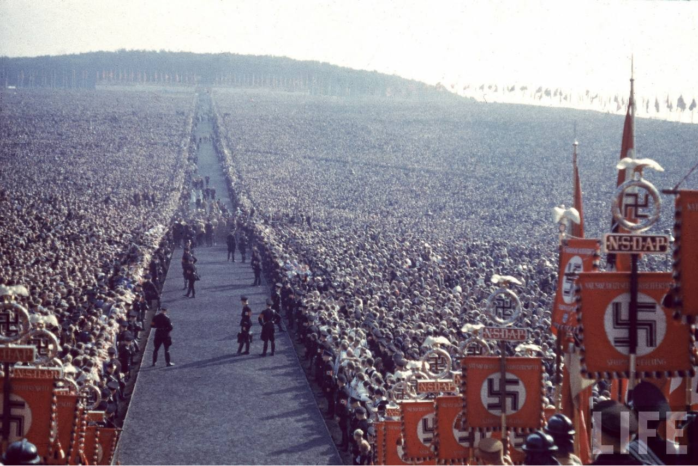
NSDAP Party Meetings (1923-1939)
1st Party Congress, Munich, (Jan. 27, 1923)
German Day Rally, Nuremberg (Sept. 1-2, 1923)
2nd, Weimar (July 3-4, 1926)
3rd, Nuremberg (August 19-21, 1927)
4th, Nuremberg (August 1-4, 1929)
Reichsparteitag (Reich Party Congresses)
5th, Nuremberg (Aug. 31-Sept. 3, 1933)
6th, Nuremberg (Sept. 5-10, 1934)
7th, Nuremberg (Sept. 10-16, 1935)
8th, Nuremberg (Sept. 8-14, 1936)
9th, Nuremberg (Sept. 6-13, 1937)
10th, Nuremberg (Sept. 5-12, 1938)
11th, Nuremberg (Sept. 2-11, 1939 planned)

Slide 5
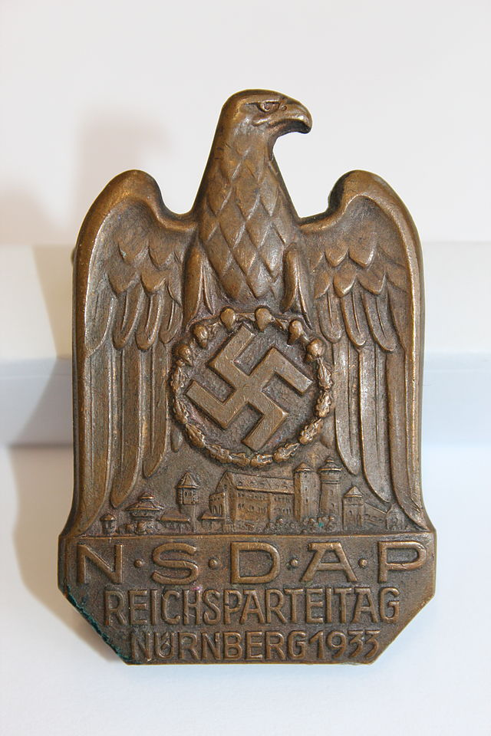
NSDAP Party Meetings (1933-1939)
5th (1933) “Victory”
6th (1934) “Unity & Strength”
7th (1935) “Liberty”
8th (1936) “Honor”
9th (1937) “Labor”
10th (1938) “Greater Germany”
11th (1939) “Peace”

Slide 6
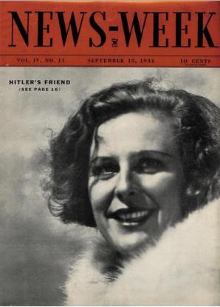
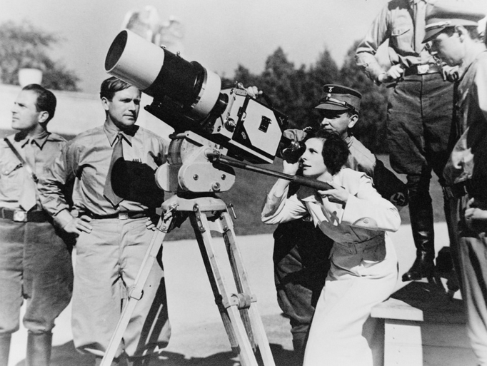
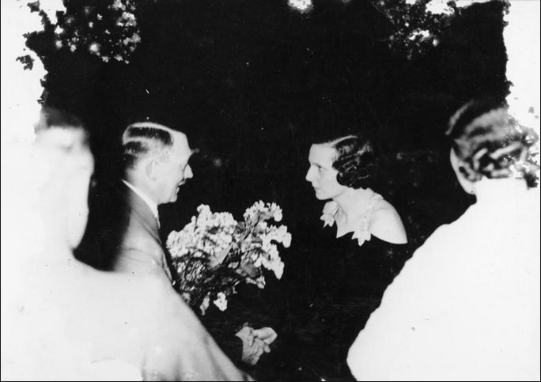
Leni Riefenstahl (1902-2003)
(1932) attends Hitler’s public speech
(1932) directs The Blue Light & reads Mein Kampf
(1933) Victory of Faith
(1934) Triumph of the Will
(1935) Day of Freedom
(1936) Olympia: Berlin Olympic Games

Slide 7
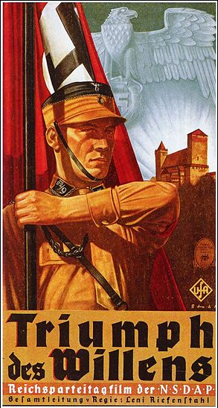
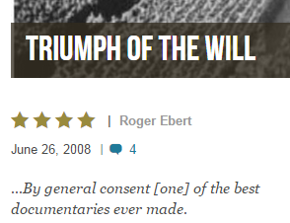
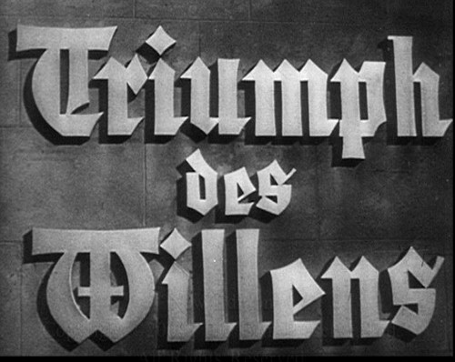
“a love story with Hitler” & “a unilateral commitment to Hitler”

Slide 8
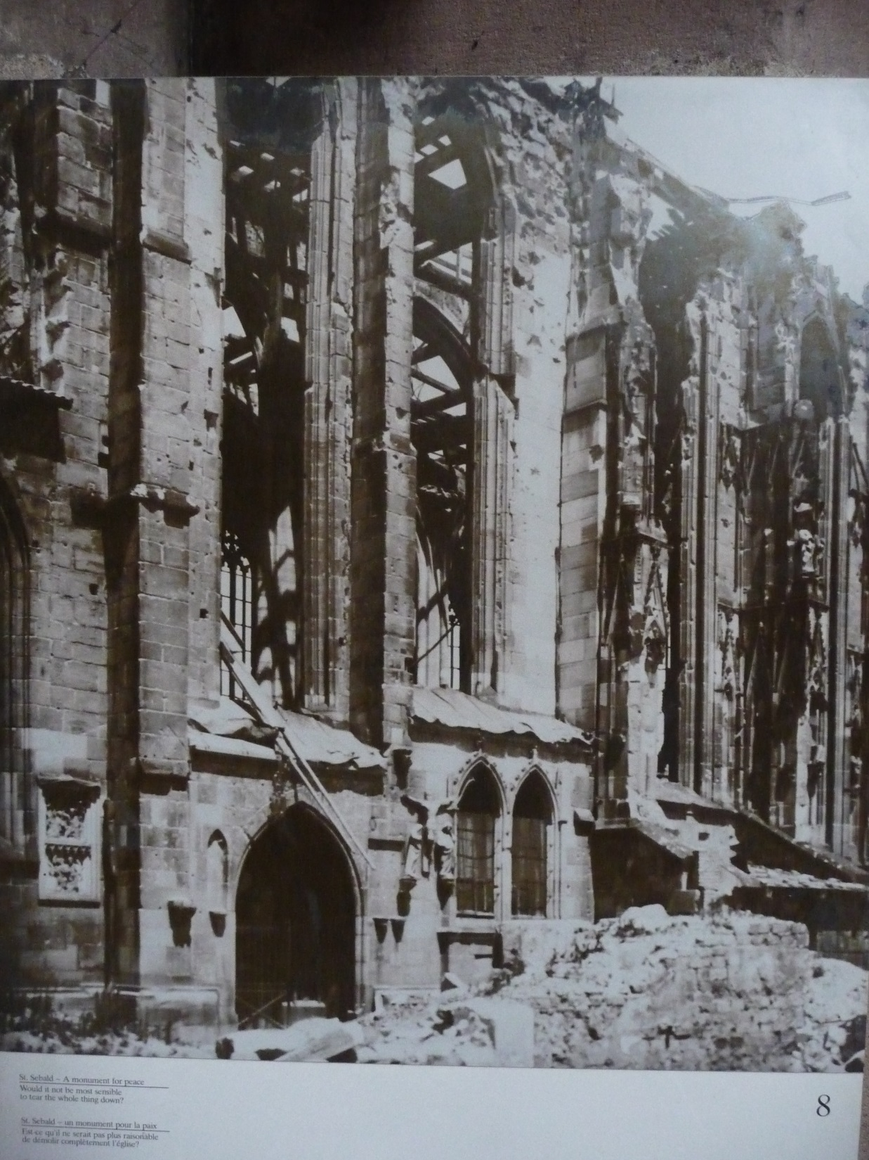
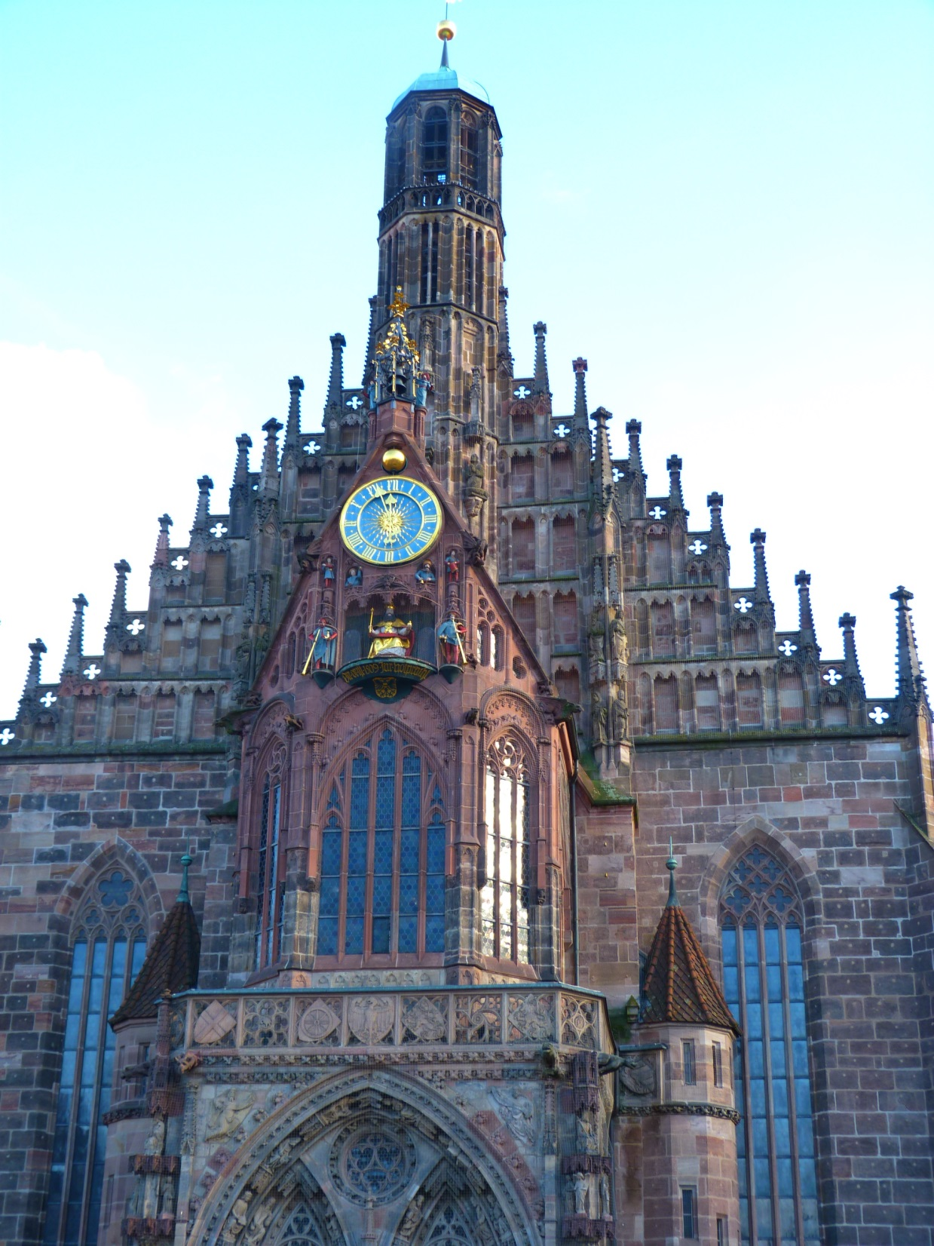
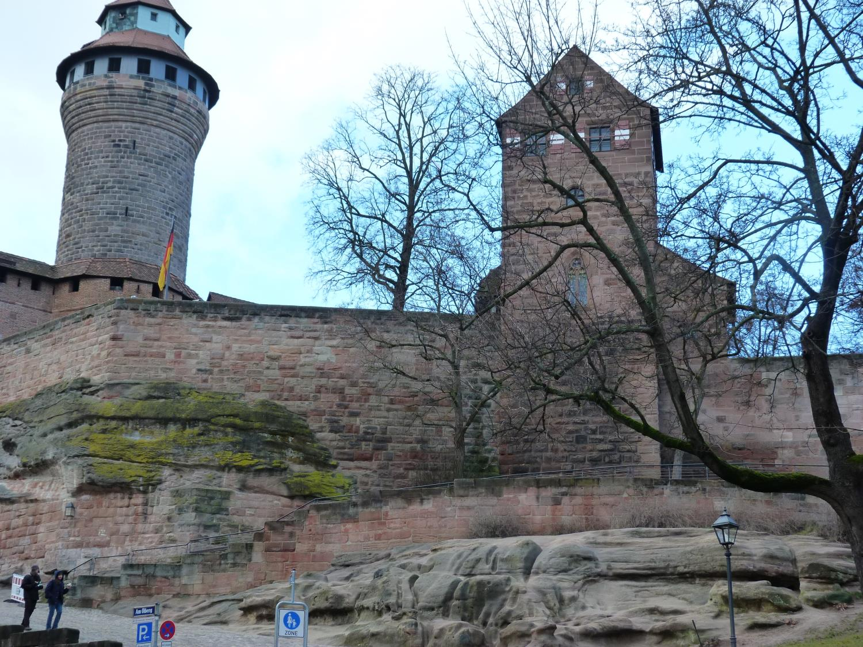

Slide 9
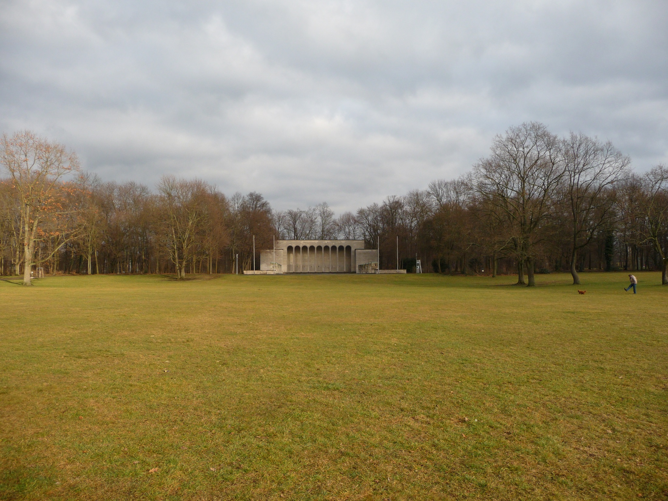
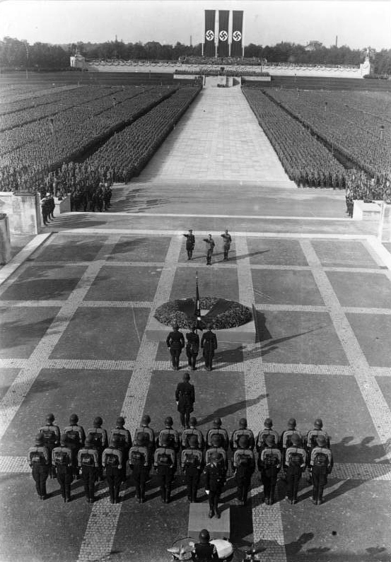
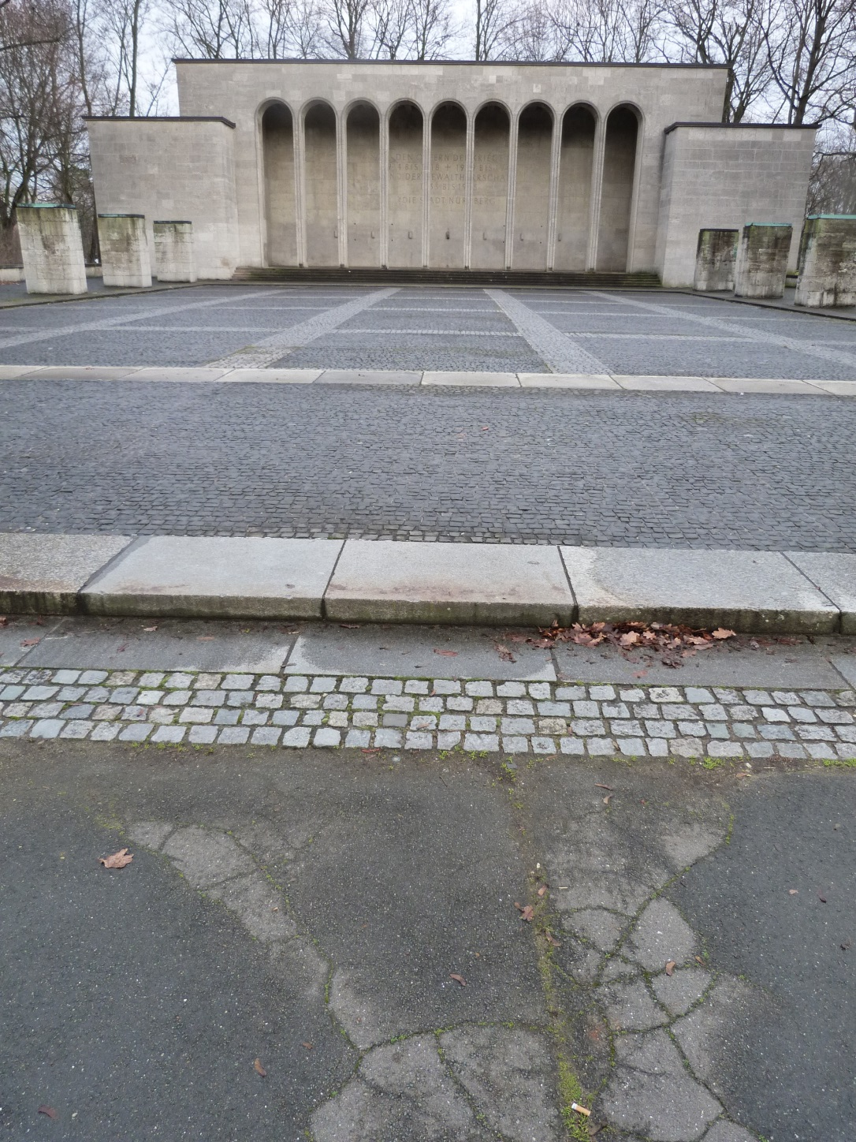

Slide 10
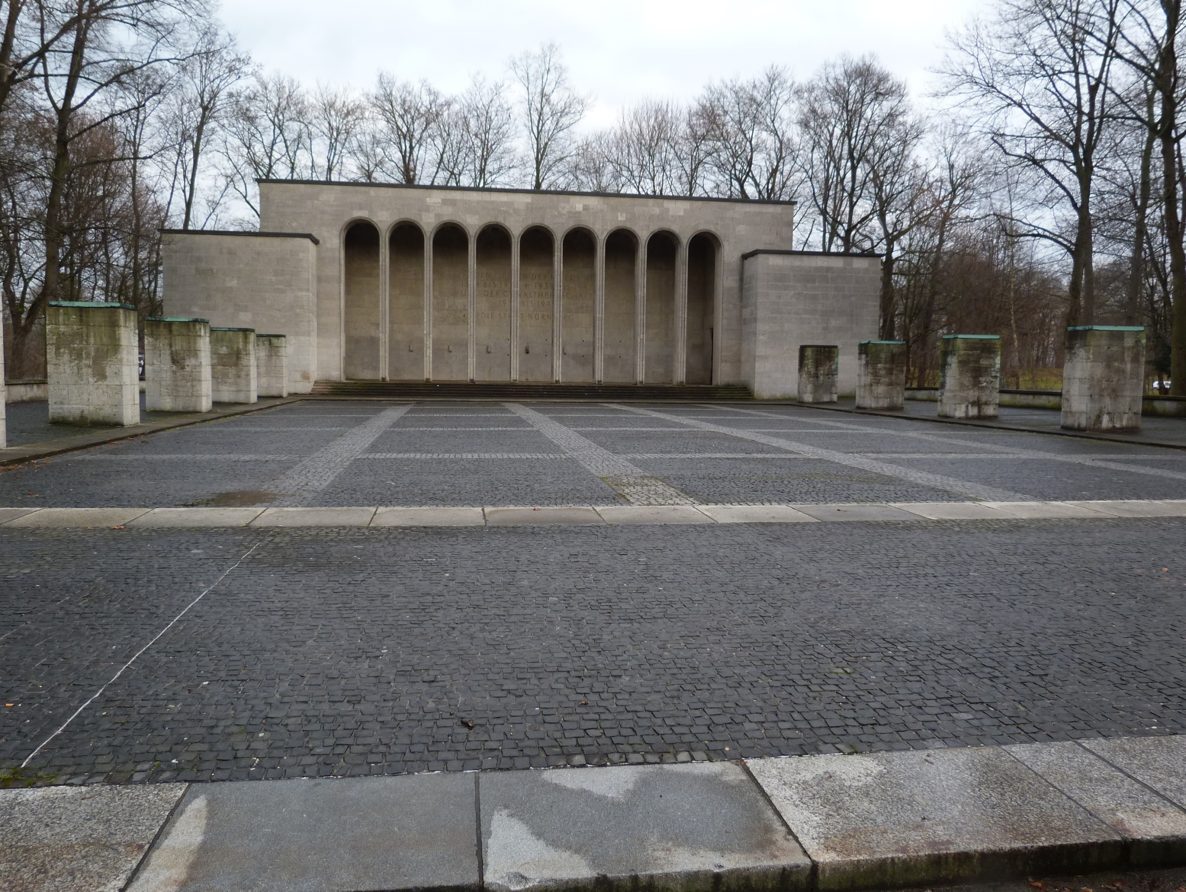
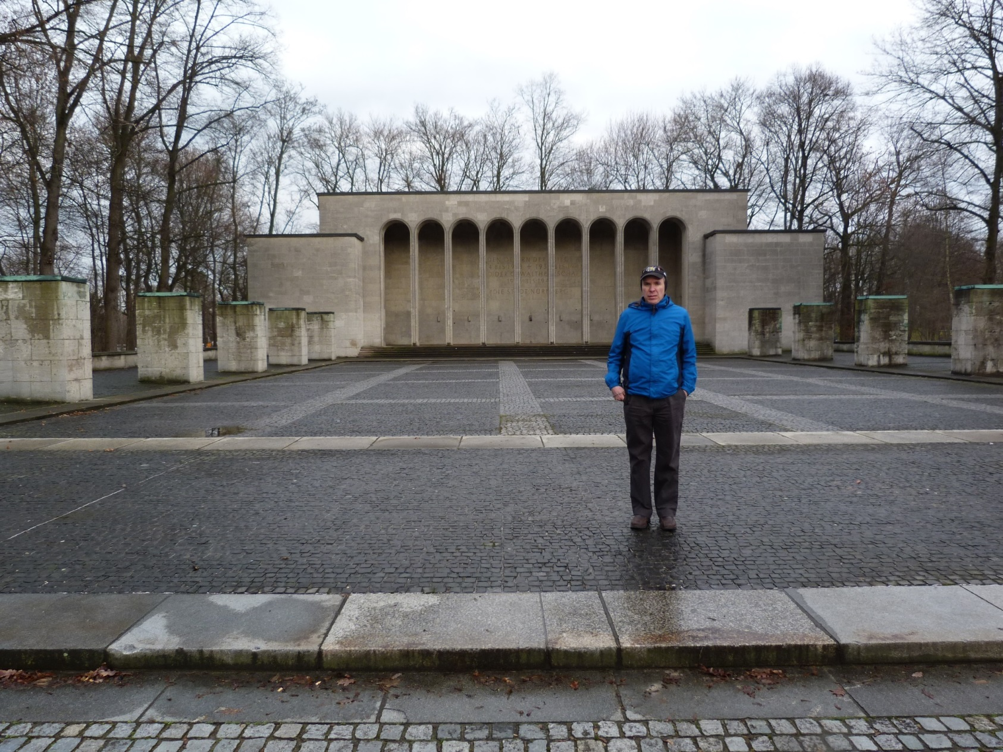

Slide 11
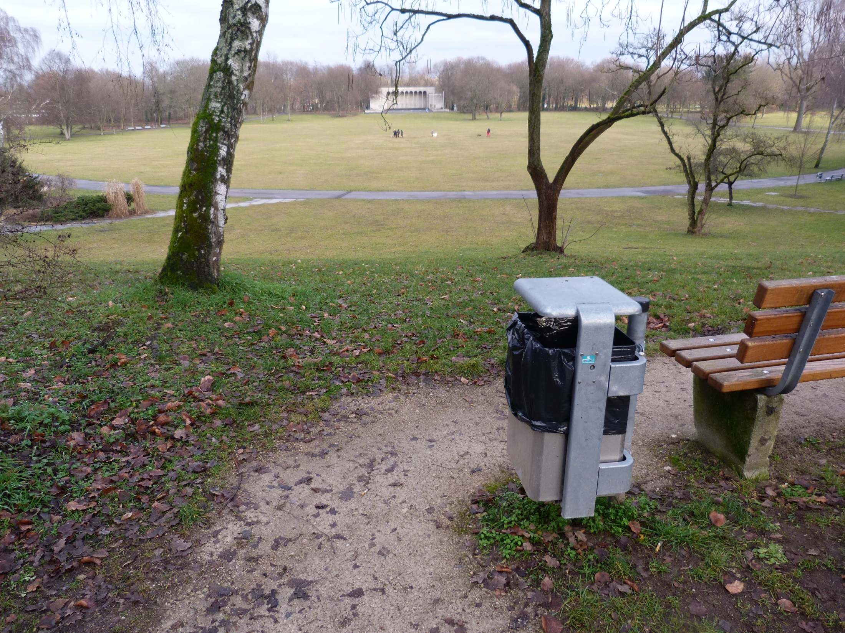
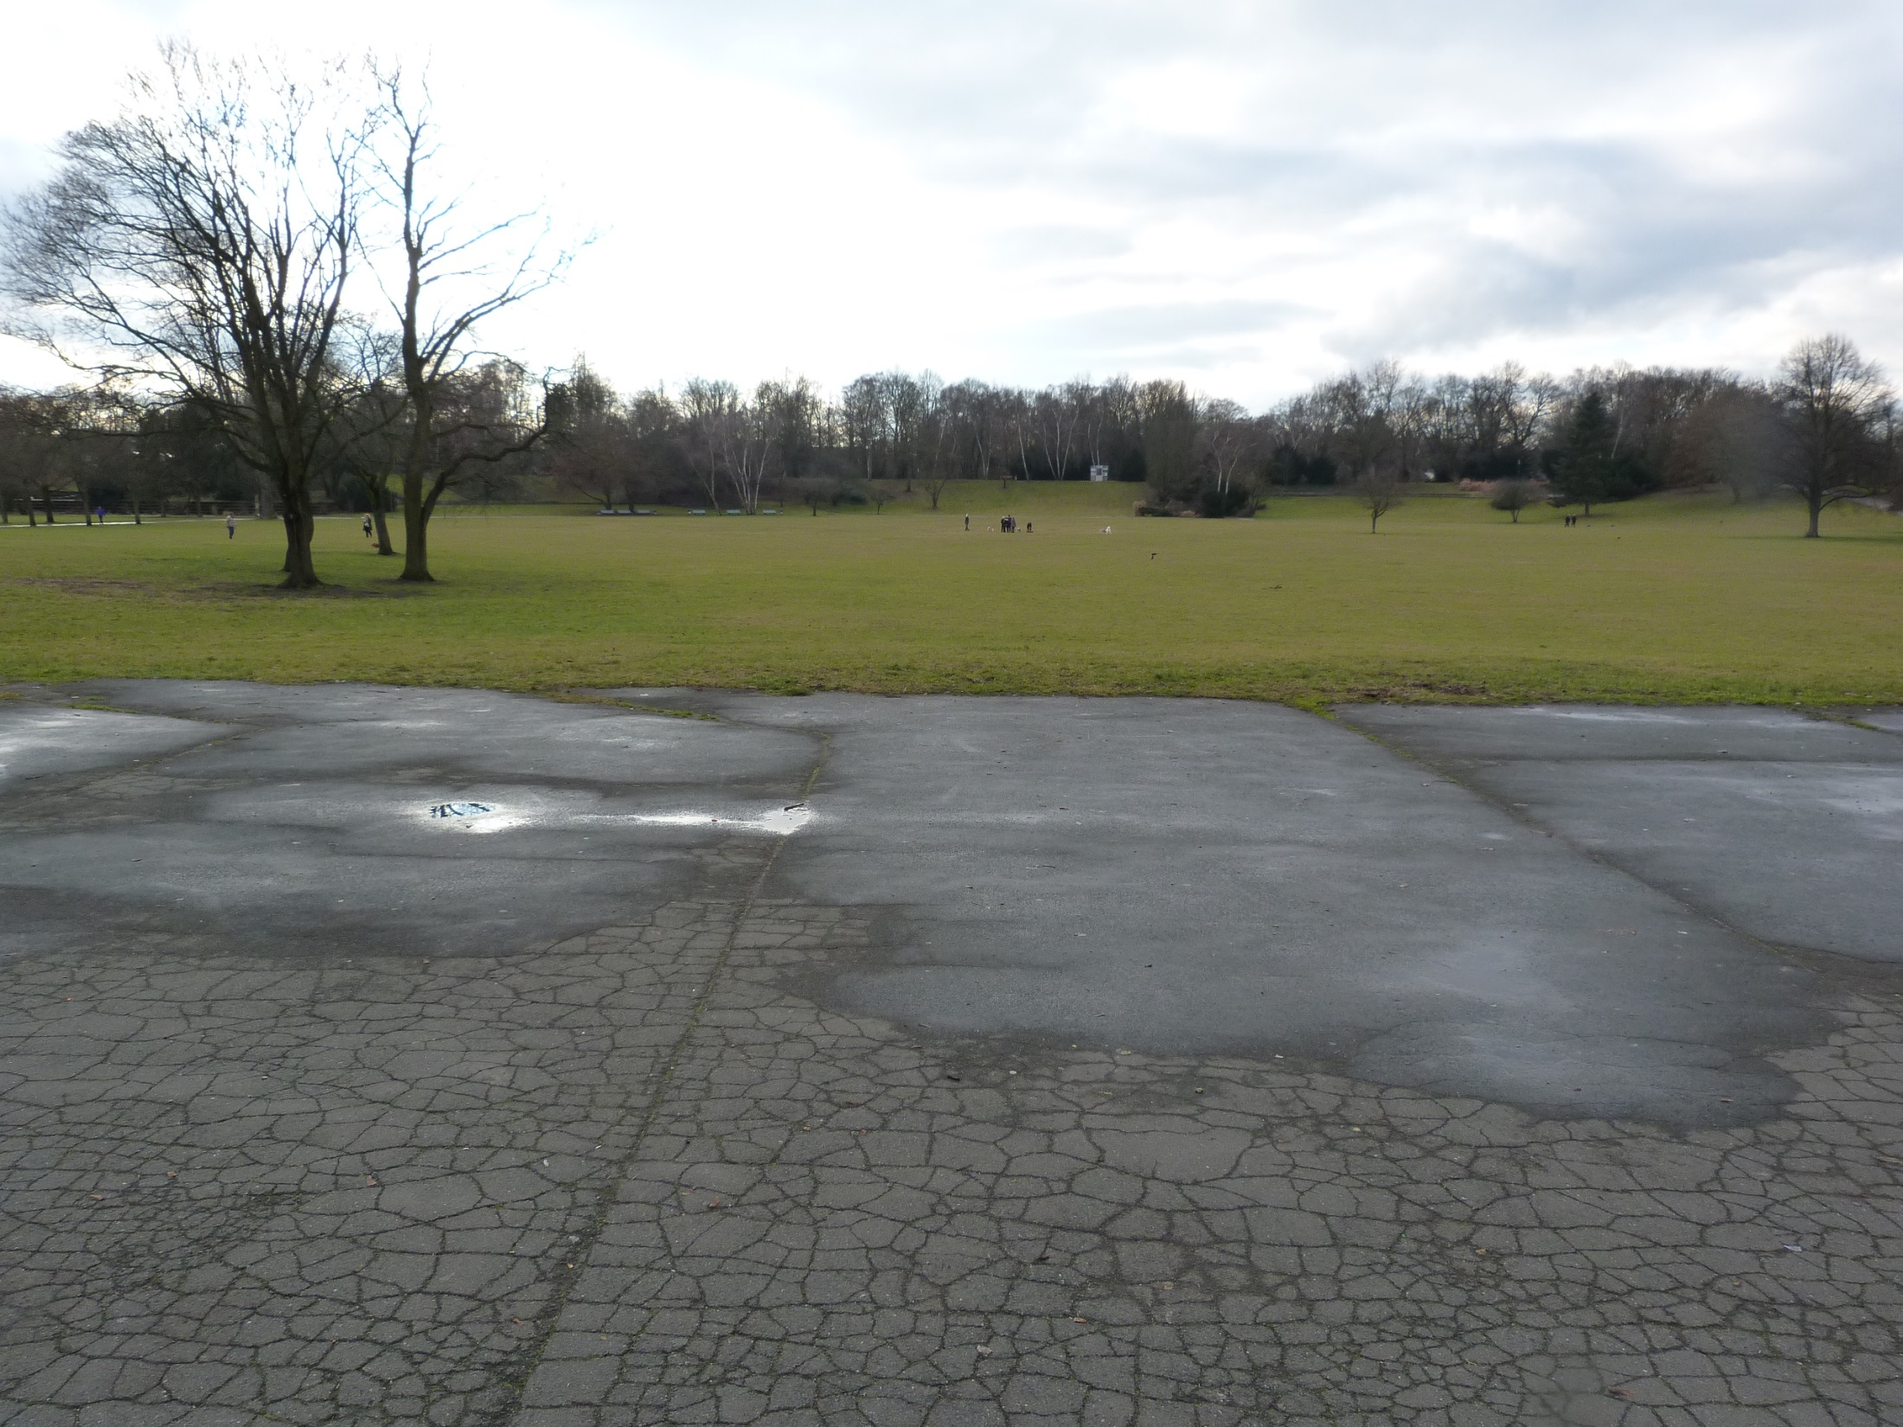
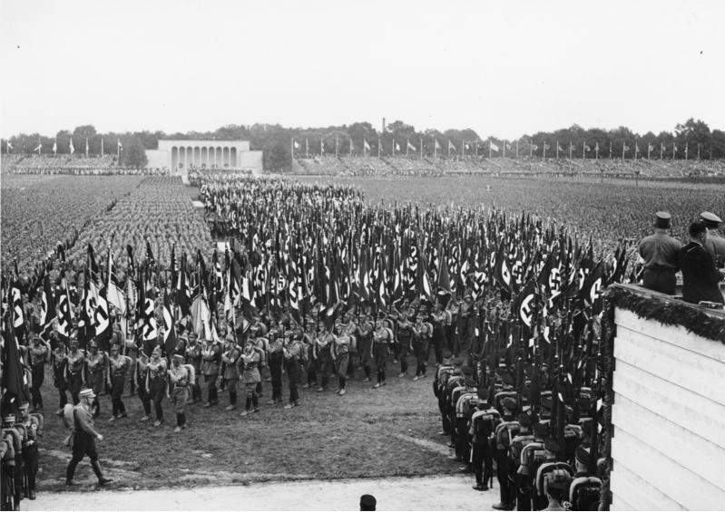

Slide 12
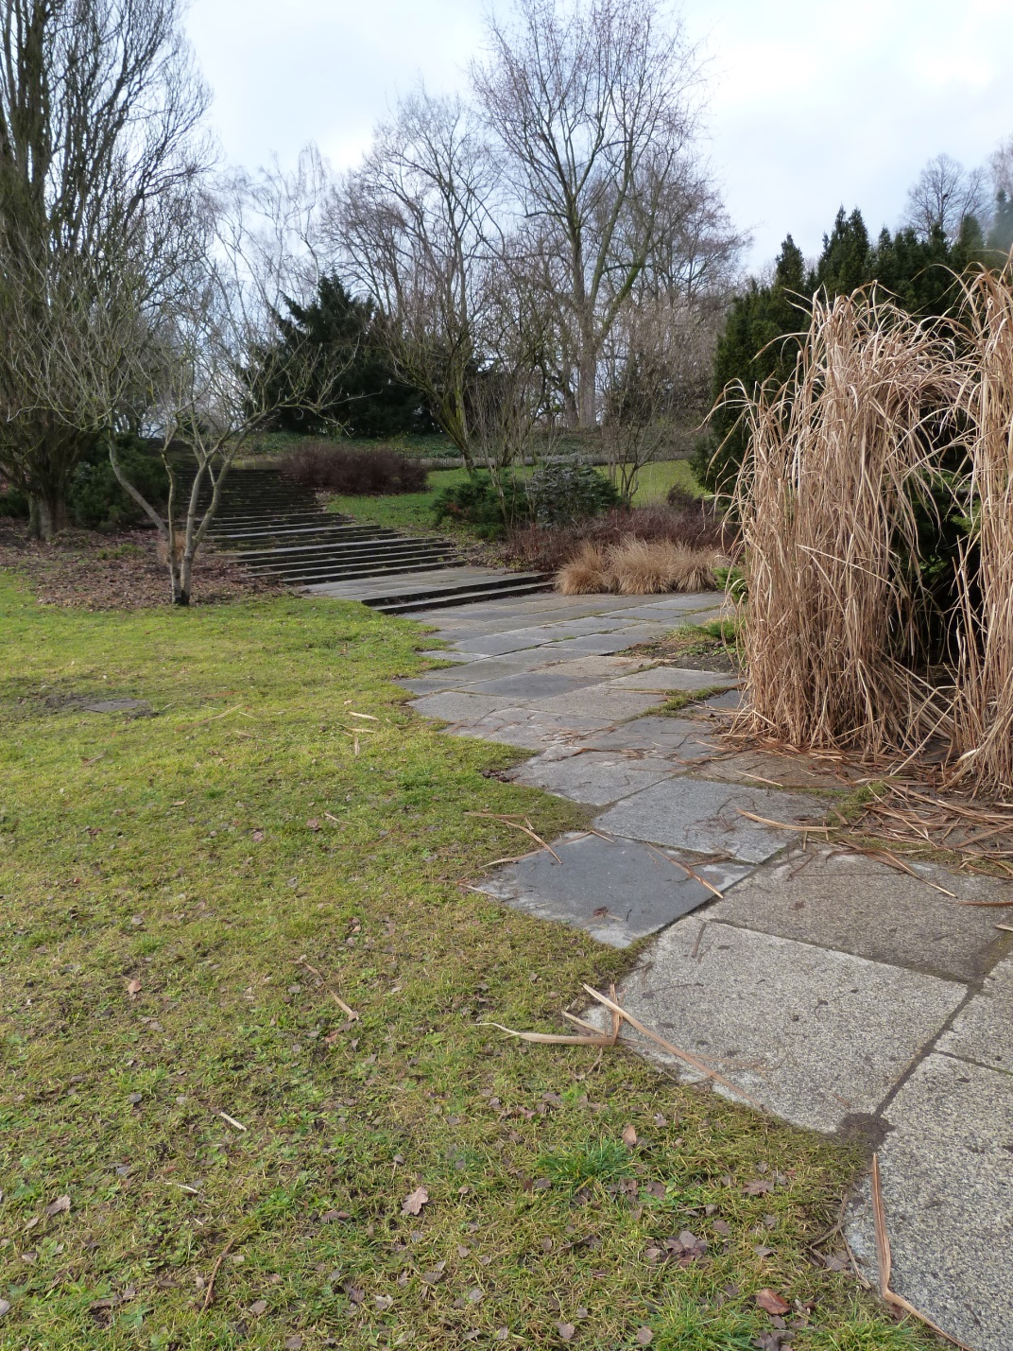
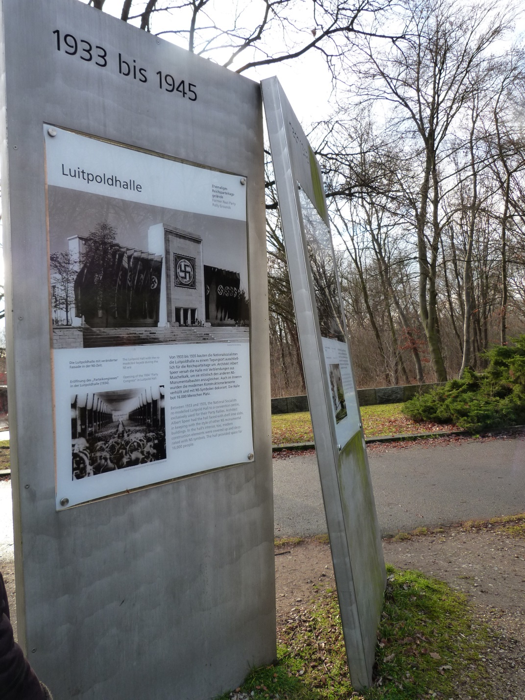
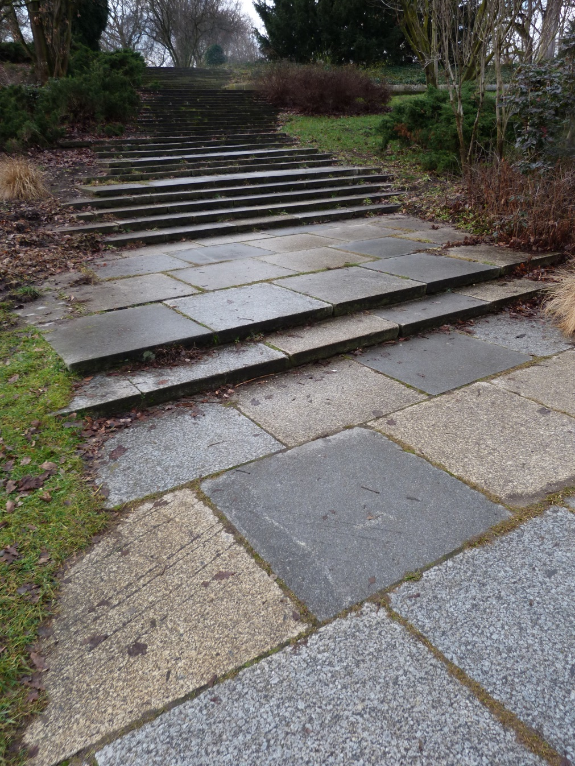

Slide 13
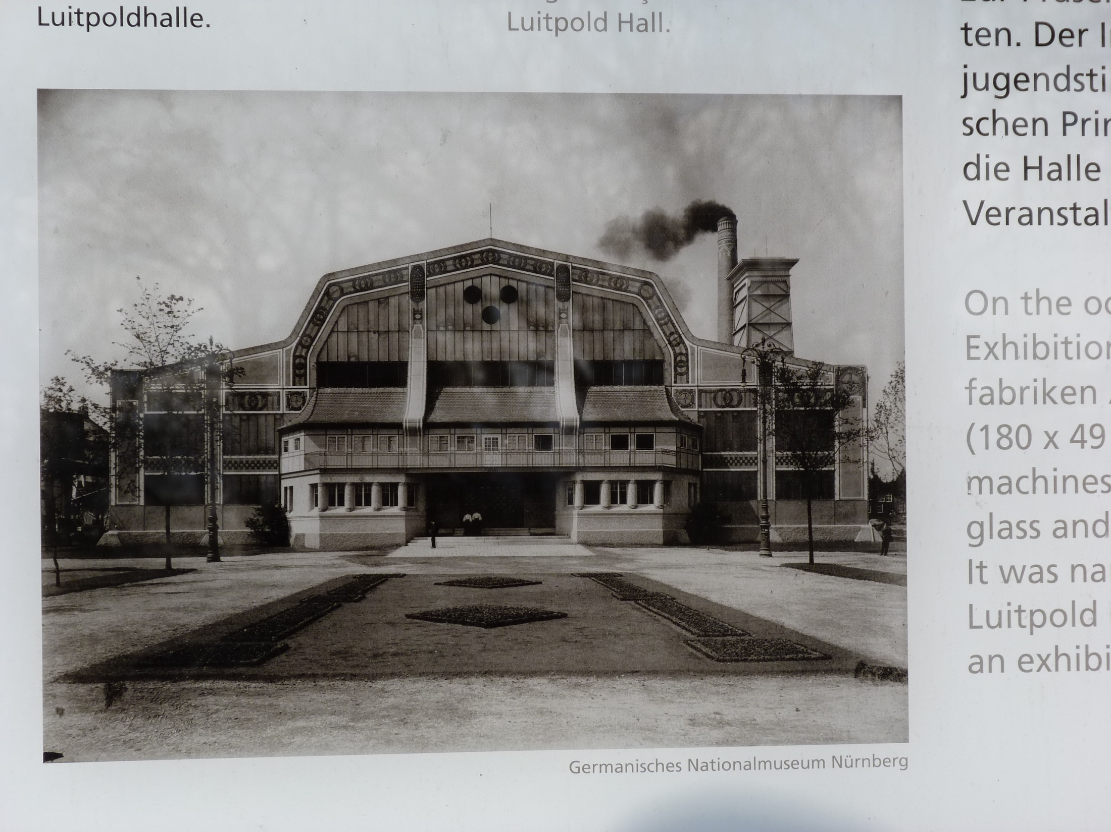

Slide 14
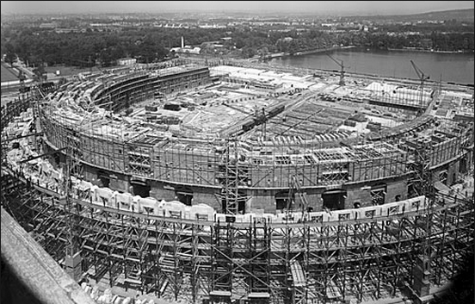
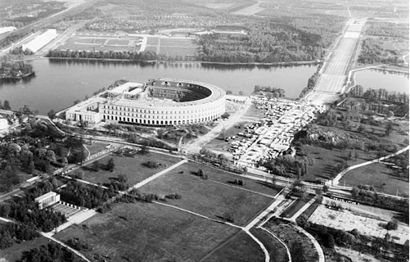
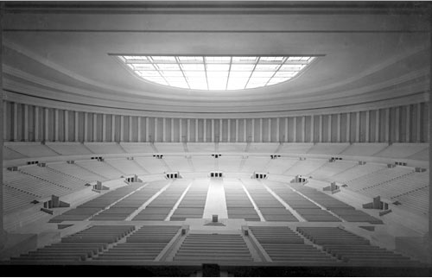
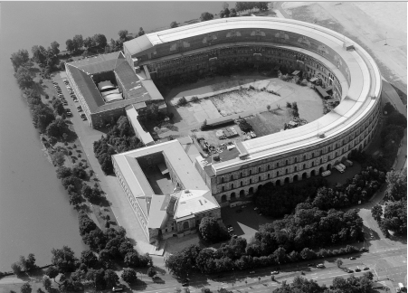
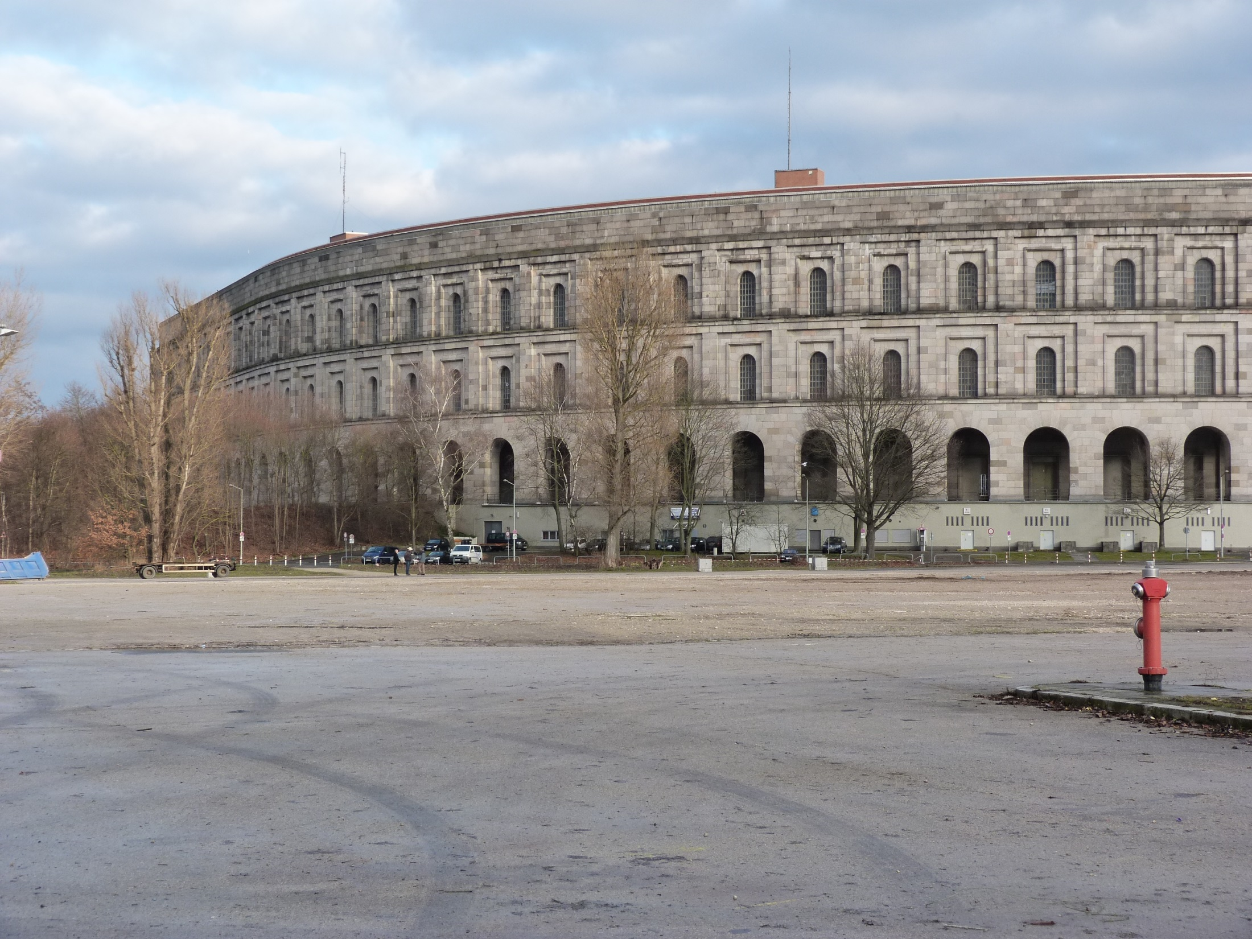
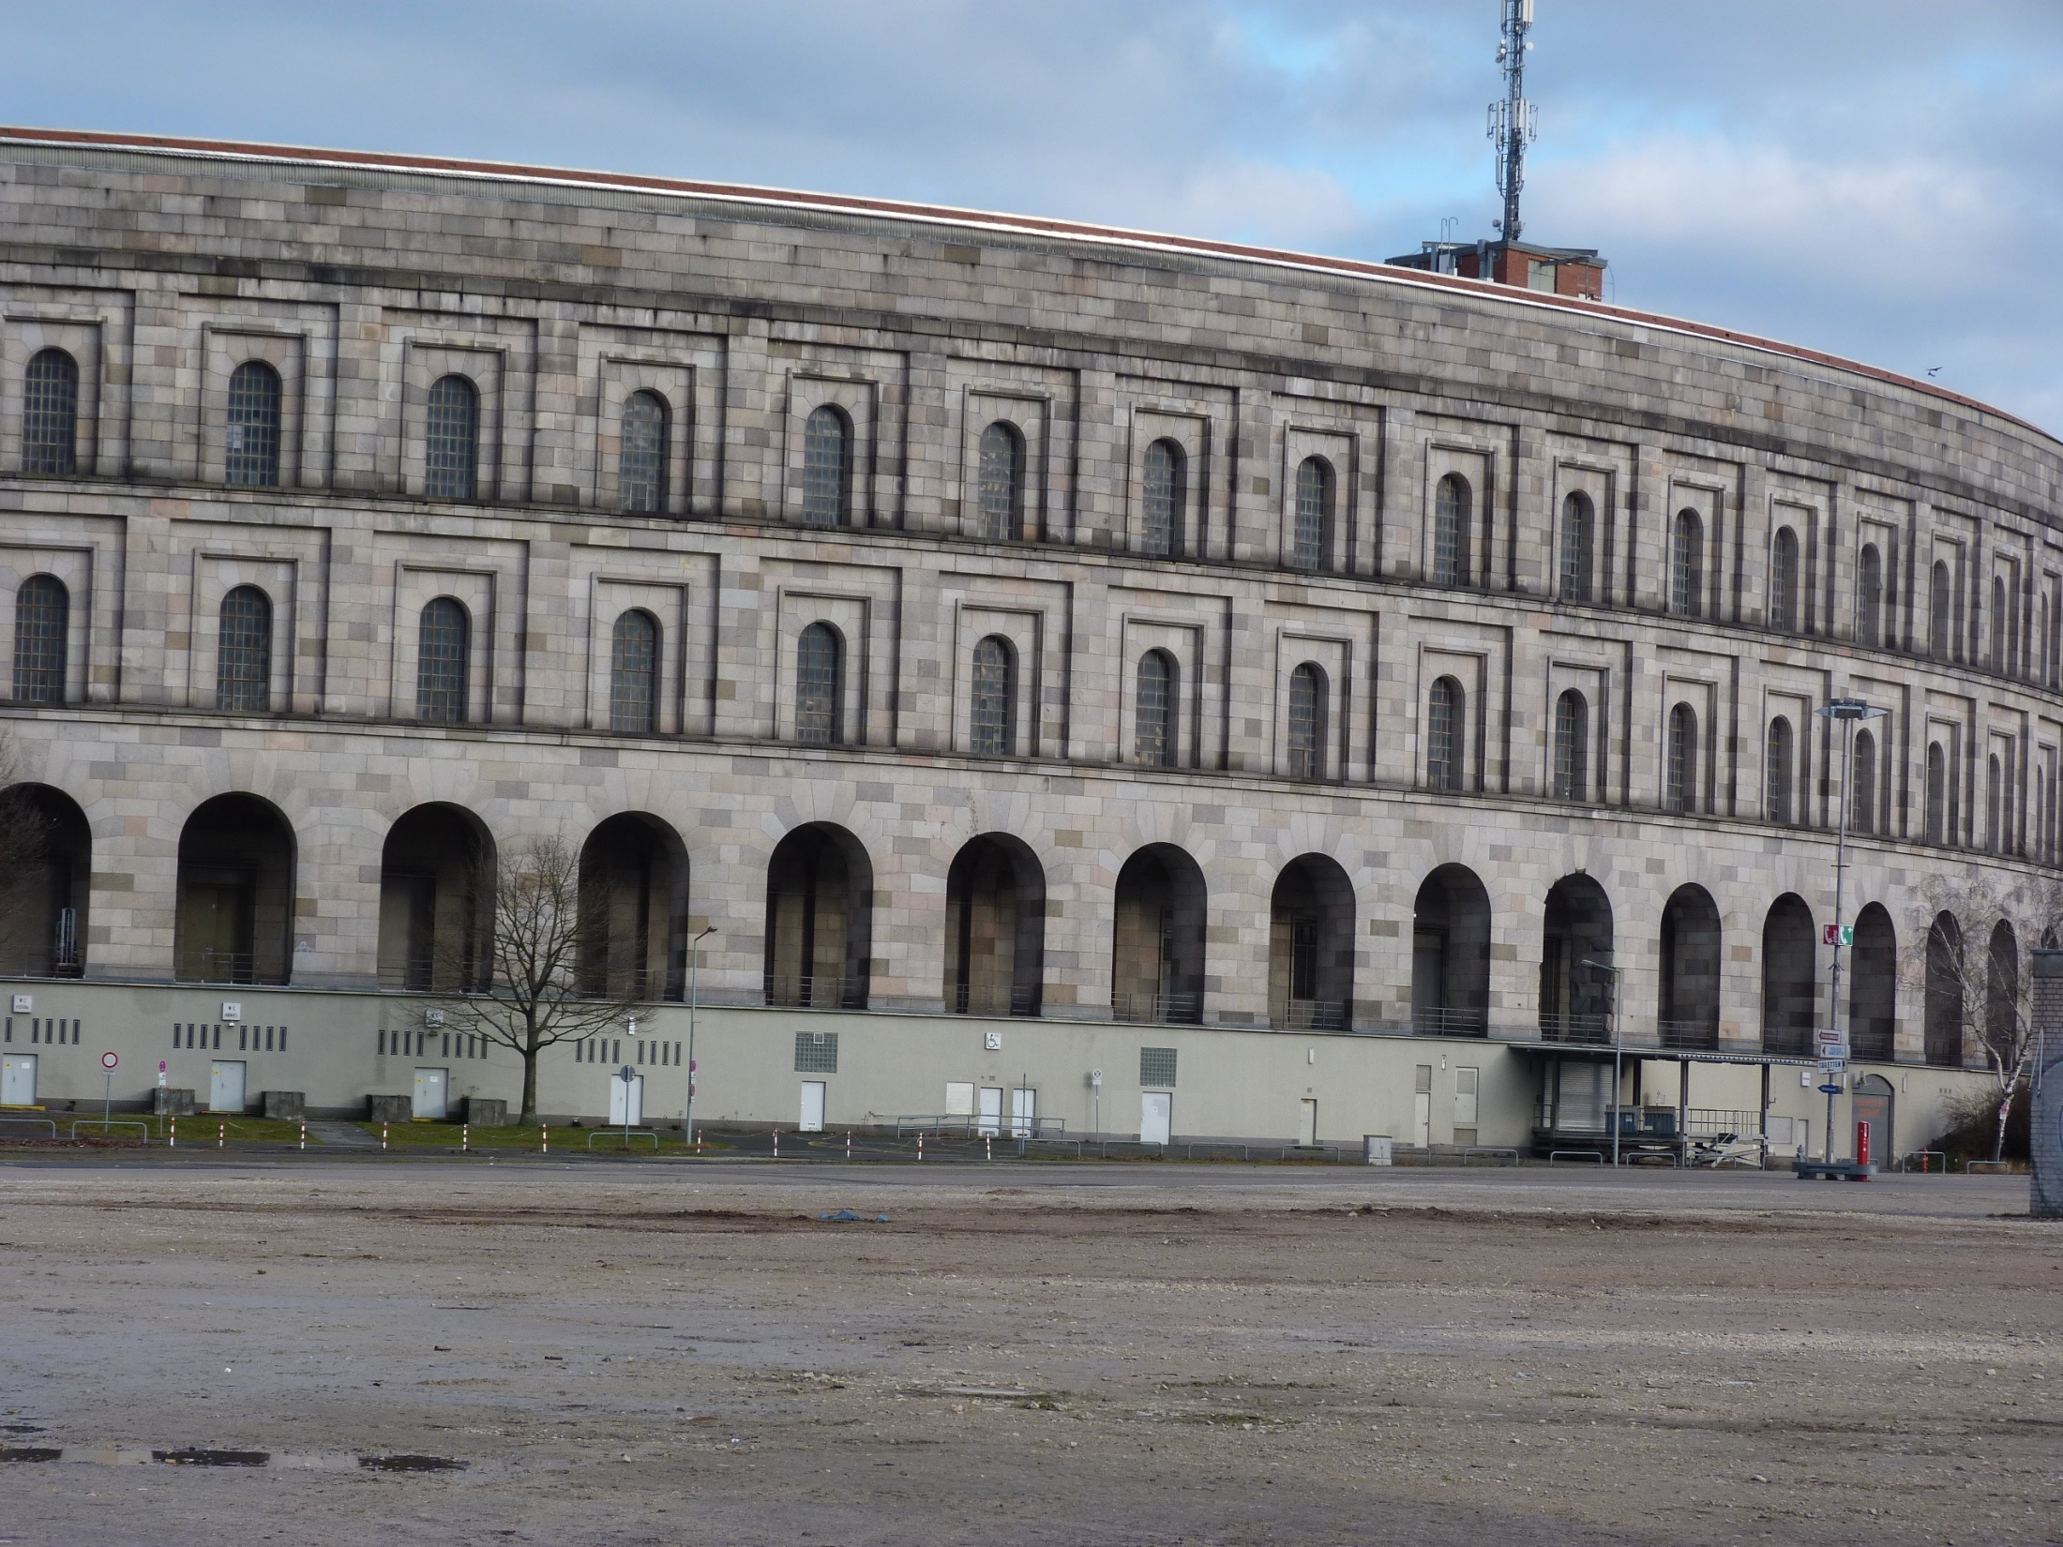

Slide 15
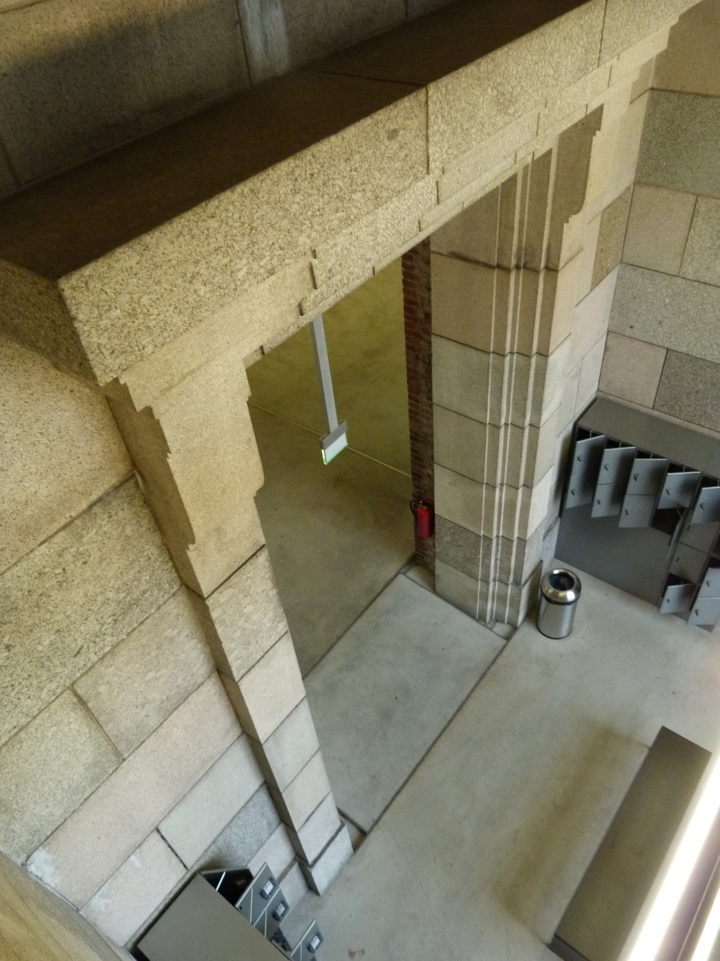
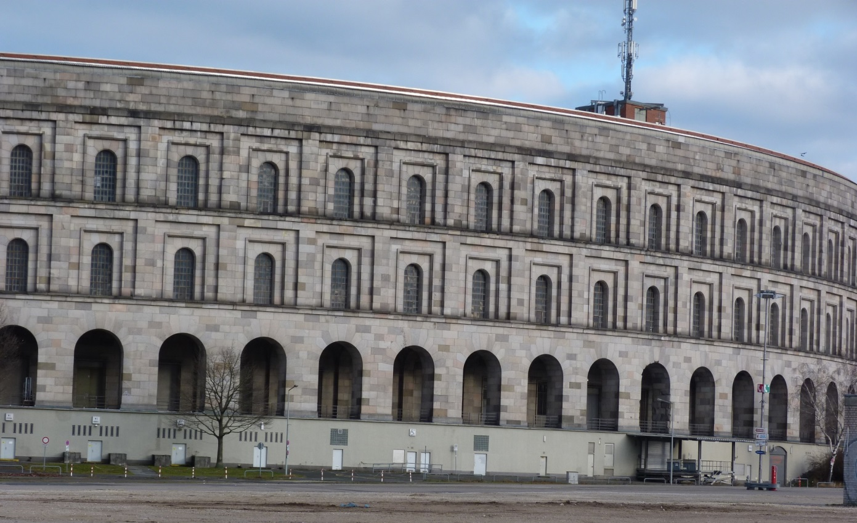

Slide 16
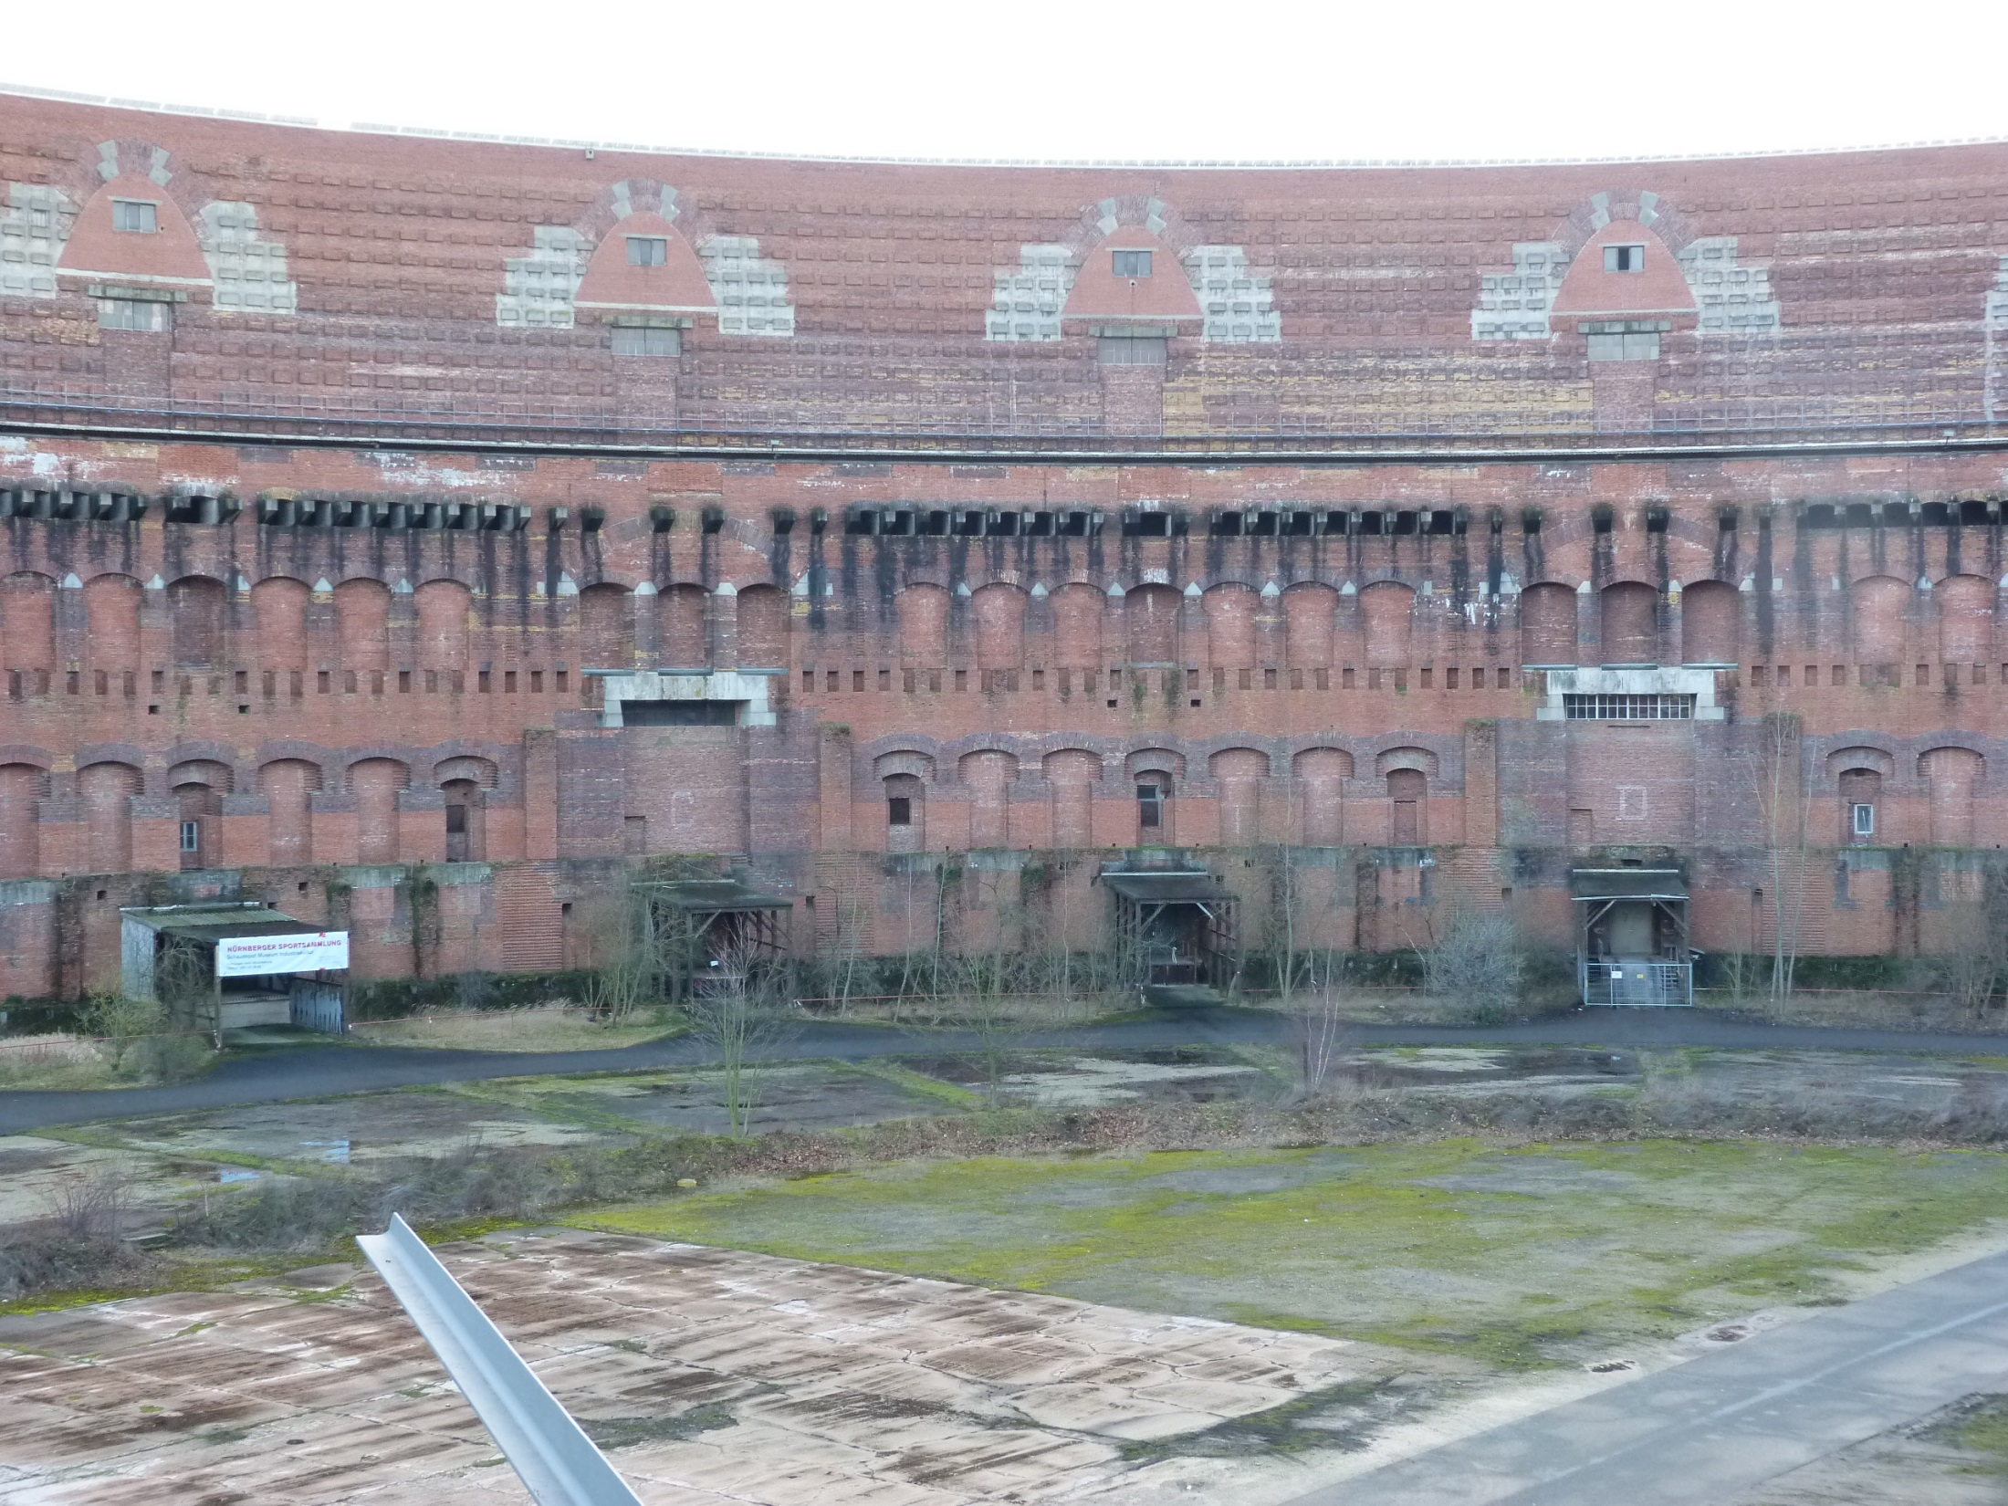
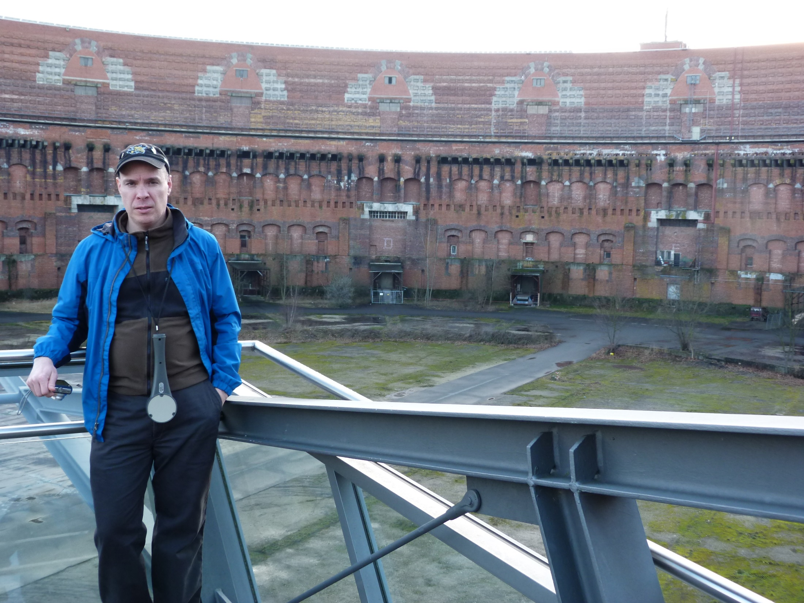

Slide 17
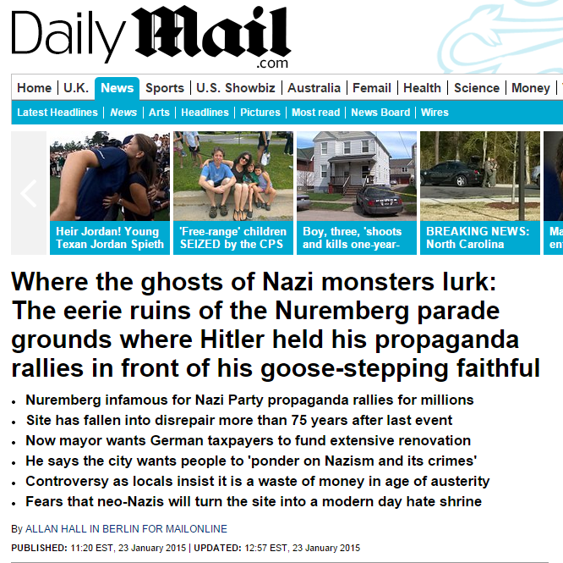

Slide 18
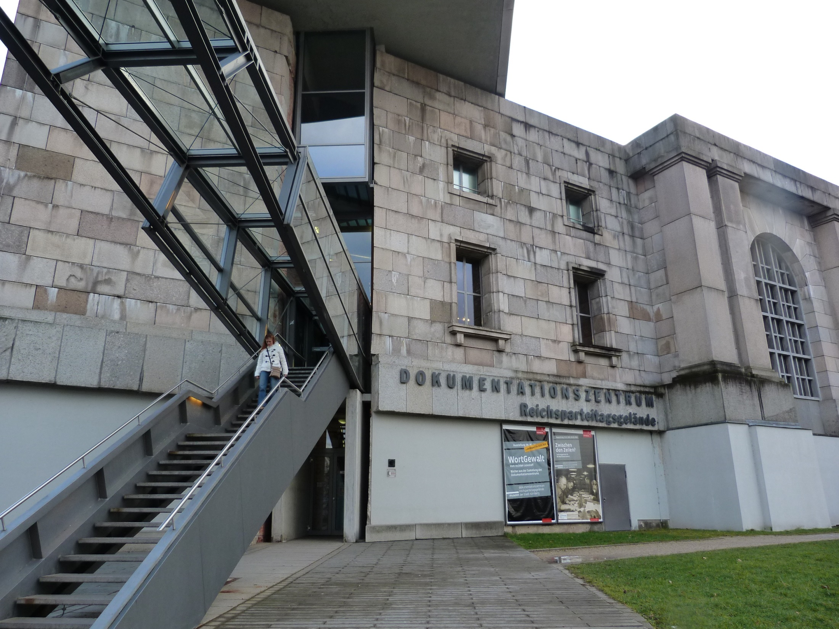
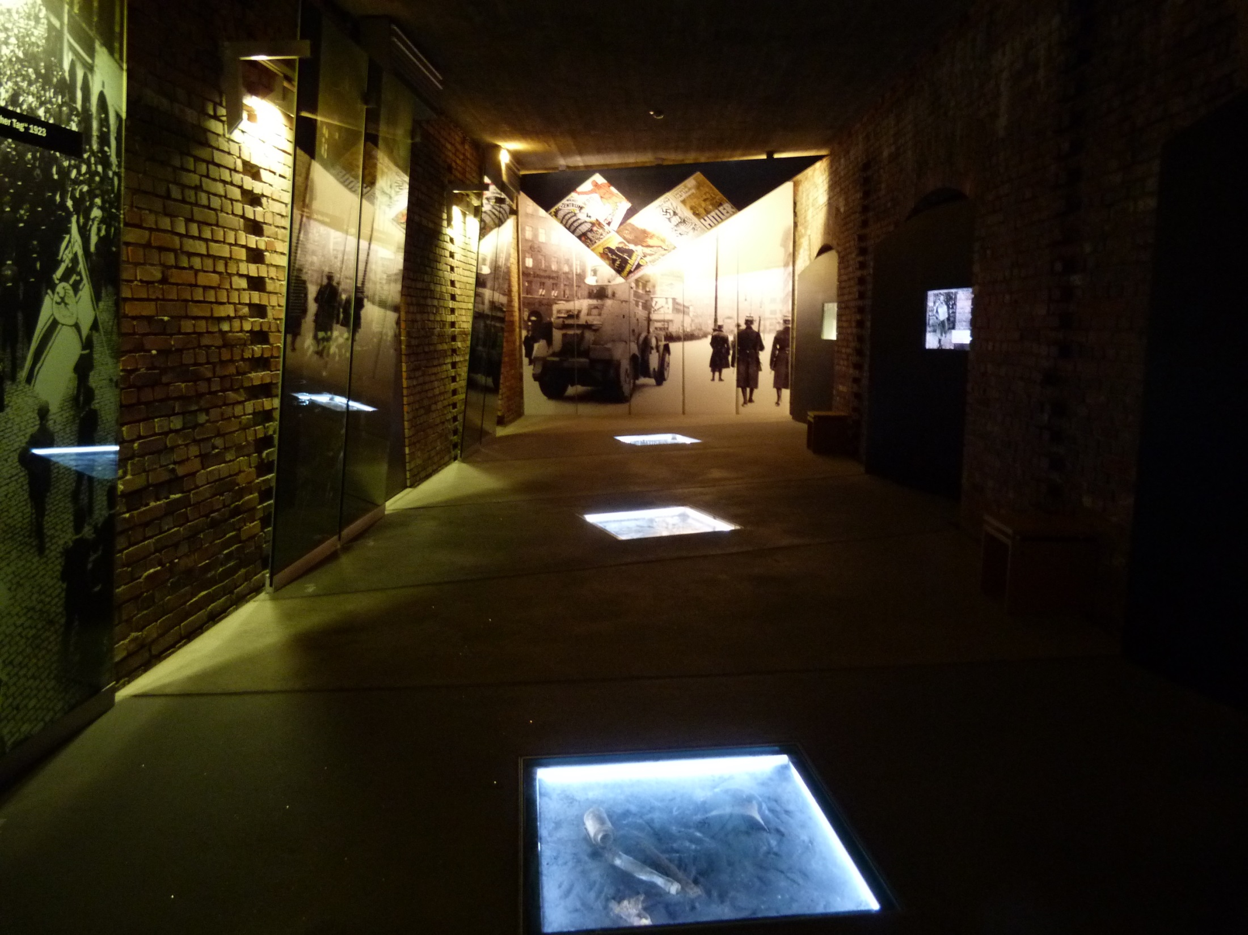

Slide 19
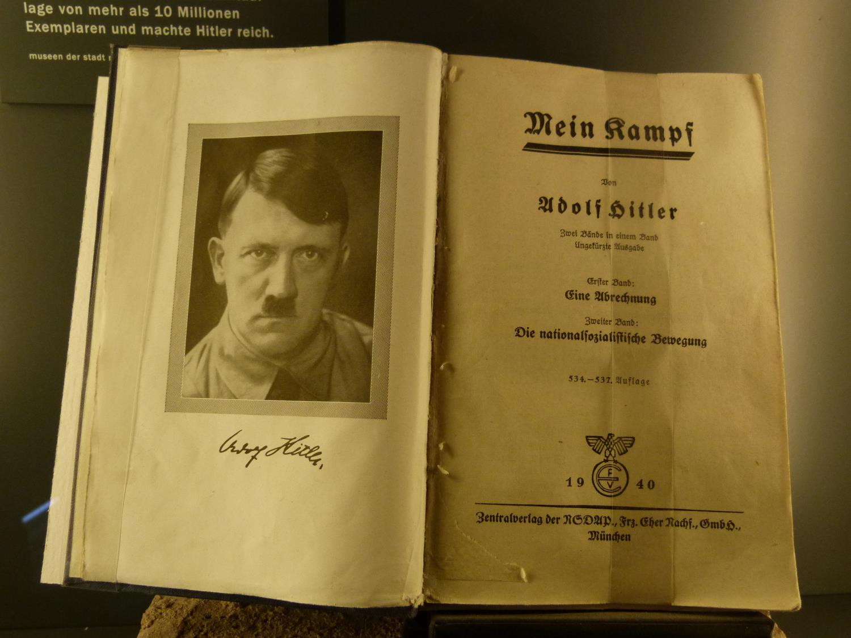
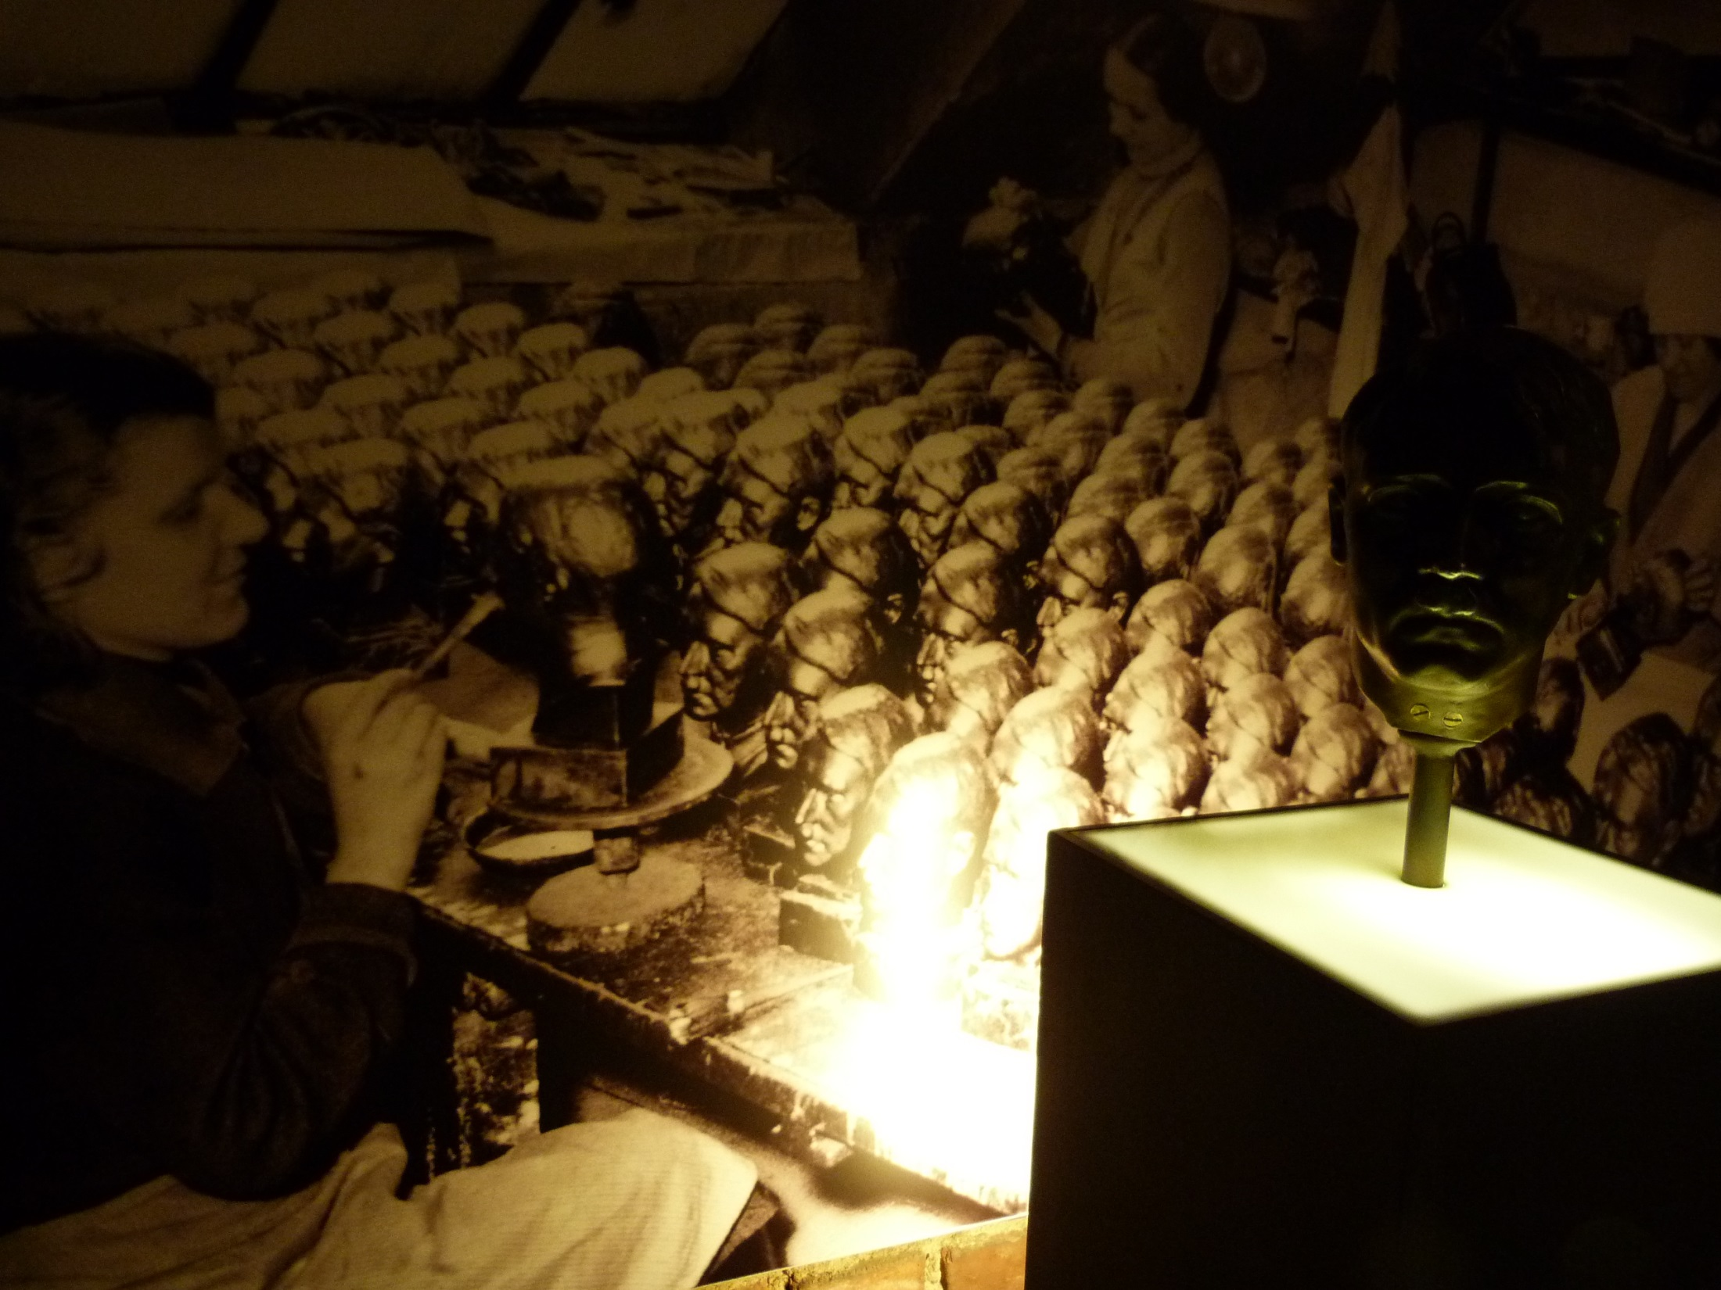
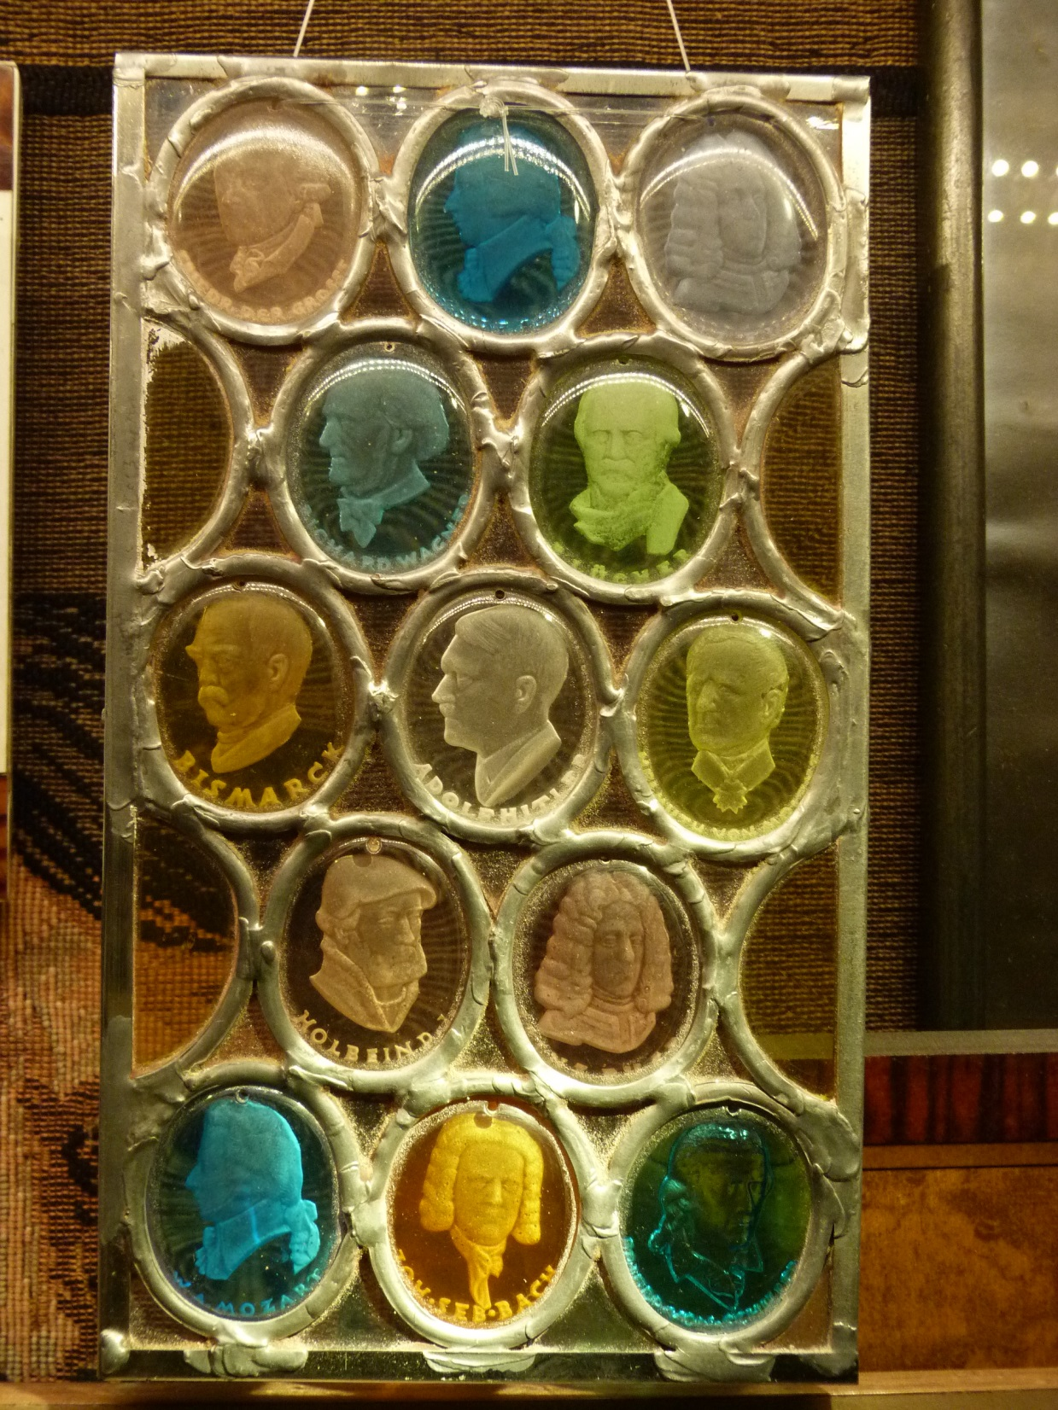

Slide 20
