Slide 1
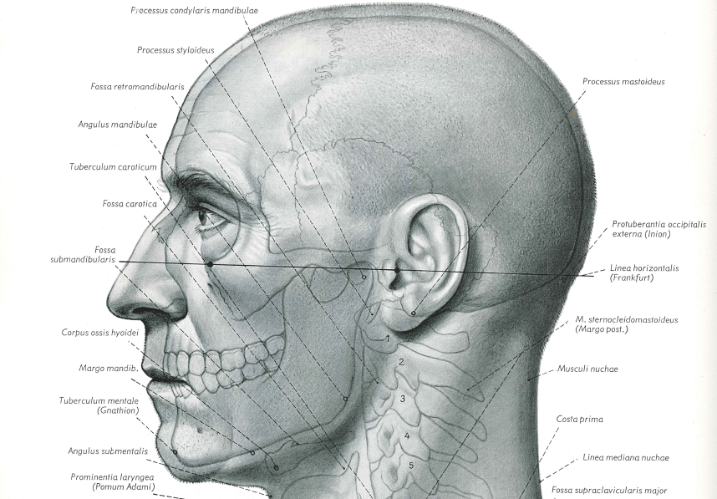
“A Troubled Masterpiece”:
The Anatomical Atlas of Eduard Pernkopf
Robinson Yost
December 5, 2019
Judged by any standard, Pernkopf’s [Atlas] is a remarkable feat… He was a perfectionist who demanded and received high-quality work from his artists… They knew they had created something special in anatomic illustration. [1988]
This anatomical atlas by a committed Nazi, Dr. Pernkopf, is evil. The creator was evil, and it should have no place in any medical library. I suggest that it be tossed into the waste bin of time. [1996]

Slide 2
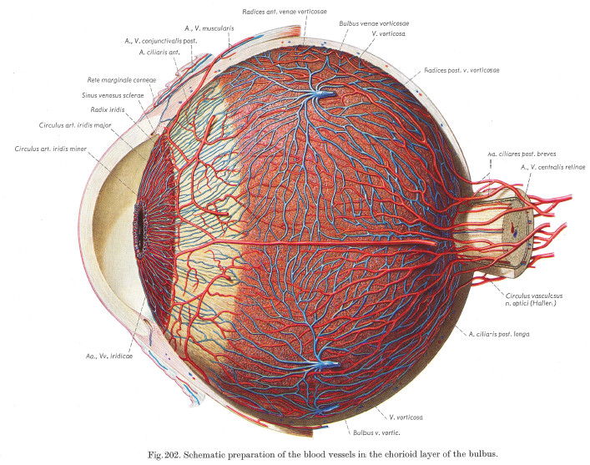
“most of the illustrations are outstanding works of art…it should be in every medical school library.” [The Lancet (1963)]
“The quality of the plates and their reproduction are excellent and many of the drawings are works of art.” [British Medical Journal (1964)]
“an outstanding book of great value to anatomists and surgeons... in a class of its own” [New England Journal of Medicine (1990)]
“a classic among atlases... [and] for all those who have an interest and appreciation of anatomical illustration… this atlas is one of the best.” [JAMA (1990)]

Slide 3
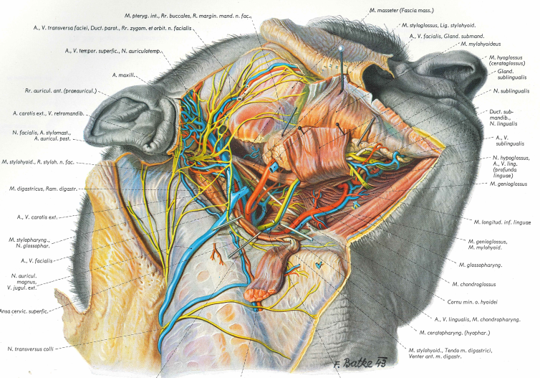
Ethical Questions:
Should it be utilized for medical practice?
Should it used for teaching?
What are the guidelines for its use?
Should the Atlas should be used or
“tossed into the waste bin of time”?

Slide 4
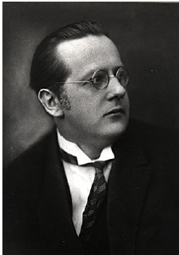
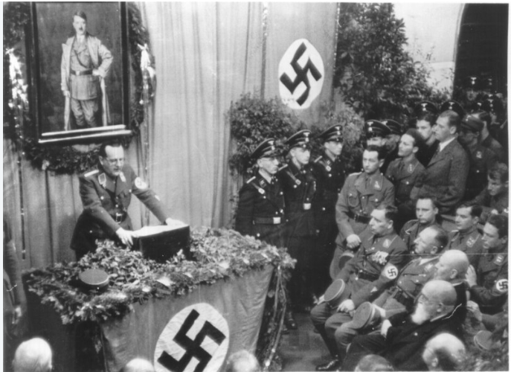
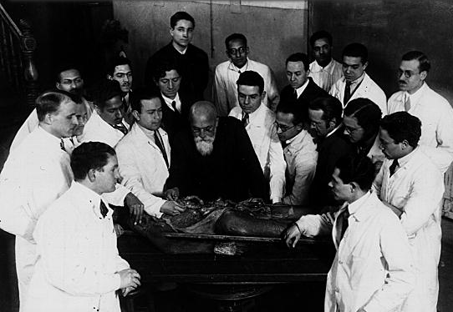
University of Vienna
Education & Career:
medical degree (1912)
full professor (1928)
Anatomy Institute (1933)
dean of medical school (1938)
rector of university (1943)
Politics:
joins foreign branch NSDAP (1933)
requires medical faculty (1938): declare “Aryan” or “non-Aryan” & swear loyalty oath to Hitler
153 of 197 faculty dismissed
address to faculty (April 6, 1938)
Eduard Pernkopf (1888-1955)
Notes:
“National Socialism & Science” (April 6, 1938) four days before the plebiscite to join with Germany
“What was the dream of our youth, what we dared not hope for, has become reality: we are one people, one Reich, one leader, Adolf Hitler; he strides before us and we follow him gladly… He you will be educated as doctors, that is a German, as National Socialist doctors…. I believe it is entirely in order to explain to you how deeply the Idea of National Socialism must permeate our education and our science….”
“To assume the medical care…. of the Body of the People which has been entrusted to you, not only in the positive sense of furthering the propagation of the fit, but also in the negative sense of eliminating the unfit and defective [by] control of marriage, propagation of the genetically fit whose genetic [and] biologic constitution promises healthy descendants; [by] discouragement of breeding by individuals who do not belong together properly, whose races clash; and finally [by] the exclusion of the genetically inferior from future generations by sterilization and other means.”

Slide 5
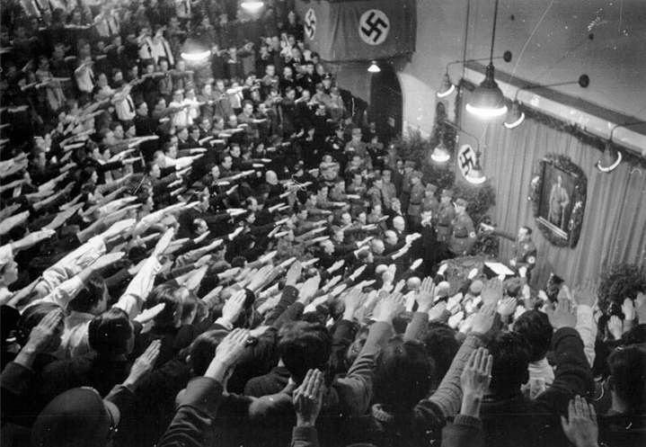
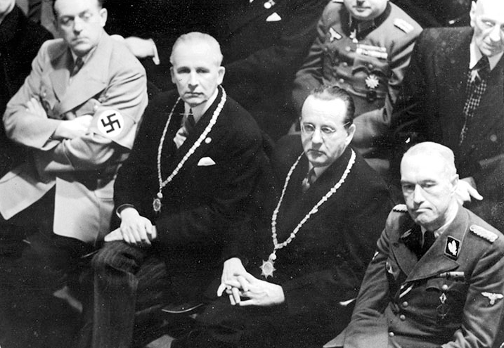
Notes:
“To him who is the proclaimer of National Socialist thought and the new way of looking at the world and in whom the legend of history has blossomed and has awakened and who has the heroic spirit within him, the greatest son of our homeland, we wish to give our gratitude and also to say that we doctors with our whole life and our whole soul gladly wish to serve him. So may our call express only what each of us feels from the bottom of his heart; Adolf Hitler, Sieg Heil!, Sieg Heil! Sieg Heil!”
“Our Colleagues in Austria” (The Lancet, March 26, 1938)
In view of recent events, we… express our alarm at the possible fate of our colleagues either on account of their medical or social views, or on account of their belonging to the Jewish race. We beg our colleagues in all countries… to do all in their power, whether by public protest, by public or private assistance, to stand by any member of our profession who may suffer hardship under the new regime. 18 signatures

Slide 6
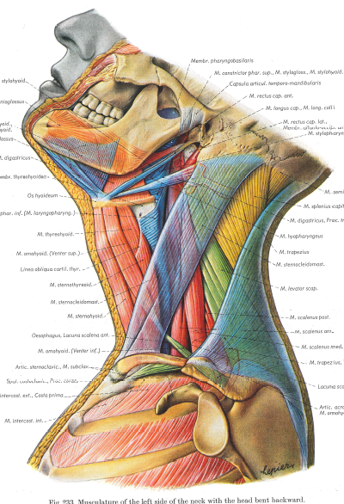
Producing the Atlas
18-hour work days
800+ paintings, colors like living tissue (watercolor & charcoal)
printing process (four-color separation)
larger, more detailed, colorful
Notes:
“Pernkopf directs the dissections and preparations of the cadavers for painting. These preparations can be exacting, hour upon hour spent pinning back skin on a forearm, scraping fascia from a bone, sawing skulls open to reveal a fine minutiae of arteries, the skein of veins beneath the dura. But he learns quickly: The better the preparation—the more fresh and vivid the viscera—the better the painting. He is driven by ideas of accuracy and clarity. He stresses again and again: The paintings must look like living tissue, even more alive than living tissue, if such a thing is possible.” [source]

Slide 7
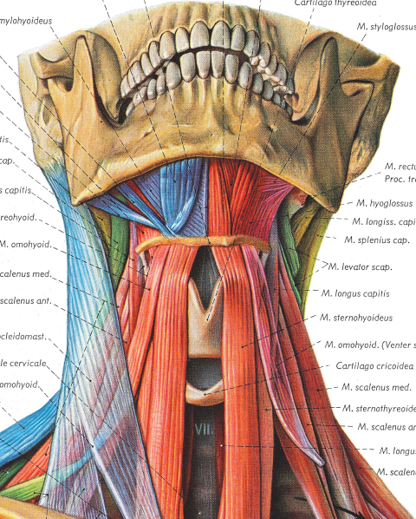
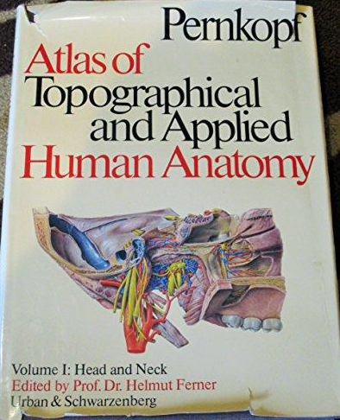
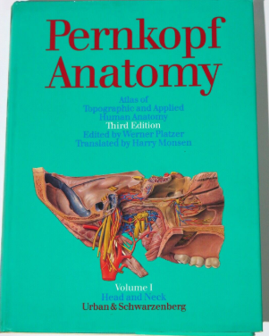
Pernkopf’s Atlas
Topographische Anatomie des Menschen
volume I (1937) two books
volume II (1941) two books
volume III (1952) one book
volume IV (1960) two books
team of Viennese artists
Erich Lepier (1898-1974)
Karl Endtresser (1903-1978)
Franz Batke (1903-1983)
Ludwig Schrott (1906-1970)
English editions (1963, 1980, 1989)
Atlas of Topographical & Applied Human Anatomy (1963-64)
Notes:
All artists were active Nazi Party members who “frequently demonstrated their allegiance to the Nazi cause, by signing the anatomical paintings with Nazi icons.” [source]

Slide 8
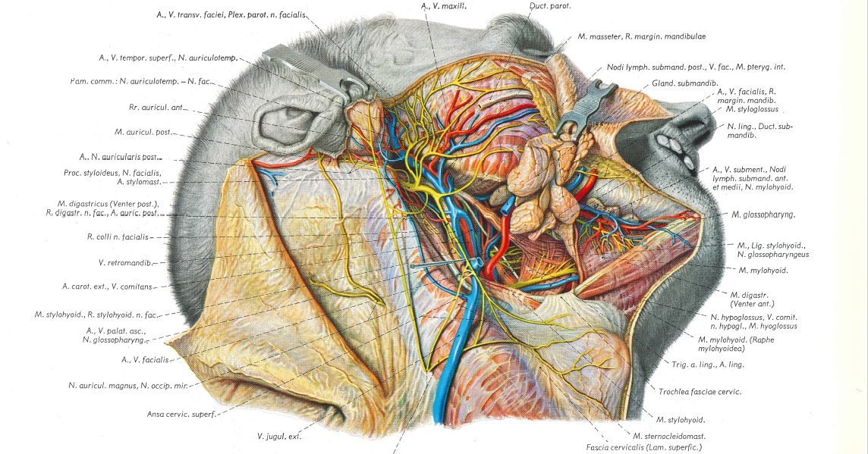
Notes:
“The creation of a large, original, illustrated work such as the seven volumes of Topographische Anatomie des Menschen by Eduard Pernkopf could only have been achieved through the combination of numerous particularly fortunate circumstances…. Pernkopf was fortunate in being associated with a number of artists who were able to reproduce, in the finest detail, anatomically precise and pictorially impressive drawings from specimens prepared by the master. Most of the illustrations are outstanding pieces of art and, in spite of abundance of detail, are drawn with great clarity and accuracy…
The appearance of Pernkopf’s work as a two-volume atlas of human anatomy makes available these unique pictures in a more concise format that will facilitate widespread use of this work, which is valuable not only to anatomists but also to practitioners in other fields, particularly surgery.” [Preface by Dr. Helmut Ferner, Atlas of Topographical & Applied Human Anatomy, 1963]

Slide 9
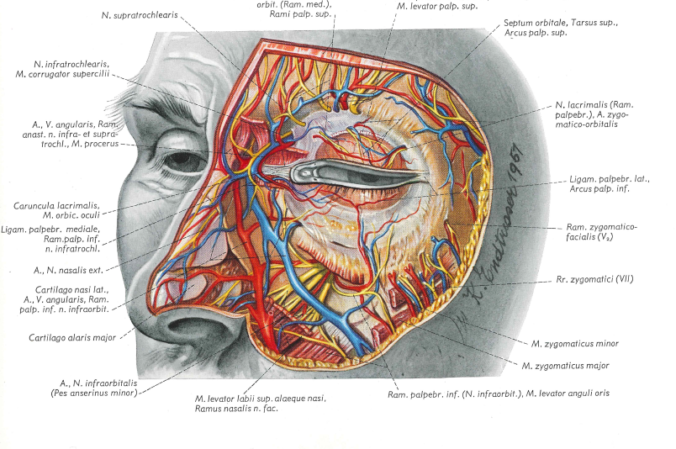
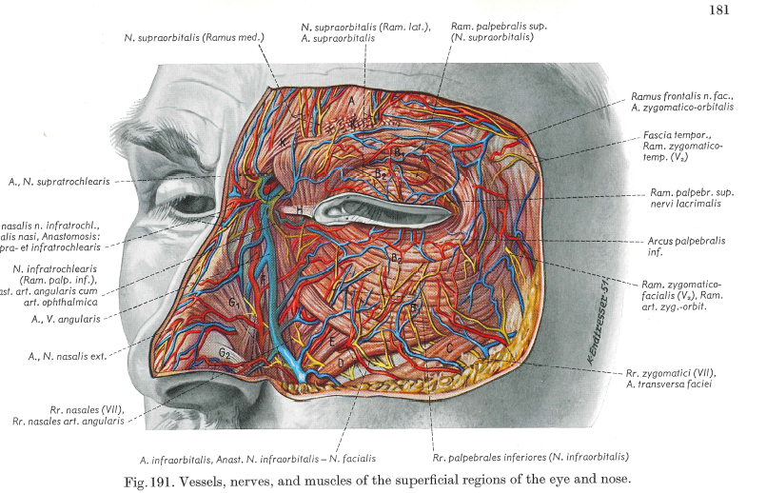
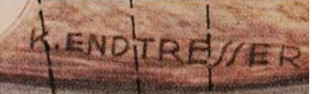

Slide 10
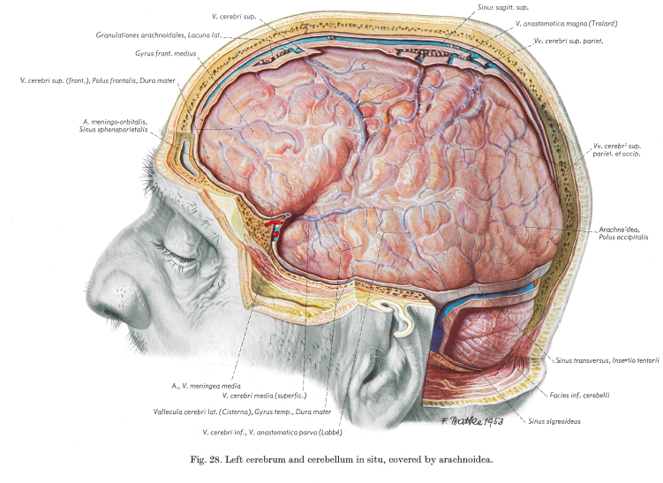



Slide 11
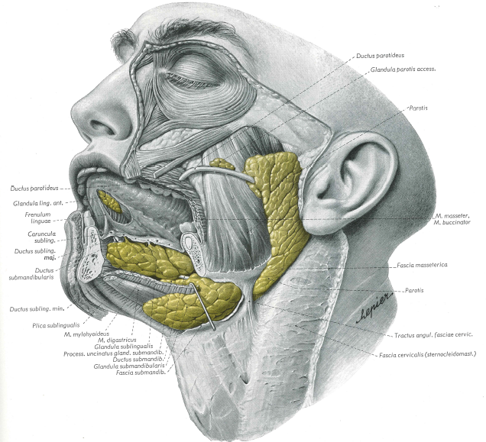
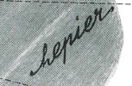
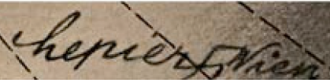

Slide 12
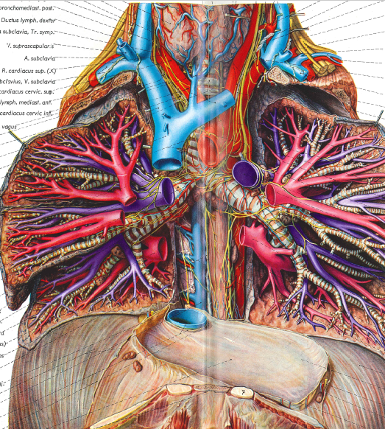
Controversy
1945-1980s: “Great Silence” on role of medicine in Third Reich’s crimes
late-1980s: research into author’s & artists’ backgrounds, & unethical origin of bodies
1990s: ethical debate heats up regarding use & origins
1995: Yad Vashem requests an investigation
1997-98: University of Vienna’s investigation & report
2000s: most medical libraries retained Atlas, moved to special collections

Slide 13
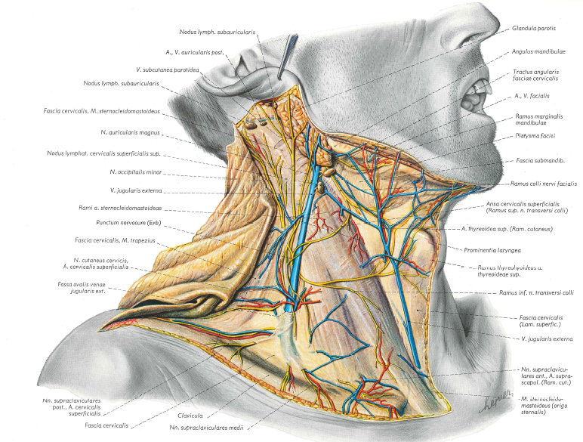
Notes:
Senate Report (1998):
Vienna Anatomical Institute (1938-1945)
3,964 unclaimed bodies: hospitals & geriatric institutions
7,000 bodies: fetuses, still-born babies, children
1,377 execution victims: 50% for political reasons
41 plates: definitely executed prisoners
350 paintings: unclear origins
791 illustrations: 50% pre-1938 or post-1945

Slide 14
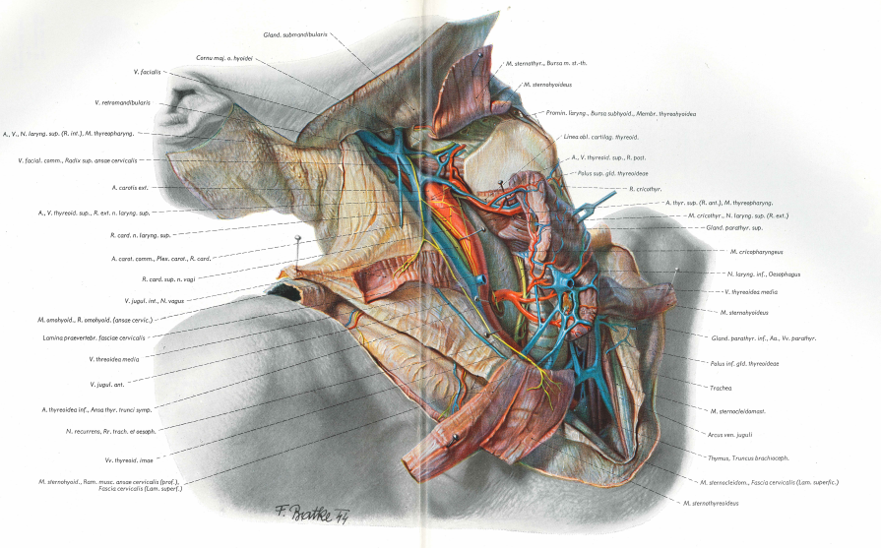
Ethical Questions:
Should it be utilized for medical practice?
Should it used for teaching?
What are the guidelines for its use?
Should it should be used or
“tossed into the waste bin of time”?

Slide 15
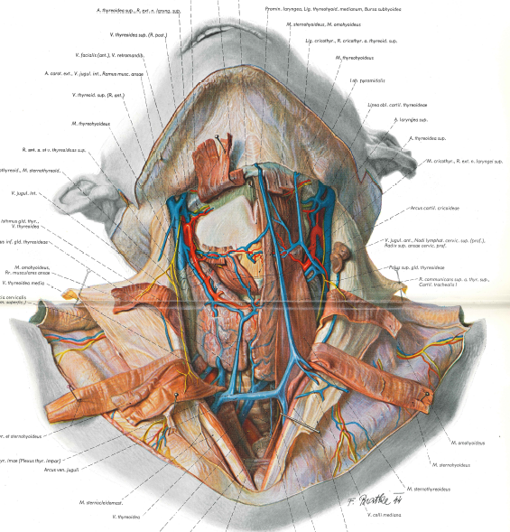
Against:
Creation of Atlas was fundamentally evil
Nobody should profit from exploitation of human life
Using this research could appear to endorse Nazi atrocities
Atlas can readily be replaced with modern atlases & modern imaging techniques
Atlas is the product of transgressions of law and medical ethics
Using any Nazi data is a “slippery slope”
For:
Good may come from evil
No evidence that Pernkopf executed anyone
Atlas cannot be easily replaced
Atlas has great aesthetic value
Banning books is a characteristic of totalitarian systems
Nazi’s victims & their sacrifice are best honored by Atlas’s continued use
Atlas in original form may be useful for anatomical, ethical, & historical purposes
Notes:
Against:
Creation of Atlas was fundamentally evil
Nobody should profit from exploitation of human life
Using this research could appear to endorse Nazi atrocities
Atlas can readily be replaced with modern atlases & modern imaging techniques
Atlas is the product of transgressions of law and medical ethics
Using any Nazi data is a “slippery slope”

Slide 16
Notes:
Against:
Creation of Atlas was fundamentally evil
Nobody should profit from exploitation of human life
Using this research could appear to endorse Nazi atrocities
Atlas can readily be replaced with modern atlases & modern imaging techniques
Atlas is the product of transgressions of law and medical ethics
Using any Nazi data is a “slippery slope”
For:
Good may come from evil
No evidence that Pernkopf executed anyone
Atlas cannot be easily replaced
Atlas has great aesthetic value
Banning books is a characteristic of totalitarian systems
Nazi’s victims & their sacrifice are best honored by Atlas’s continued use
Atlas in original form may be useful for anatomical, ethical, & historical purposes

Slide 17
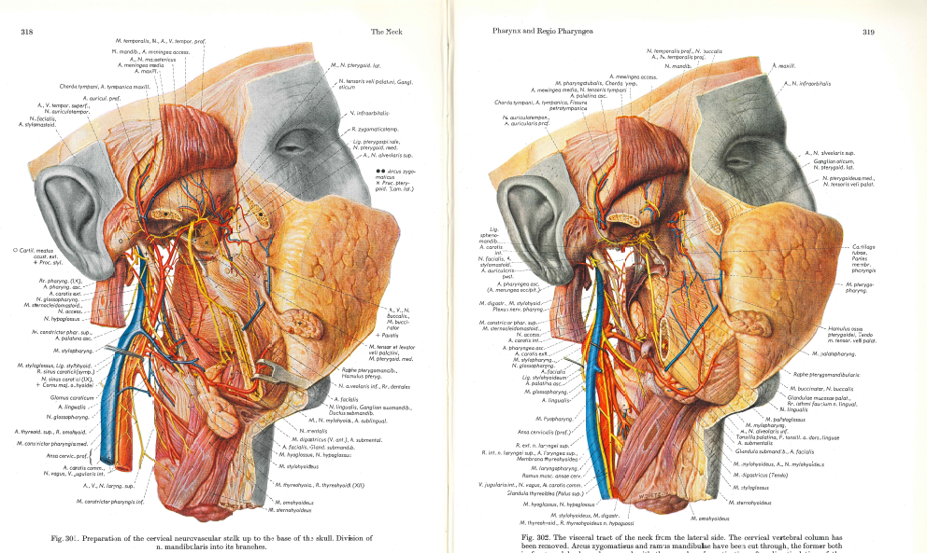
Notes:
“While comprised of some of the most beautiful medical illustration ever created, the work is marred by Pernkopf’s association with the Nazi Party as well as the inclusion of the hakenkreuz (swastika) in some of the artists’ signatures (removed in later editions), and the uncertain provenance of cadavers dissected at the Anatomy Institute of the University of Vienna during the war. Due to ethical concerns regarding its controversial origin, the books are now out of print, and their [current] publisher no longer licenses the use of the images.”
History of Illustration (2019) edited by Susan Doyle, et. al.

Slide 18
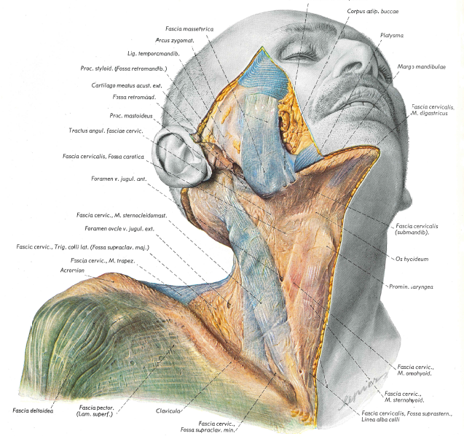
Notes:
“The continued use of Pernkopf’s atlas in clinical medicine presents an ethical dilemma that is multifaceted, complex, and debatable in nature… As an unusually detailed anatomic atlas, the Pernkopf atlas’s utility in informing complex or rare surgical problems is in tension with its ethically tainted origin… An ethical use of images from Pernkopf’s atlas should be subject to strict conditions and limitations, integrating the focus on saving the life of a patient with memorialization of the persons whose bodies were used for the creation of the images.” [source]

Slide 19
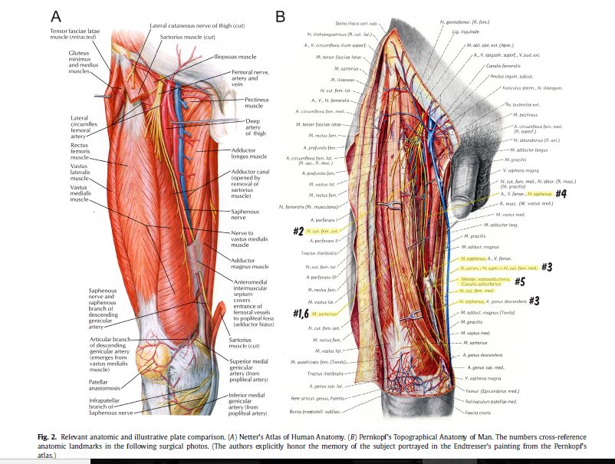
Conditional Use:
immediate & substantial benefit to the patient
no better resource available
acknowledge & publicize the immoral origins
honor the victims, not the perpetrators or exploiters of the victims
Notes:
[Not] every utilization of Nazi-generated data or information is morally out of bounds; however, such decisions do not and must not free others to avoid the difficult moral thinking that guided this decision favoring use… Deciding whether to engage evil does not yield to any simple resolution. [Kaplan, Surgery 165 (2019)]

Slide 20
